Slide 1
Principal’s Chat Data Updates/ 24-25 Goals October 3, 2024

Slide 2
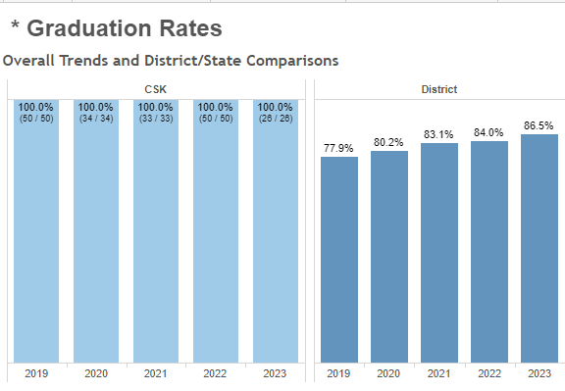
CSK Graduation Cohort 2024 – 100%

Slide 3
WHAT’s New
American Sign Language
Artificial Intelligence Pathway
AP Honor Roll School
Senior Class – Puerto Rico
2024 Graduation Rate
Full STEAM Ahead initiative
Chorus/Piano
Debate Team
NIMS Ambassadors
English Honor Society

Slide 4
EOC Rate of Proficiency - Goal 1
40-45% of students will score proficient and above as indicated on the GMAS End of Course
EOC | 22/23 | 23/24 | +Growth - Decrease | 24/25 GOAL
ELA | 17.4% | 45% | +27.6 | 50%
US History | 42.9% | 48% | +5.1 | 50%
Biology | 30.0% | 31.1% | +1.1 | 50%
Algebra | 18.5% | 42.2% | +23.7 | 50%

Slide 5
8th Gr EOG Rate of Proficiency - Goal 2
50% of students will score proficient and above as indicated on the GMAS End of Grade Assessment
EOG | 22/23 | 23/24 | +Growth - Decrease | 24/25 GOAL
ELA | 36% | 45% | +9 | 50%
Science | 18% | 32.5% | +17.5 | 50%
Soc Scienc | 20% | 22.5% | +2.5 | 50%
Math | 24% | 40% | +16 | 50%

Slide 6
6th Gr EOG Rate of Proficiency - Goal 2
40% of students will score proficient and above as indicated on the GMAS End of Grade Assessment
EOG | 22/23 | 23/24 | +Growth - Decrease | 24/25 GOAL
ELA | 32.1% | 25.9% | -6.2 | 50%
Math | 9.4% | 11.1% | 1.7 | 50%

Slide 7
7th Gr EOG Rate of Proficiency - Goal 2
40% of students will score proficient and above as indicated on the GMAS End of Grade Assessment
EOG | 22/23 | 23/24 | +Growth - Decrease | 24/25 GOAL
ELA | 41% | 29.5% | -11.5 | 50%
Math | 15.4% | 15.9% | +.5% | 50%

Slide 8
2024 EOG Breakdown

Slide 9
7th Grade – Lowest Average Daily Attendance

Slide 10
23/24 Average Daily Attendance 91.4%

Slide 11
MAP Take Rate = 100%

Slide 12
2024 End of Pathway Assessment Data
Veterinarian Science – 100% Pass rate
Public Science – 75% Pass rate
Computer Science – 83% Pass rate
Overall 2024 EOPA Pass rate = 84%

Slide 13
2025 End of Pathway Projections
Veterinarian Science – 10
Applications of Public Science – 10
AP CSP Applications – 5
Projected EOPA Pass rate = 90%

Slide 14
FY24 Priorities
FY24 School Priorities | Rationale
Increase and maintain students average daily attendance to 95% for students in grades 6-12 | There is a direct correlation between student attendance and academic outcomes. Through attendance Initiatives and Incentives along with increased opportunities for parent engagement, we will focus on a 6% increase of student ADA.
Increase the GMAS proficiency rate to 50% for students in grades 6-12 (Math, Reading, Science, Soc Studies) Increase the number of Advanced Placement course offerings by 20% Maintain a Graduation Rate of 100% through Cohort 2025 | We will focus on developing learners and targeted support to move from developing to proficient through zero period, instructional focus advisory and tutorial. In order to support college and career readiness we must focus on college preparedness. Beginning with the 2024 school year counselors will loop up with students in order to focus on turnaround and individualized student needs.
Decrease by 20% the number of behavior incidents resulting in out of school suspension. | Student behaviors/disruptions results in instructional time minimized. All teachers will be trained on restorative practices to limit the number of behavior incidents.
Notes:
Review the priorities that the GO Team has developed and the rationale for these priorities. Feel free to copy this slide if you have more than 3 priorities to account for.

Slide 16
Celebrating Growth in Rdg/Math

Slide 17
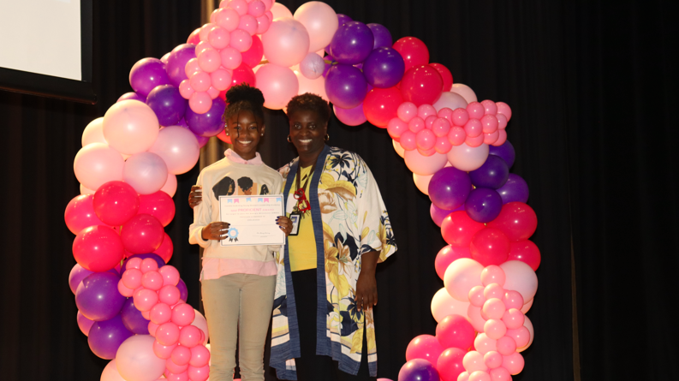

Slide 18
Advanced Placement – 40% Pass Rate
40% AP students taking the exam will score +3 proficient and above
Subject | Total Students | Proficient and Above (+3) | Mean Score
Computer Science Principals | 6 | 67% | 2.6
US History | 10 | 40% | 2.4
English Lang Comp | 17 | 29% | 1.88
Human Geography | 13 | 15.4% | 1.69
World History | 15 | 7% | .67

