Slide 1
GO Team Meeting #1
Sarah Smith Elementary

Slide 2
TOPICS
School Strategic Plan
Strategic Plan & Priorities Review
SMART Goals
Data Discussion
Spring MAPS
GMAS
Principal’s Report
Current Enrollment & Leveling
Information about our school

Slide 3
2021-2025 Strategic Plan

Slide 4
14

Slide 5
Strategic Plan
Priority Ranking
Insert the school’s priorities from Higher to Lower
Create a school-wide culture of high expectations, trust, and strong communication.
Cultivate a global learning community that cohesively aligns our school’s systems and resources with the IB curriculum and supports our diverse population.
Develop a literate community in which students read and write with clarity and fluency across the curriculum.
Embed a data-driven, multi-tier system of support to improve all subgroup performance in Math and ELA.
Offer a rigorous curriculum with an enhanced focus on the integration and application of math, science, and technology.
Create a well-rounded curriculum that develops the whole child by providing more exposure to and appreciation of the Arts and social-emotional learning.
7. Implement CARE Team with 100% fidelity utilizing the 7 core components.​
8. Offer authentic and diverse professional learning experiences and tiered coaching to increase teacher efficacy.
9. Foster an active and engaged school community that encourages inclusion of all stakeholders.
Higher
Lower

Slide 6
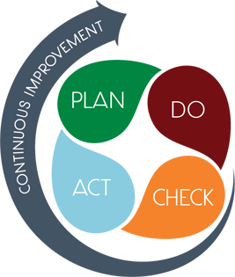
Connecting the Strategic plan & Continuous Improvement Plan
By 2025, SRSES will increase from 56% to 65% proficient or above on the Georgia Milestones in Literacy.
By May 2024, our students will increase from 58.1% to 61.1% in literacy as measured on Milestones.
61.1% of students 3-5 will score at the proficient or above level on MAP Achievement levels.
By 2025, SRS will increase from 57% to 66% proficient or above on the Georgia Milestones in Numeracy.
By May 2024, Sarah Smith students will increase from 47.3% to 52.3% in numeracy as measured on Milestones.
52.3% of students 3-5 will score at the proficient or above level on MAP Achievement levels.
SRSES will implement a series of parent workshops, and fireside chats to increase parent engagement to improve ADA from 93.8% to 96.8 percent by 2025.
By May 2024, our attendance will improve from 81.1% CCRPI Attendance to 84.1% as measured by CCRPI.
Our CCRPI attendance will improve by 3 percent each semester.

Slide 7
Data Discussion

Slide 8
Spring MAP Results
Map Growth Achievement

Slide 9
Spring MAP Results
Map Growth Achievement Math
Map Growth Achievement Reading

Slide 10
GMAS Results Math

Slide 11
GMAS Results Reading

Slide 12
Glows & Grows
Glows
Grows
are we on target to successfully ACCOMPLISH our priorities?
IMPACT

Slide 13
GO Team Discussion: Data Protocol
What do you notice?
What are your wonderings?
What additional questions do you have?

Slide 14
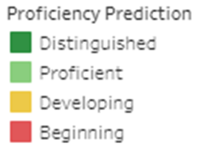
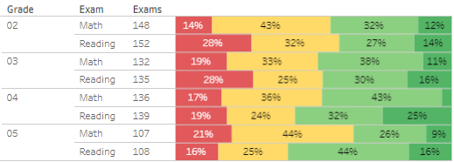
FALL MAP Results
Map Growth Achievement 2023-2024

Slide 15
Timeline for GO Teams
You are HERE
Fall 2021
GO Team Developed 2021-2025 Strategic Plan
1
Summer
School Leadership completed Needs Assessment and defined overarching needs for SY22-23
2
August
School Leadership completed 2022-2023 Continuous Improvement Plan
3
Sept. – Dec.
Utilizing current data, the GO Team will review & possibly update the school strategic priorities and plan
4
Before Winter Break
GO Team will take action (vote) on the rank of the strategic plan priorities for SY23-24 in preparation for budget discussions.
5

Slide 16
Questions?

Slide 17
Principal’s Report

Slide 18
Enrollment
Projected Enrollment | 839
Current Enrollment | 814 (829)
Difference | -25
Leveling
Leveling is the process the District uses to adjust school budget allocations to match student enrollment.
Budget Impact | Change at Base Weight $5,193: $ -129,825.00 Reserves: $137,594.16 Title I -Family Engagement Adjustment: $ 0.00 Carryover of unspent FY2023 non-personnel funds: $ 8,124.03 Prorate Losses 50%: $ 64,912.50 Total Adjustment: $ 80,805.69
Notes:
Principals: Based on your enrollment, please give your GO Team the information on how you plan to account for any budget changes due to leveling.

Slide 19
Information about our school
Updates
Roof
Dress code
Generator
Building SRS Community
Race to Read 2023-2024 goal 2,000, 000 minutes
We would love to see the GO Team at Taste of Sarah Smith
Superstar Sprint on September 22, 2023
Working on a follow-up safety meeting

Slide 20
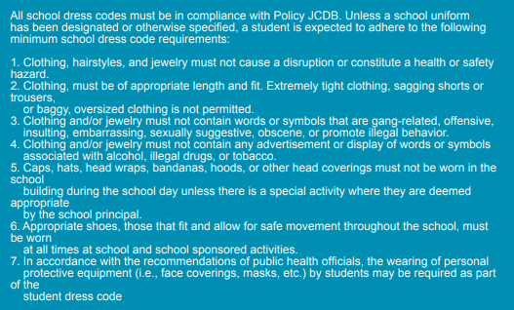
Information about our school

Slide 21
Questions?

Slide 22
Plan for AT LEAST 3 of your GO Team members to attend!

