Slide 1
GO Team Meeting
Kindezi @ Gideons
April 24, 2024

Slide 2
Agenda
Call to Order
Roll Call; Establish Quorum
Action Items
  Approval of Agenda
  Approval of Previous Minutes:
Discussion Items
  2024 Spring MAPS results
  Attendance Data
  Needs Assessment
Information Items
  Principal’s Report
    2023-2024 Family Engagement and/or Partnership Highlights
  Gifted Model
  GMAS Bootcamp
  SY 24/25
Announcements
Public Comment
Adjournment

Slide 3

2024 Spring
MAPS Results
Data Points to Consider
Spring Results
Fall to Spring Comparison
  Literacy
  Numeracy

Slide 4
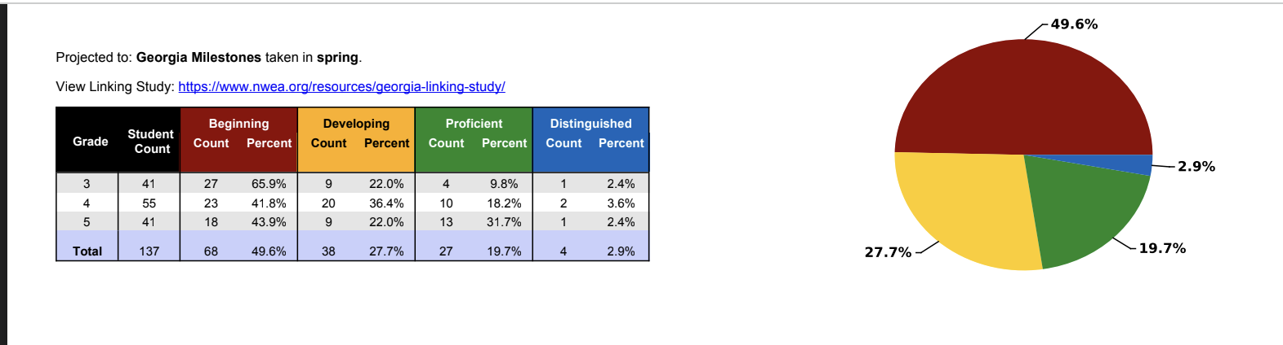
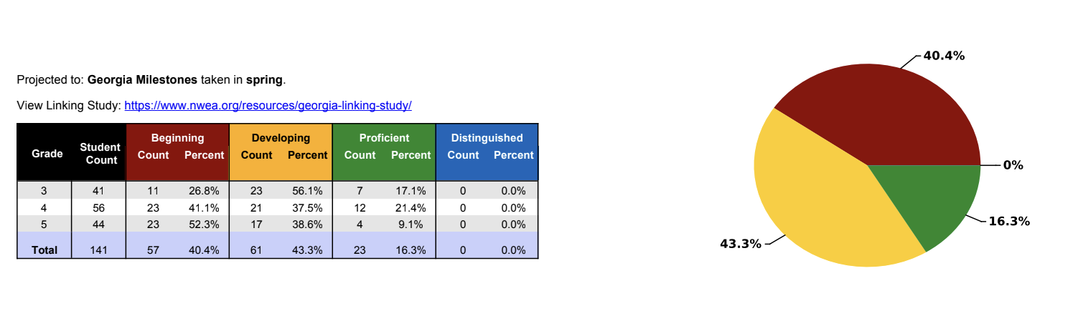

Slide 5

Attendance Data

Slide 6
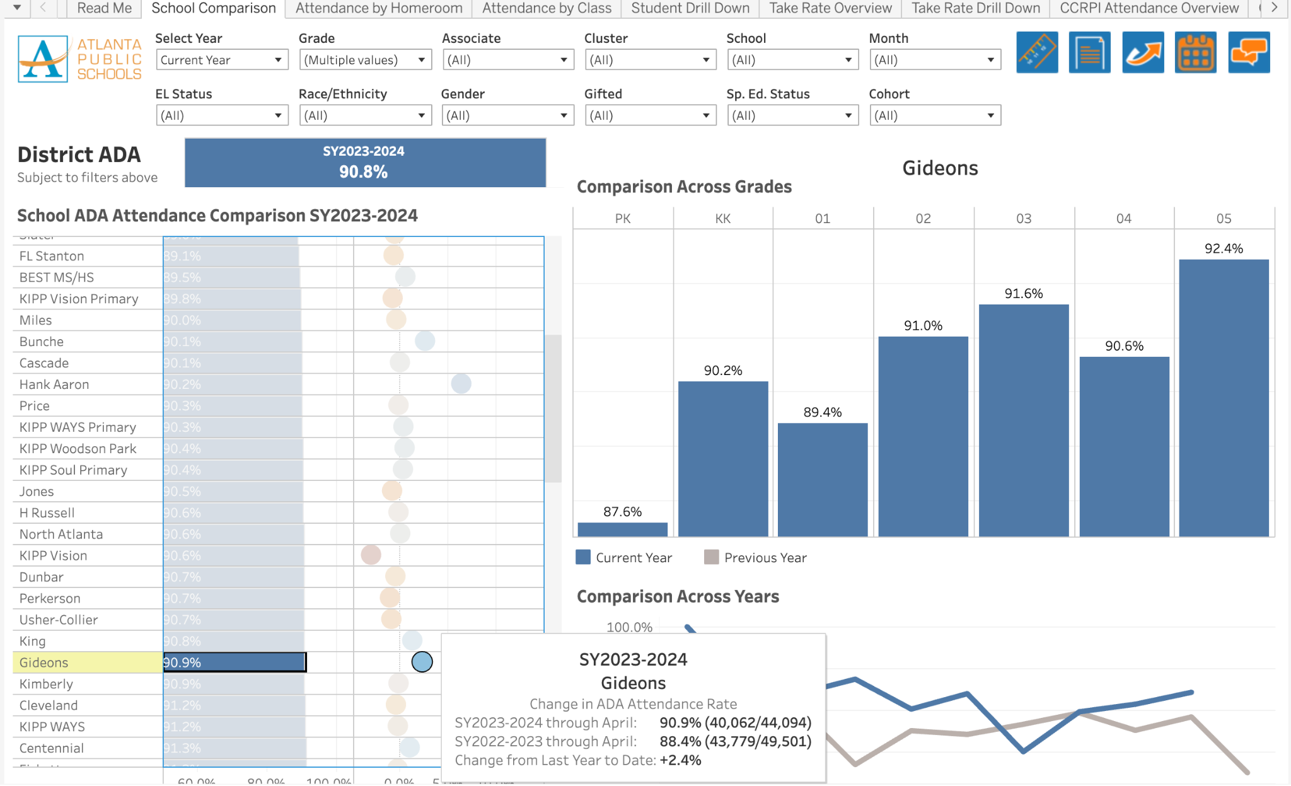

Slide 7

Needs Assessment
Needs Assessment
During this Needs Assessment, we will look at data from the Spring MAPS administration and identify 2-3 potential needs for the 2024-2025 school year.
This discussion will help school leadership as they complete the school’s 2024-2025 Continuous Improvement Plan.
ACTIVITY

Slide 8
Needs Assessment:
Guiding Questions
What does this data tell us?
What good news is there to celebrate?
Where are growth opportunities?
What trends do we see in the data?

Slide 9
Needs Assessment:
What are two to three (2-3) needs we can identify based our data?
 | Need
1
2
3

Slide 10

Principal’s Report

Slide 11
PTA nominated new officers for next year.
PTA discussed ways to increase involvement next year.
PTA will partner with admin to celebrate teachers.
T- Ball and Soccer every Saturday
Gifted Model for next year will be inclusion and possibly pull out from gifted teacher.
GMAS bootcamp!
Updates for next year!
- Start Date
- More days of preplanning for staff

Slide 12
Additional Information Items
Cluster Advisory Team Report
GO Team Elections
  Find candidates at apsstrongschools.com
  Vote APRIL 16-25
  Households are sent a unique link based upon information in Infinite Campus
  School Staff will be sent a link to their APS email address

Slide 13

Announcements
GO Team Members
  Complete your end of year surveys
    Principal Feedback Survey (AVAILABLE NOW! Check your email for the link)
    GO Team Satisfaction Survey (Available May 1st)
  Complete your required trainings ASAP
    Contact the GO Team Office with any questions

Slide 14


