Slide 1
GO TEAM MEETING #3
North Atlanta High School

Slide 2
TOPICS
School Strategic Plan
Strategic Plan & Priorities Review
SMART Goals
Data Discussion
Spring GMAS by Race
Graduation Rate
Continuous Improvement Plan
Needs Assessment
SMART GOALS
Action Plan
Strategic Plan Alignment & Update
School Uniform Discussion
Principal’s Report
Current Enrollment & Leveling
Information about our school

Slide 3
Timeline for GO Teams
You are HERE
1
2
3
4
5
Fall 2021
GO Team Developed 2021-2025 Strategic Plan
Summer
School Leadership completed Needs Assessment and defined overarching needs
August
School Leadership completed Continuous Improvement Plan
Sept. – Dec.
Utilizing current data, the GO Team will review & possibly update the school strategic priorities and plan
Before Winter Break
GO Team will take action (vote) on the rank of the strategic plan priorities for SY25-26 in preparation for budget discussions.

Slide 4


Where We Are
Our strategic plan is the guide for the work we’re doing in the school. By monitoring the plan and ranking priorities, we can all work towards the common goals. Using the priorities in the strategic plan, the school leadership team developed a Continuous Improvement Plan (CIP) for the current school year.

Slide 5
2021-2025
STRATEGIC PLAN

Slide 6
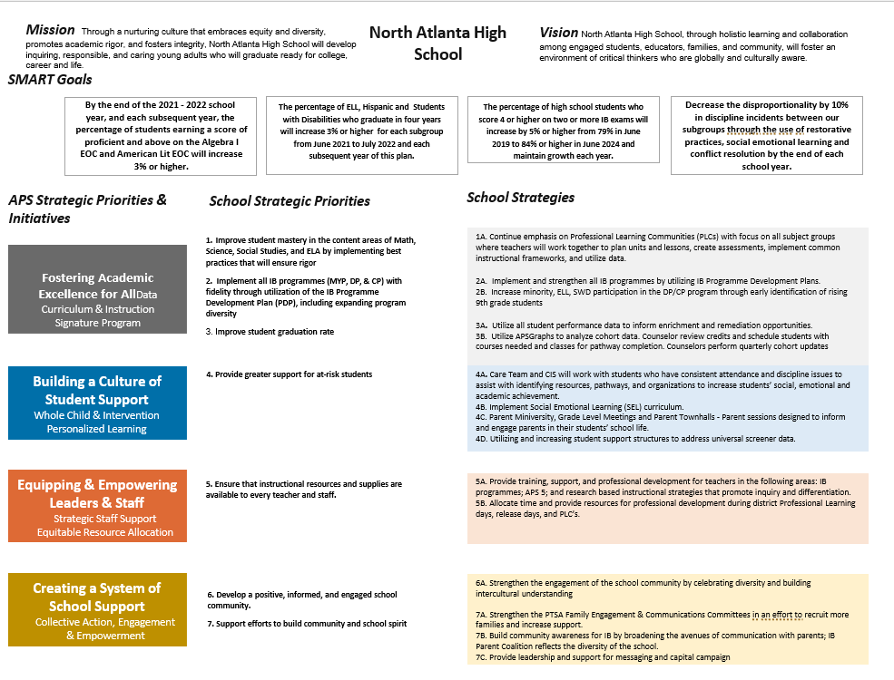
School Name
Mission
Vision
SMART Goals
TBD
TBD
TBD
TBD
APS Strategic Priorities & Initiatives
School Strategic Priorities
School Strategies
1A. tbd
1B. tbd
1C. tbd
Fostering Academic Excellence for All Data
Curriculum & Instruction Signature Program
Building a Culture of Student Support
Whole Child & Intervention Personalized Learning
TBD: tbd
TBD: tbd
4.
Equipping & Empowering Leaders & Staff
Strategic Staff Support Equitable Resource Allocation
6.
7.
TBD: tbd
Creating a System of School Support
Strategic Staff Support
Equitable Resource Allocation
8.
9.
TBD: tbd
14

Slide 7
    Ensure that instructional resources and supplies are accessible to all staff.
    Enhance student achievement in core content areas (math, science, social studies, and ELA).
    Provide increased support to students at risk.
    Raise the student graduation rate.
    Implement the IB programmes (MYP, DP, and CP) with fidelity through the IB
    Programme Development Plan (PDP), including expanding program diversity.
    Develop a positive, informed school community.
Strategic Plan
Priority Ranking
Insert the school’s priorities from Higher to Lower
Higher
Lower

Slide 8
DATA
DISCUSSION

Slide 9
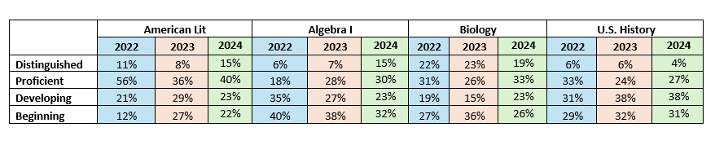
GMAS RESULTS
2022 - 2024

Slide 10
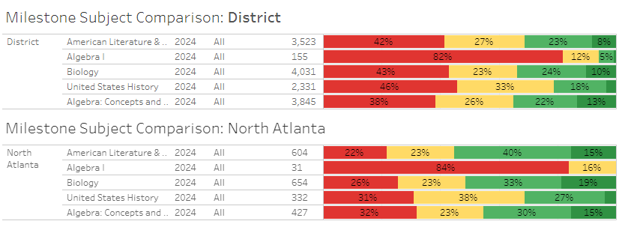
GMAS RESULTS
ALL SUBJECTS SPRING 2024

Slide 11
GMAS RESULTS
American Lit Spring 2024 Break Down by Race
American Lit
Ethnicity | Distinguished Learner | Proficient Learner | Developing Learner | Beginning Learner
Whole School | 15% | 40% | 23% | 22%
Asian/Pacific Islander | 26% | 63% | 11% | 0%
Black/Non-Hispanic | 6% | 33% | 35% | 25%
Hispanic | 5% | 29% | 20% | 46%
Multi-racial | 21% | 50% | 11% | 18%
White/Non-Hispanic | 32% | 51% | 14% | 3%

Slide 12
GMAS RESULTS
American Lit Spring 2024 Break Down by EL and SWD
American Lit: SWD
SWD | Beginning Learner | Developing Learner | Proficient Learner | Distinguished Learner
Not SWD | 18% | 23% | 42% | 16%
SWD | 61% | 22% | 12% | 4%
American Lit: ELL
ELL | Beginning Learner | Developing Learner | Proficient Learner | Distinguished Learner
No | 18% | 23% | 42% | 16%
Yes | 82% | 16% | 3% | 0%

Slide 13
GMAS RESULTS
Algebra I Spring 2024 Break Down by Race
Algebra I
Ethnicity | Distinguished Learner | Proficient Learner | Developing Learner | Beginning Learner
Whole School | 0% | 0% | 16% | 84%
Black/Non-Hispanic | 0% | 0% | 13% | 87%

Slide 14
GMAS RESULTS
Algebra I Spring 2024 Break Down by EL and SWD
Algebra I: SWD
SWD | Beginning Learner | Developing Learner
Not SWD | 83% | 17%
Algebra I: SWD
ELL | Beginning Learner | Developing Learner
No | 83% | 17%

Slide 15
GMAS RESULTS
Biology Spring 2024 Break Down by Race
Biology
Ethnicity | Distinguished Learner | Proficient Learner | Developing Learner | Beginning Learner
Whole School | 19% | 33% | 23% | 26%
Asian/Pacific Islander | 57% | 29% | 7% | 7%
Black/Non-Hispanic | 7% | 31% | 29% | 33%
Hispanic | 9% | 22% | 28% | 41%
Multi-racial | 24% | 39% | 21% | 15%
White/Non-Hispanic | 40% | 44% | 11% | 4%

Slide 16
GMAS RESULTS
Biology Spring 2024 Break Down by EL and SWD
Biology: SWD
SWD | Beginning Learner | Developing Learner | Proficient Learner | Distinguished Learner
Not SWD | 20% | 23% | 36% | 21%
SWD | 68% | 23% | 8% | 1%
Biology: ELL
ELL | Beginning Learner | Developing Learner | Proficient Learner | Distinguished Learner
No | 21% | 23% | 36% | 21%
Yes | 65% | 25% | 10% | 0%

Slide 17
GMAS RESULTS
U.S. History Spring 2024 Break Down by Race
United States History
Ethnicity | Distinguished Learner | Proficient Learner | Developing Learner | Beginning Learner
Whole School | 4% | 27% | 38% | 31%
Black/Non-Hispanic | 1% | 27% | 39% | 34%
Hispanic | 6% | 18% | 33% | 43%
Multi-racial | 0% | 33% | 47% | 20%
White/Non-Hispanic | 13% | 42% | 40% | 4%

Slide 18
GMAS RESULTS
U. S. History Spring 2024 Break Down by EL and SWD
United States History: SWD
SWD | Beginning Learner | Developing Learner | Proficient Learner | Distinguished Learner
Not SWD | 26% | 39% | 30% | 4%
SWD | 63% | 26% | 9% | 2%
United States History: ELL
ELL | Beginning Learner | Developing Learner | Proficient Learner | Distinguished Learner
No | 26% | 40% | 30% | 4%
Yes | 79% | 18% | 3% | 0%

Slide 19
GOOD NEWS
Fast Track Algebra I/Geometry
MAP Predictions - 43% proficient and 57% developing
Actual Winter EOC Scores - 57% distinguished, 43% proficient, 0% developing

Slide 20
GRADUATION RATE
Year | 4 Year Graduation Rate
2020 | 92.3
2021 | 93.9
2022 | 89.7
2023 | 94.2
2024 | 92.9
Notes:
575 students actually graduated out of 619 total students

Slide 21
2024 GRADUATION RATE BY RACE
Race | Race per Total Race Graduated | Race per Total Graduated
Asian/Pacific Islander | 100% | 2.3%
Black | 91.5% | 35.7%
Hispanic | 89.4% | 24.9%
Multi-Racial | 87% | 3.5%
White | 97.4% | 33.2%
Notes:
Amount of students by race that have graduated Total amount of graduated students: 575
American/Native Islander: 0 American/Native Islander: 0 out of 575 = 0
Asian/Pacific Islander: 13 out of 13 = 100% Asian/Pacific Islander: 13 out of 575 = 2.3
Black: 205 out of 224 = 91.5% Black: 205 out of 575 = 35.7
Hispanic: 143 out of 160 = 89.4 Hispanic: 143 out of 575 = 24.9
Multi-Racial: 20 out of 23 = 87 Multi-Racial: 20 out of 575 = 3.5
White: 191 out of 196 = 97.4 White: 191 out of 575 = 33.2

Slide 22
GRADUATION RATE BY EL AND SWD
SWD | SWD per Total SWD Graduated | SWD per Total Graduated
Yes | 84.1% | 12.9%
No | 94.4% | 87.1%
ELL | ELL per Total ELLGraduated | ELLper Total Graduated
Yes | 76.1% | 6.1%
No | 94.2% | 93.9%
Notes:
Total amount of SWD students that graduated per the total amount of SWD students in school Total amount of SWD students that graduated per the total amount of students that graduated:575
Yes: 74 out of 88 Yes: 74 out of 575 = 12.9
No: 501 out of 531 No: 501 out of 575 = 87.1
Total amount of ELL students that graduated per the total amount of ELL students in school Total amount of ELLstudents that graduated per the total amount of students that graduated:575
Yes: 35 out of 46 = 76.1 Yes: 35 out of 575 = 6.1
No: 540 out of 573 = 94.2 No: 540 out of 575 = 93.9%

Slide 23
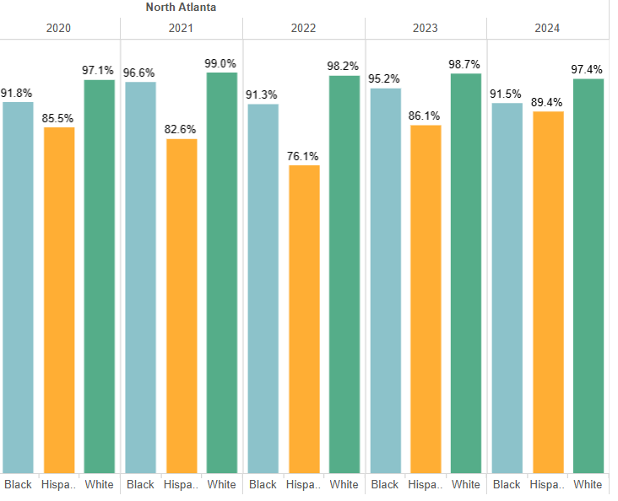
4 YEAR GRADUATION RATE BY RACE

Slide 24
GLOWS & GROWS
GLOWS
GROWS
Milestone EOC Scores have improved in every subject.
The graduation rate for our Hispanic subgroup has increased over the last 3 years and is nearly 90%
•We want to continue to increase Milestone scores/ student achievement.
•Scores of Exceptional Education students lag behind other subgroups.
ARE WE ON TARGET TO SUCCESSFULLY ACCOMPLISH OUR PRIORITIES?
IMPACT

Slide 25
GO TEAM DISCUSSION:
DATA PROTOCOL
What do you notice?
What are your wonderings?
Based on our school’s trend data from MAP assessments and end-of-year test assessments, which student sub-groups and grade levels showed the most significant gaps or unexpected trends?
Based on our school’s trend data from MAP assessments, Milestones and other indicators, are there specific trends that require more focused attention?
What additional questions do you have?

Slide 26
QUESTIONS?

Slide 27
Continuous Improvement Plan

Slide 28

CONNECTING THE STRATEGIC PLAN &
CONTINUOUS IMPROVEMENT PLAN
Strategic Plan Priority
CIP SMART Goal
Key Indicator
Improve student mastery in 4 core.
Use personalized learning strategies to increase the percentage of students scoring proficient or higher by 3 points in all Milestone EOC areas.
Milestone EOC Score
Improve Graduation Rate
Improve graduation rate for each subgroup by 3%
Graduation Rate
Provide support for at-risk students
Use student survey results to decrease the number of students failing 1+ courses by 6%
Course Failure Rates

Slide 29
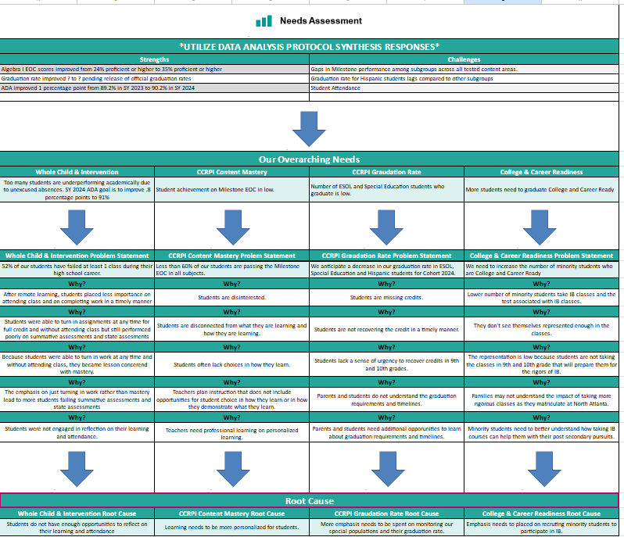
School Name
Needs Assessment
Strengths | Opportunities/Challenges
Our Overarching Needs
Literacy: | Numeracy: | Whole Child & Student Support
Jamboard Link Here
Literacy Problem Statement | Numeracy Problem Statement | Whole Child & Student Support Problem Statement
Notes:
Notes for School CIP Teams: After completing your Comprehensive Needs Assessment ( data protocol), you will come here and identify some strengths and opportunities/challenges you have observed from the data. The priority areas are Literacy, Numeracy, and Whole Child & Student Support. Identify an overarching need for each area. Formulate a problem statement for each area. Make sure the problem statement meets the criteria. Refer to your CIP resources.

Slide 30
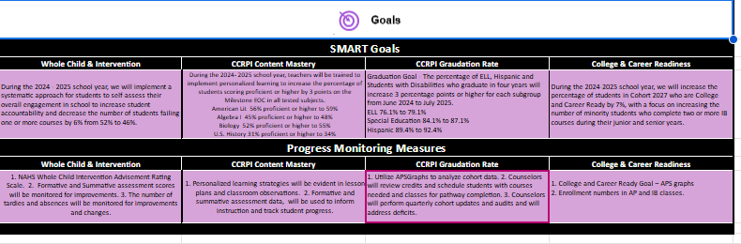

Slide 31
GO Team
Activity
&
Discussion
GO TEAM DISCUSSION: Review the priorities and goals in your strategic plan and the information and goals CIP. Reflect on if updates need to be made to the Strategic Plan.
Are all CIP Goals reflected in
our Strategic Plan Priorities?
If not, which CIP Goal(s) are missing and should be added to the Strategic Plan?

Slide 32

Updates to the
Strategic Plan
Enter all changes/updates to your plan – be sure to include accountability measures, as appropriate.

Slide 33
DISCUSSION: OPTIONAL SCHOOL
UNIFORM

Slide 34



OPTIONAL SCHOOL UNIFORM
In the 2023-2024 school year, the APS Board of Education updated the district’s dress code policy. As part of the update, starting with the 2025-2026 school year if a school wishes to maintain or explore implementing an optional school uniform, it must go through an engagement process and have a vote as outlined below:
ELEMENTARY
MIDDLE
HIGH
A school uniform is adopted upon the agreement of the principal and a majority vote of the School Governance Team (GO Team).
School uniforms are adopted upon the agreement of the principal, GO Team and the elected student government. If the school does not have an elected student government, then a majority vote must be secured from the student body to adopt a school uniform.
School uniforms are adopted upon the agreement of the principal, GO Team and the elected student government. If the school does not have an elected student government, then a majority vote must be secured from the student body to adopt a school uniform.
If your school currently has a school uniform and wishes to continue it, you must go through this process!

Slide 35
ABOE POLICY JCDB
STUDENT DRESS CODE
(Last Revised, 06/03/2024)
http://tinyAPS.com/?APSDressCodePolicy
REQUIREMENTS
RESTRICTIONS
A top of non-see through fabric
A bottom of non-see through fabric
Shoes
Undergarments that are not visible
No words or symbols that are gang-related, sexually suggestive, obscene or promote illegal behavior
Nothing associated with alcohol, illegal drugs or tobacco
No flip-flops, athletic slides or footwear that doesn’t support the front and back of the foot

Slide 36
SCHOOL-SPECIFIC DRESS CODES
We have one districtwide student dress code adopted
by the Atlanta Board of Education.
School-specific dress codes may not contradict Board policy.
Examples of problematic school specific dress-code provisions
“dress in good taste”
“no baggy pants”
“no sweatpants”
“no activewear”
“no short shorts or skirts”
“no spaghetti straps”
“no tube tops”
“no dresses”
“no tight/revealing clothing”
“no leggings”
“no joggers”
“no ‘extreme’ hairstyles or colors”
“no Crocs”
“all shirts must be tucked in
“no hoodies/hooded jackets”
“hair should be clean and neatly groomed”
“no shirts which expose cleavage”
“students dressed in uniform are better perceived by teachers and peers”

Slide 37
SCHOOL UNIFORMS
Schools may choose to adopt an optional school uniform.
Effective immediately, at no time will students have their instructional time interrupted or be barred from school or class for declining to wear the optional school uniform.

Slide 38
ESTABLISH AN OPTIONAL SCHOOL UNIFORM
If your school currently has a school uniform and wishes to continue it, you must go through this process!
The GO Team needs to TAKE ACTION (vote) on maintaining or exploring implementing an optional school uniform.
After the motion and a second, the GO Team may have additional discussion. Once discussion is concluded, the GO Team will vote.
If the GO Team votes to move forward, then the team should proceed to discuss the School Uniform Advisory Committee.
TAKE ACTION

Slide 39
DISCUSSION
Only needed if the GO Team voted YES to maintaining or exploring establishing an optional school uniform.
The GO Team will now discuss if they wish to move forward with establishing a School Uniform Advisory Committee.
The School Uniform Advisory Committee will be responsible for:
  Develop a stakeholder engagement plan to receive feedback on implementing a uniform and its components, if adopted. Must include a minimum 20-day public comment period on any proposed uniform
  Recommending the optional school uniform components.
  Establishing the student voting timeline and process (if necessary).
  Determine the length of time the uniform will be in use before reconsideration
  Developing a communication plan to inform the school community about the optional school uniform, if the uniform is adopted
  Other objectives as defined by the GO Team.

Slide 40
COMMITTEE MEMBERS
Only needed if the GO Team voted YES to maintaining or exploring establishing an optional school uniform.
The GO Team will also need to determine who will be on the committee:
  The GO Team Chair will name the Committee Chair.
  No more than 2 additional GO Team members may be on the committee (a maximum of 3 GO Team Members).
  Committee must have at least 3 students as outlined below:
  Other committee members may be added, as determined by the GO Team.
ELEMENTARY
MIDDLE
HIGH
Elementary School with Ambassadors Recommend inclusion of at least 3 student ambassadors
Elementary School without Ambassadors
Recommend inclusion of at least 3 students selected by the principal with GO Team input
Middle School with Student Ambassadors
At least 3 student ambassadors
Middle School without Student Ambassadors
At least 3 students selected by the principal with GO Team input
High School with Elected Student Government
At least 3 students as selected by the SGA
High School without Elected Student Government
At least 3 students as selected by the principal with GO Team input

Slide 41
ESTABLISH THE COMMITTEE
Only needed if the GO Team voted YES to maintaining or exploring establishing an optional school uniform.
The GO Team needs to TAKE ACTION (vote) on establishing its School Uniform Advisory Committee based on the previous discussion.
After the motion and a second, the GO Team may have additional discussion.
Once discussion is concluded, the GO Team will vote.
If the GO Team votes in the affirmative (yes) for moving forward, then the Chair will need to fill out a committee resolution form (see example on next slide) and send to the GO Team Office.
TAKE ACTION

Slide 42
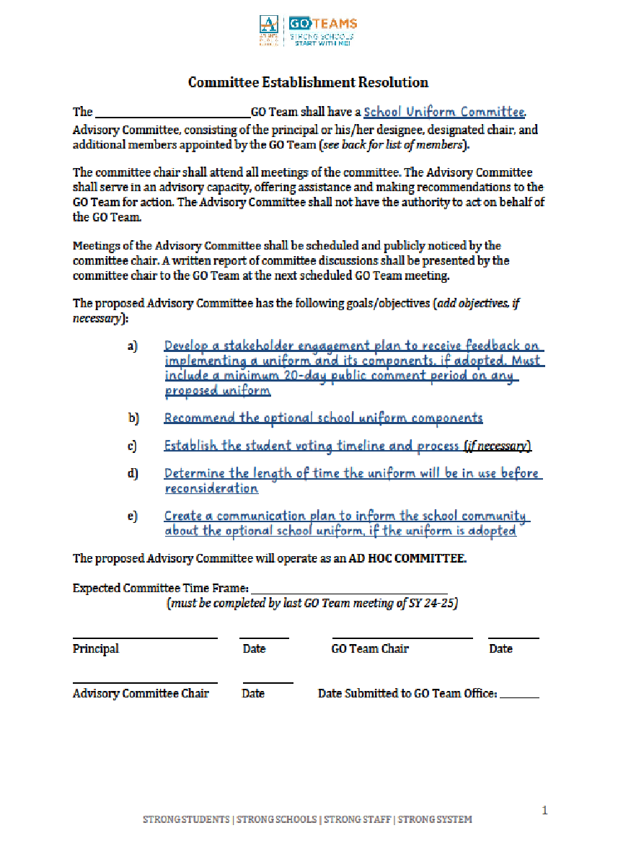
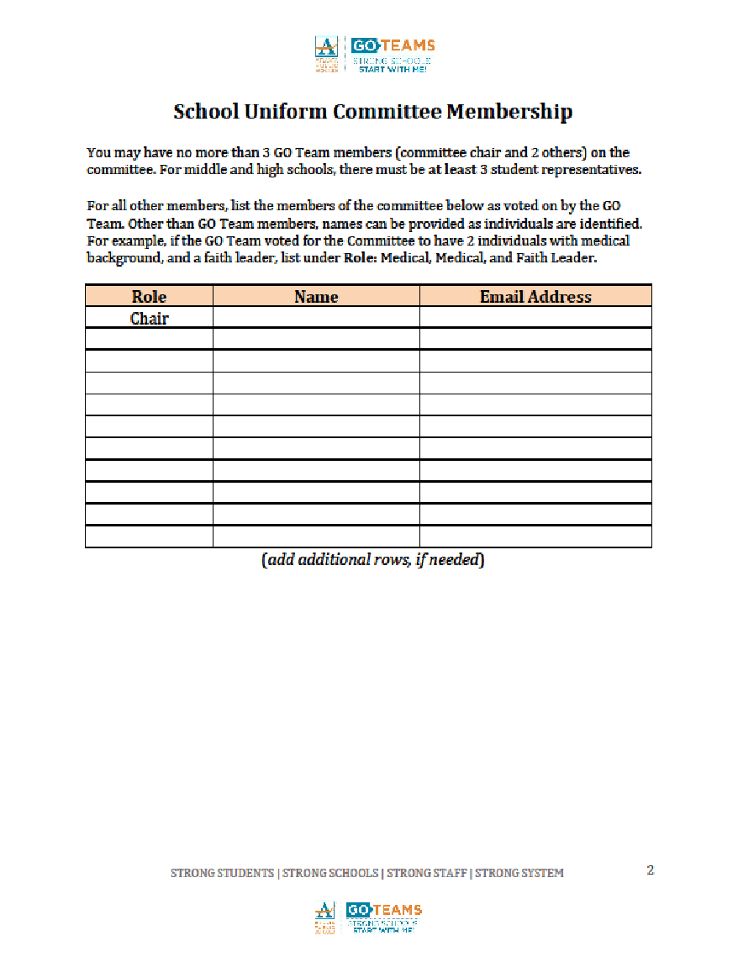
BLANK COMMITTEE RESOLUTION

Slide 43
PRINCIPAL’S REPORT

Slide 44

JOIN US ON
SATURDAY, JANUARY 11
All GO team members are invited, but plan to have at least 3 members of your GO Team attend!

Slide 45
QUESTIONS?

