Slide 1
FY26 Budget Feedback Meeting

Slide 2
AGENDA
Action Items (add items as needed)
  Approval of Agenda
  Approval of Previous Minutes
Discussion Items (add items as needed)
  Budget Development Presentation
    ACTION ITEM: GO Team vote on Draft Budget (AFTER presentation and discussion)
Information Items (add items as needed)
  Principal’s Report
  Committee Reports (as needed)
  Cluster Advisory Report (if CAT has met since last meeting)
Announcements (add items as needed)
Public Comment (if applicable)

Slide 3
Meeting Norms
This is a meeting of the GO Team. Only members of the team may participate in the discussion. Any members of the public present are here to quietly observe.
We will follow the agenda as noticed to the public and stay on task.
We invite and welcome contributions of every member and listen to each other.
We will respect all ideas and assume good intentions.

Slide 4
Budget Feedback presentation & Discussion

Slide 5

GO Team Budget Development Process
YOUR SCHOOL STRATEGIC PLAN…
is your roadmap and your role.
It is your direction, your priorities, your vision, your present, your future.
Step 1: Data Review
Step 2: Strategic Plan Review
Step 3: Budget Parameters
(Strategic Priorities)
Step 4: Budget Choices

Slide 6
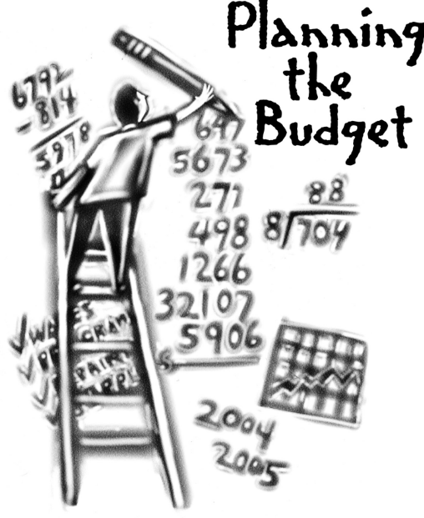
Overview of FY26 GO Team Budget Process
Step 2 Principals Workshop FY 26 Budget
January 15
Step 4 Principals Cluster Supt. Discussions
Step 1 Update Strategic Plan & Rank Priorities
Step 7 Principals HR Staffing Conferences Begin
Feb. 24-27
Step 3 GO Team Initial Budget Session
January 15-31
Step 8* GO Team Final Budget Approval Meeting
Budgets Approved by March 14
Step 6 Cluster Supt. Review February 17-21
Step 5* GO Team Feedback Mtg. February 10-14
GO Teams are encouraged to have ongoing conversations
* GO Teams will need to take ACTION on the budget at these meetings.

Slide 7
Budget Feedback Meeting
What
During the GO Team Feedback meeting the principal will share the 25-26 Strategic Plan Breakout, provide an overview of the school’s draft budget, share updated tabs from the Excel template, and review/collaborate with the GO Team on the comments/notes to explain the use of school-level flexibility in budget allocations.
Why
This meeting provides an opportunity for GO Teams to discuss the principal’s proposed budget and how it supports the school's programmatic needs and key strategic priorities for the 25-26 school year. It also provides the GO Team the opportunity to review and provide feedback on proposed use of school-level flexibility.
When
Early February 10 - February 14th, before Cluster Superintendent review.

Slide 8
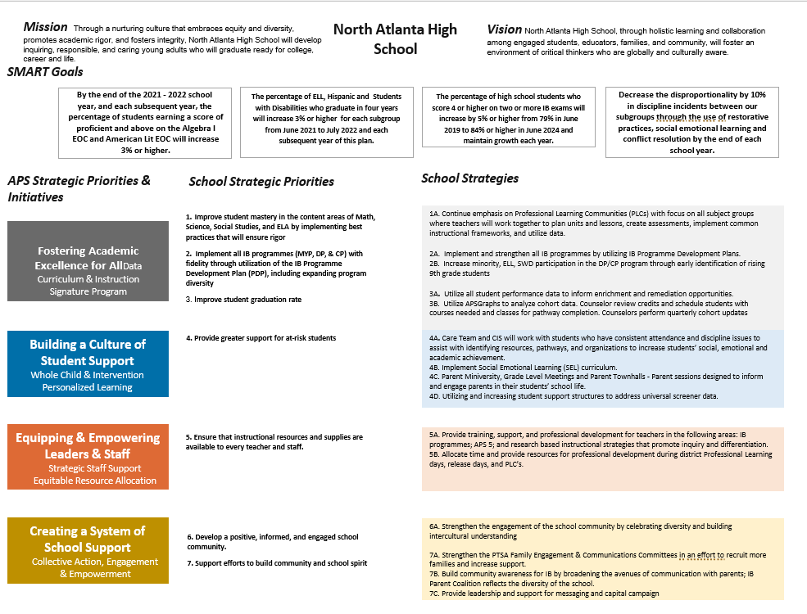
NORTH ATLANTA Strategic Plan

Slide 9
North Atlanta
Strategic Plan
Priority Ranking
Insert the school’s ranked priorities from High to Low
Higher
Ensure that instructional resources and supplies are accessible to all staff.
2. Enhance student achievement in core content areas (math, science, social studies, and ELA).
3. Provide increased support to students at risk.
4. Raise the student graduation rate.
5. Implement the IB programmes (MYP, DP, and CP) with fidelity through the IB Programme Development Plan (PDP), including expanding program diversity.
6. Develop a positive, informed school community.
Lower

Slide 10
FY 26 Budget Parameters
FY26 Ranked School Priorities | Rationale
Ensure that instructional resources and supplies are accessible to all staff. | Providing equitable access to instructional resources and supplies empowers all staff to deliver high-quality education, fosters consistency in teaching, and promotes a collaborative environment where everyone can effectively meet the needs of students.
Enhance student achievement in core content areas | Enhancing student achievement in core content areas is essential to equip students with the foundational knowledge and skills needed for academic success, critical thinking, and future career opportunities. Strengthening these areas ensures students are prepared to meet educational standards and excel in a competitive, global economy.
Provide increased support to students at risk. | Providing increased support to students at risk is essential to ensure equitable opportunities for academic and personal success. Targeted interventions address their unique challenges, helping to close achievement gaps, improve engagement, and promote long-term well-being and future potential.

Slide 11
FY 26 Budget Parameters
FY26 School Priorities | Rationale
Raise the student graduation rate. | Increasing the graduation rate is vital for fostering individual success and community growth. Higher graduation rates open pathways to better career opportunities, reduce socioeconomic disparities, and contribute to a more skilled and productive workforce, ultimately strengthening the economy and society.
Implement IB programs with fidelity | This will improve learning outcomes for all learners who participate in the programs and ensure that students are ready for the rigors of college.
Develop a positive, informed school community. | A positive, informed school community fosters trust, collaboration, and a sense of belonging among students, staff, and families. It enhances student success, encourages parental involvement, supports teacher morale, and creates a safe, inclusive environment. By keeping everyone informed and engaged, the community can work together effectively to address challenges, celebrate achievements, and build a strong foundation for lifelong learning and growth.

Slide 12
Review of FY26 Signature and Turnaround Program Funding Process
Overview
* The district is piloting a zero-based budgeting (ZBB) process for Signature and Turnaround Program Funds this year.
* Zero-based budgeting (ZBB) is a budgeting process that allocates funding based on program efficiency and necessity rather than budget history. As opposed to traditional budgeting, no item is automatically included in the next budget.
* As such the initial allocation for these programs at all schools will be $0.
Process
* Principals will develop proposed requests for the personnel and non-personnel they need to support the Signature and/or Turnaround Programs at their schools.
* Principals will share and discuss their proposals and rationale for the proposals with their school GO Team for feedback.
* After discussing with their GO Team, principals will submit their request for review by January 31st. Funding for these programs will be provided the week of February 3rd.

Slide 13
Overview of Approved Signature Program Funds

Slide 14
Signature program funds requested vs. approved
Requested Signature Program Funds: $548, 353
PRINCIPALS: Please update with the list of what you requested to support your signature program. Example: Signature Program Coaches - 2 Signature Programming Supplies/Resources - $234, 490.00
APPROVED Signature Program Funds: $548, 353
PRINCIPALS: Please update with the Staffing and Non-Staffing allocation of your updated Signature Program funds. Signature Program Coaches - 2 Signature Programming Supplies/Resources - $234, 490.00

Slide 15
North Atlanta HiGh school
FY26 Summary of Proposed Staffing AND Non-Staffing
-

Slide 16
Summary Tab Overview
The Summary Tab provides a summary of the staff in our school. The columns show how many positions are:
Earned – positions allocated by district departments. There is no school-level flexibility with these positions.
Funded – District’s recommended staffing for positions where there is school-level flexibility with staffing the position.
Staffed – This shows how the principal plans to staff the position for the FY26 school year.
Difference—This shows the difference between the recommendation from the District and the Principal's proposed FY26 staffing plan.
Comments: The principal must provide comments if there is a difference in what is Funded and Staffed. Principals and GO Teams will discuss the rationale provided for the Comments section.
Position Title | Earned | Funded | Staffed | Dif | Comments
Teachers
Middle School Core |  | 49.50 | - | (49.50)
Middle Electives |  | 19.00 | - | (19.00)
Teacher Math 6-8 |  |  | 11.00 | 11.00
Teacher Science 6-8 |  |  | 10.00 | 10.00
Teacher Social Studies 6-8 |  |  | 10.00 | 10.00
Teacher ELA 6-8 |  |  | 9.00 | 9.00
Teacher Art 6-8 |  |  | 2.00 | 2.00
Teacher Band 6-8 |  |  | 1.00 | 1.00
Teacher Music 6-8 |  |  | 2.00 | 2.00
Teacher Orchestra 6-8 |  |  | 1.00 | 1.00
Teacher Physical Ed 6-8 |  |  | 7.00 | 7.00
Teacher Performing Arts 6-8 |  |  | 2.00 | 2.00
Teacher World Language 6-8 |  |  | 12.00 | 12.00
Teacher Gifted |  | 13.00 | 11.00 | (2.00)
Teacher Social Emotional Learning |  |  | - | -
EIP TEACHERS |  | 3.50 | 5.00 | 1.50
Teacher REP 6-12 |  |  | 5.00 | 5.00

Slide 17
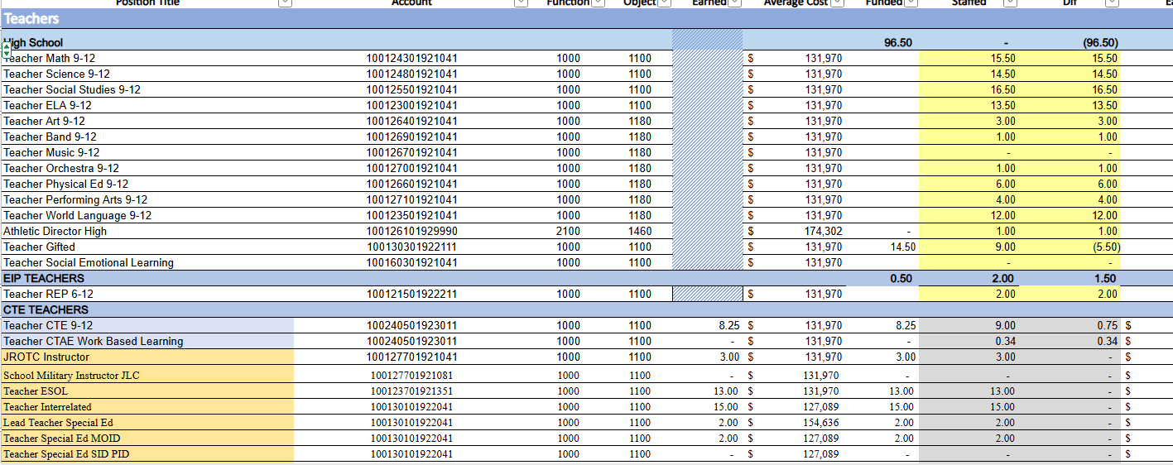

Slide 18
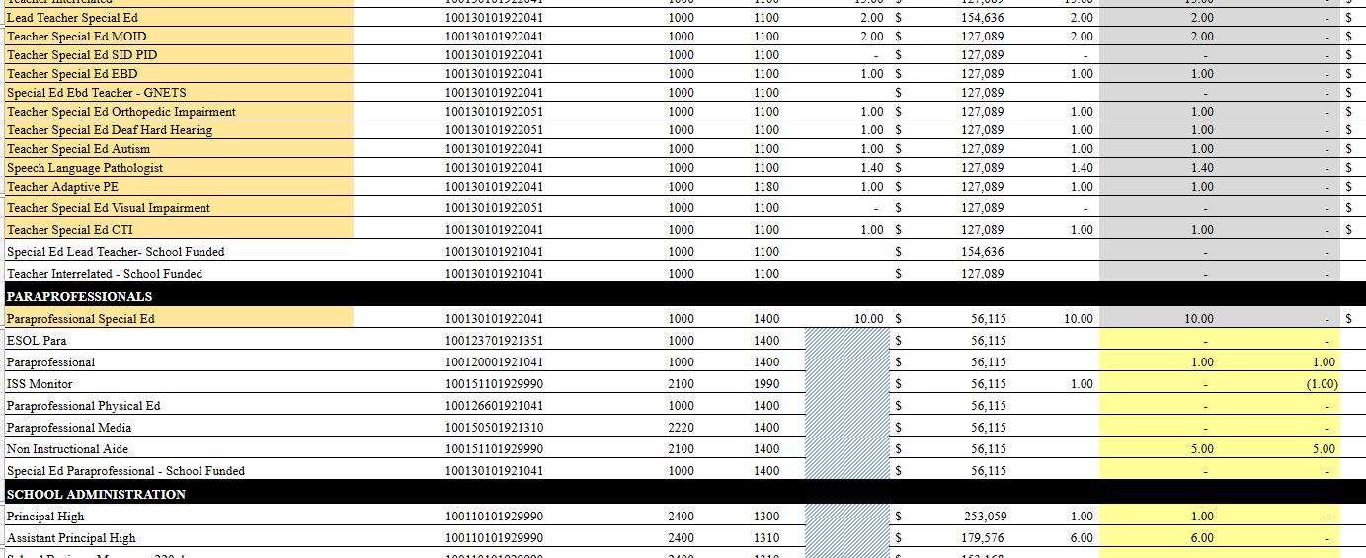

Slide 19
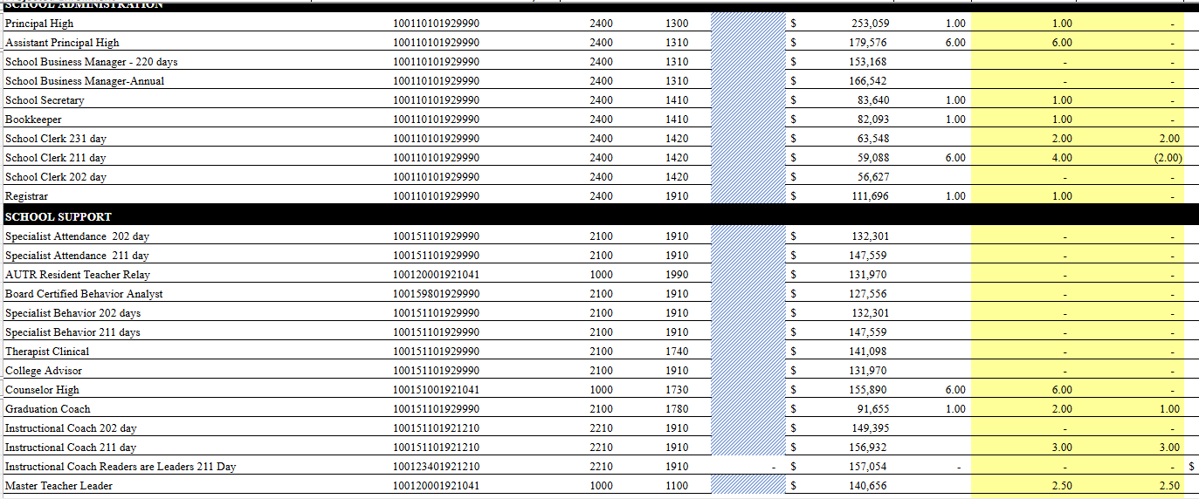

Slide 20
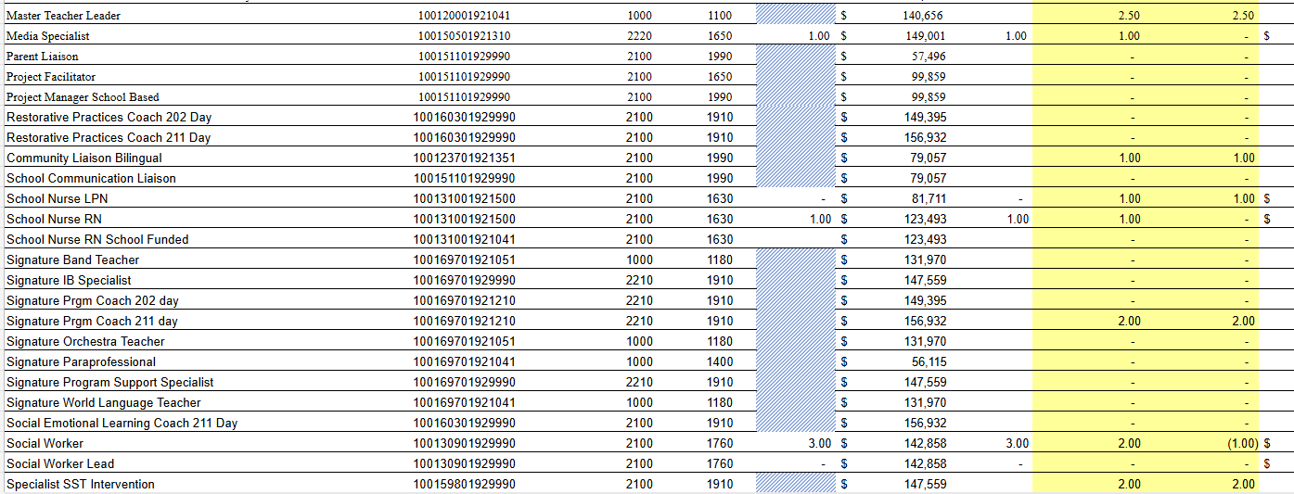

Slide 21
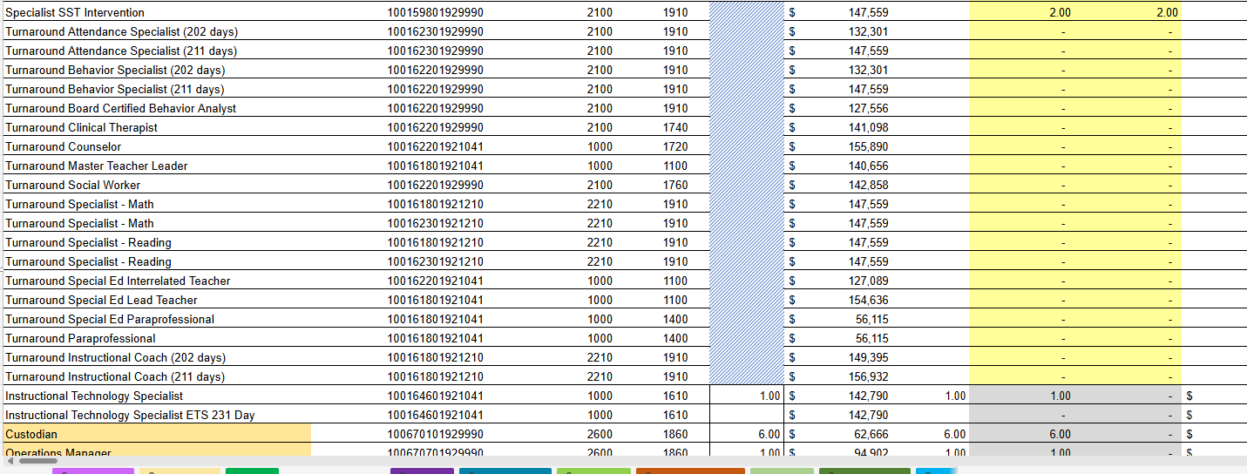

Slide 22
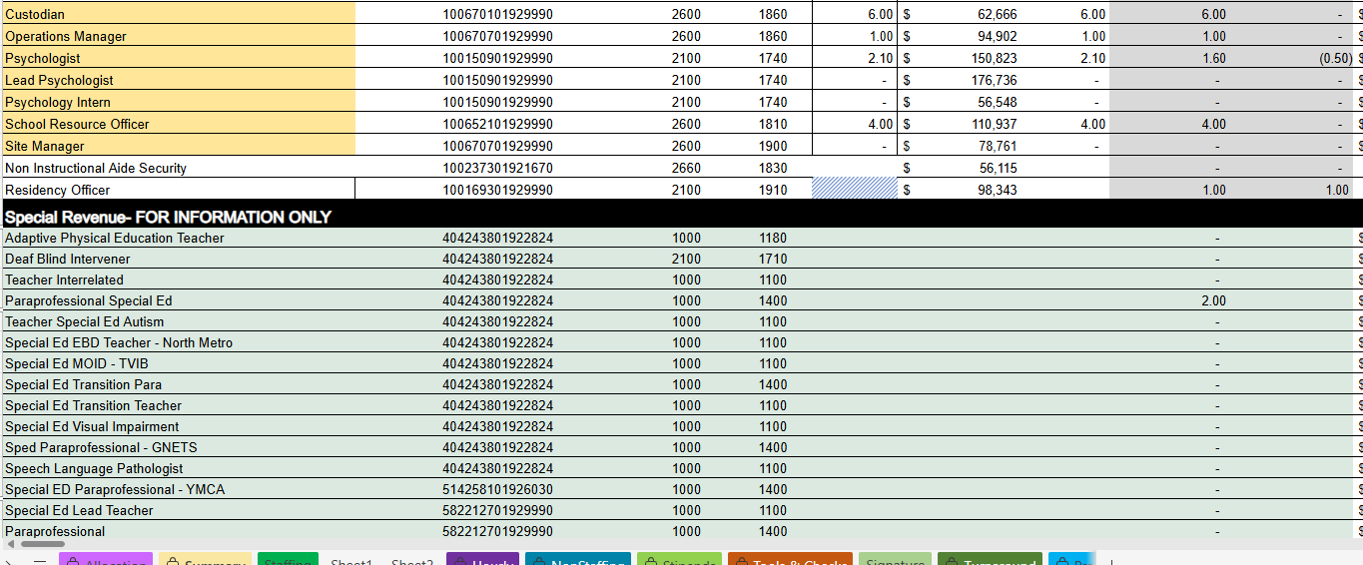

Slide 23
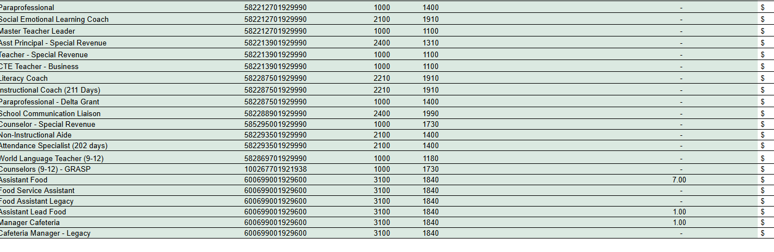

Slide 24
Summary of position Changes to Support the fy26 bUDGET
CREATED | REMOVED
Counselor | I will have this updated for our actual meeting on Thursday. I don’t want to share this information until the staff impacted is notified.
 | 7 positions
Summary of Changes
PRINCIPALS: Please provide a summary of the impact these changes and how it relates to your strategic plan here.

Slide 25
Non-Staffing Tab Overview
The Non-Staffing Tab shows how funds are allocated for non-staff items in the school. There is school-level flexibility for most of these items. The tab has columns for:
Recommended—District’s recommended amount to spend on the line item.
Allocation – This shows how much the principal is proposing to allocate towards the line item in FY26.
Difference—This shows the difference between the recommended amount and the allocation.
Notes: The principal must provide comments if there is a difference in what is Recommended and what is Allocated. Principals and GO Teams will discuss the rationale for the notes section.
Description | Rec. | Allocation | Diff | Notes
Reserve | $ 291,149 | $ 291,149 | $ -
Teacher Stipends |  |  | $ -
Secretary Overtime |  |  | $ -
Contracted Services for Instruction |  |  | $ -
Contracted Services for Professional Development |  |  | $ -
Web-based Subscriptions and Licenses |  |  | $ -
Signature Program Communication/Shipping Fee |  |  | $ -
Computer Software |  | $ - | $ -
Mileage |  |  | $ -
Student Transportation-APS Buses |  |  | $ -
District Funded Field Trips | $ 60,886 | $ 60,886 | $ -
Teaching/Other Supplies | $ 81,900 |  | $ (81,900)
Signature Program Supplies |  |  | $ -
Computer Equipment |  |  | $ -
Media Supplies | $ 13,104 |  | $ (13,104)
Example

Slide 26
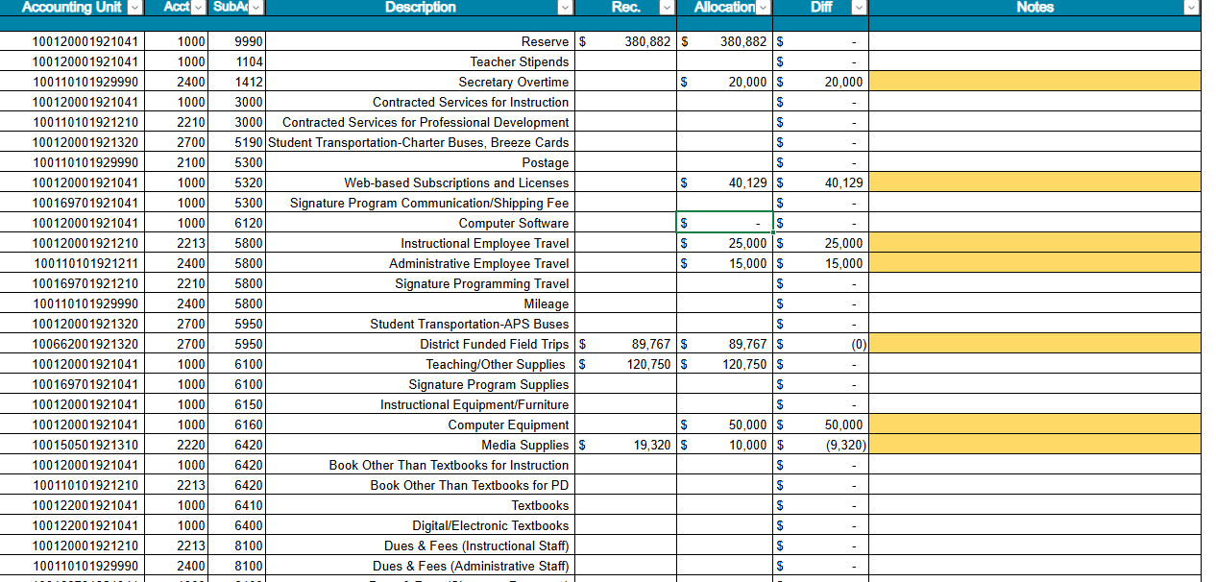

Slide 27
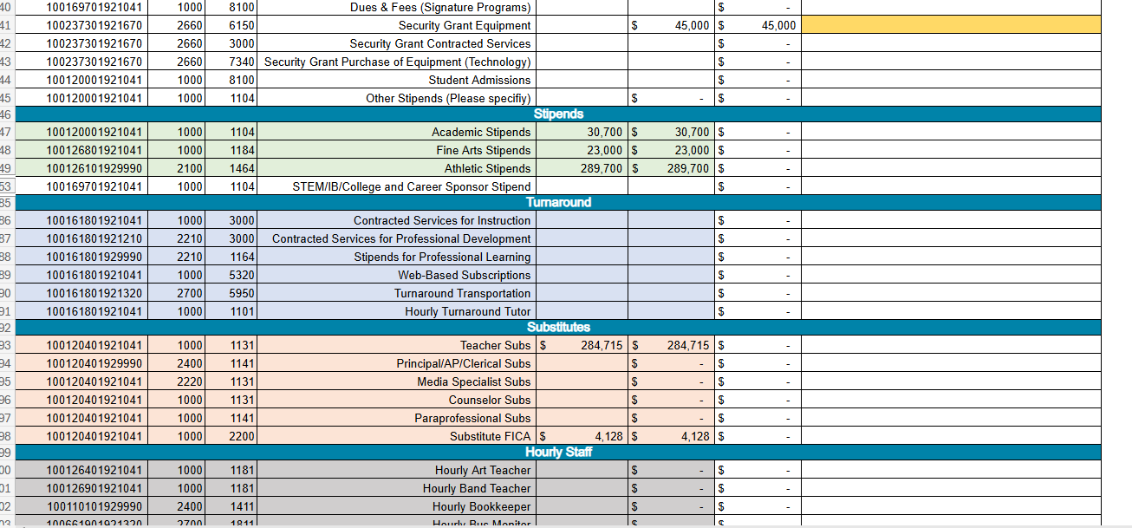

Slide 28
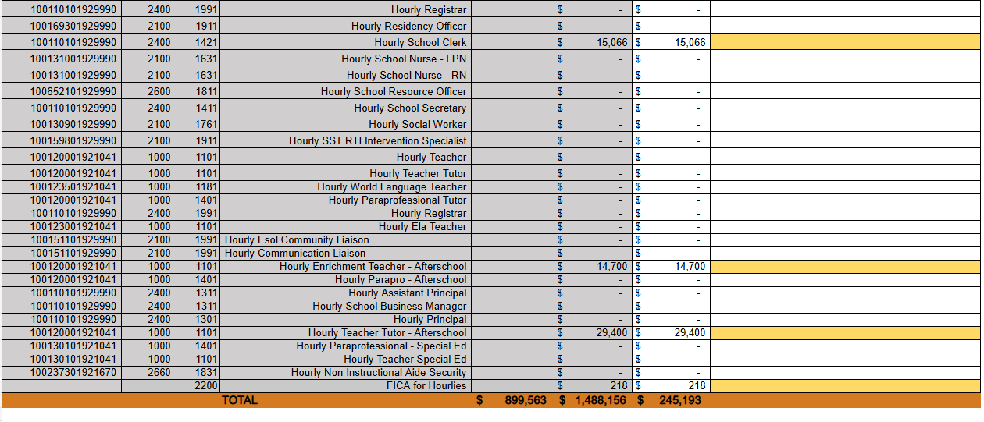

Slide 29
Descriptions of Strategic Plan
Breakout Categories
Priorities: FY25 funding priorities from the school’s strategic plan, ranked by the order of importance.
Strategies: Lays out specific objectives for school’s improvement.
Request: “The Ask” What needs to be funded in order to support the strategy?
Amount: What is the cost associated with the Request?

Slide 30
FY26 Strategic Plan Break-out
Priorities | Strategies | Requests | Amount
Ensure that instructional resources and supplies are accessible to all staff. | Increase the amount allotted for supplies. | School district suggested $120,750 Requested $122,000 for IB Supplies and Resources | $242, 750
Enhance student achievement in core content areas | Plan for programs such as Power UP and Project Hope so that students can receive additional support and recovery in real time. |  | $44, 1000 Teachers’ salaries
Provide increased support to students at risk.
Raise the student graduation rate. | Increase number of audits through the 4 years. Teach students to audit their own transcripts. | Add an additional counselor. | $155, 890.00
Implement IB programs with fidelity |  |  | $548, 353

Slide 31
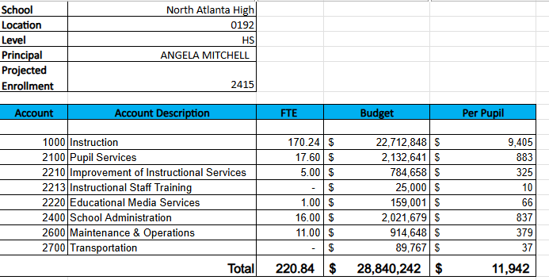
FY26 Budget by Function (required)
* Based on Current Allocation of School Budget

Slide 32
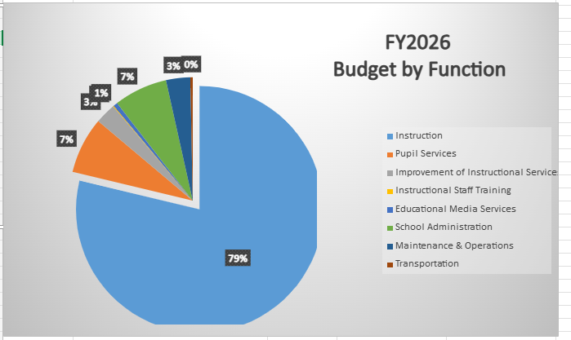
FY26 Budget by Function (required)
* Based on Current Allocation of School Budget

Slide 33
Questions for the GO Team to Consider and Discuss
Strategic Alignment and School-Level Flexibility
Does this budget proposal, as a whole, effectively support our school's strategic priorities?
How do the principal’s proposed changes directly support priorities in our strategic plan? Can we clearly connect each adjustment to a strategic goal?
If new positions, resources, or programs are being added, what data or feedback supports these changes? How will we measure their impact?
What trade-offs are involved? Are any current programs or resources being adjusted or reduced, and how will that affect our students and staff?

Slide 34
Questions for the GO Team to Consider and Discuss
District and Cluster Priorities
How do these proposed changes align with district and cluster priorities? Do we foresee any challenges or misalignments?
If the district has allocated funds for specific initiatives – for example Signature Programs - how are those reflected in our budget?
If we are sharing staff positions (e.g., nurse, counselor, teacher), how will this affect student support and service delivery at our school?

Slide 35
Discussion of Reserve & Holdback Funds

Slide 36
Plan for FY26 Leveling Reserve
$380,882.00
Priorities | Strategies | Requests | Amount
Improve student mastery in the content areas of Math, Science, Social Studies, and ELA by implementing best practices that will ensure rigor. | Create an incentive program for students who improve attendance, behavior, and grades during the school year. This initiative will be geared toward subgroups – ELL, SWD, Hispanic – but not exclusive to them. | Money for incentives | $20 K
Improve student mastery in the content areas of Math, Science, Social Studies, and ELA by implementing best practices that will ensure rigor. | Increase the number of minority students who participate in the IB program. | Money for teacher mentors Money for resources for IB buddies | $50 K

Slide 37
Plan for FY26 Leveling Reserve
$380,882.00
Priorities | Strategies | Requests | Amount
Provide greater support for at-risk students. |  | Add additional SELT | $154,636.00
Provide greater support for at-risk students. | Create and implement a recovery program during the second half of 1st semester to reduce the number of first semester failures. This money includes busses. |  | $75 K
Provide greater support for at-risk students. | Create and after-school tutorial program so teachers are paid to tutor students who need assistance beyond the weekly tutorial held by teachers. |  | $75 K
Provide greater support for at-risk students. | Purchase Chromebooks so that teachers have computers for students to use in class. |  | $66, 186 K

Slide 38
Where We’re Going
Our next meeting is the Budget Approval Meeting
What:
During this meeting we will review the budget, which should be updated based on feedback from the staffing conference, Associate Superintendents, and key leaders. After review, GO Teams will need to take action (i.e., vote) on the FY25 Budget.
Why:
Principals will present the final budget recommendations for GO Team approval.
When:
All approval meetings must be held after staffing conferences. Budgets must be approved by March 15th.

Slide 39
What’s Next?
February
  Cluster Superintendent Review (February 17-21)
  HR Staffing Conferences (February 24– February 27)
March
  Final GO Team Approval Meeting (AFTER your school’s Staffing Conference and BEFORE Friday, March 14th)
    ACTION (i.e.- GO Team votes) on final budget recommendation before March 14

Slide 40
Thank you!

Slide 41
Will be updated As soon as possible

