Slide 1
Boyd Elementary School
Notes:
Good Morning/Afternoon! Today we begin the process of planning our school’s budget for FY21. I know we are all here for the same reason and that is ensuring success for all (enter school name) students. This meeting is to provide an overview of the draft budget and for you to give feedback on the draft budget.

Slide 2
Norms
This is a meeting of the GO Team. Only members of the team may participate in the discussion. Any members of the public present are here to quietly observe.
We will follow the agenda as noticed to the public and stay on task.
We invite and welcome contributions of every member and listen to each other.
We will respect all ideas and assume good intentions.

Slide 3
GO Team Budget Development Process
YOUR SCHOOL STRATEGIC PLAN…
is your roadmap and your role. It is your direction, your priorities, your vision, your present, your future.
Step 1: Data Review
Step 2: Strategic Plan Review
Step 3: Budget Parameters
Step 4: Budget Choices
Notes:
Today I will provide an overview of the budget allocations for FY21. We will begin the work of funding the strategic priorities we agreed upon during our strategic review meeting. (IF YOU HAVE NOT DECIDED ON YOUR PRIORITIES, YOU WILL SAY – WE WILL DECIDE ON OUR PRIORITIES AND THEN DISCUSS ALLOCATING FUNDS TO ADDRESS THOSE PRIORITIES).

Slide 4
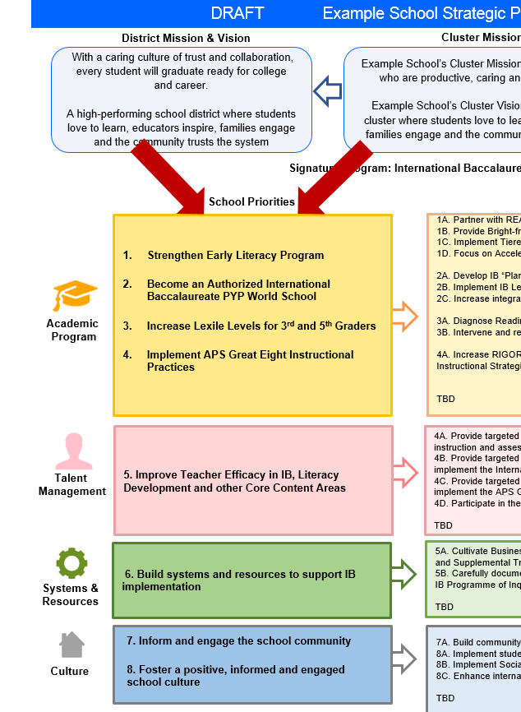
FY21 Budget Development Process
Principal’s Role
Design the budget and propose operational changes that can raise student achievement
Flesh out strategies, implement and manage them at the school level
Focus on the day-to-day operations
Serve as the expert on the school
Hire quality instructional and support personnel
The GO Team’s Role:
Focus on the big picture (positions and resources, not people)
Ensure that the budget is aligned to the school’s mission and vision and that resources are allocated to support key strategic priorities

Slide 5
Boyd Elementary School Strategic Plan
Mission and Vision
The District's mission and vision are populated in this form. Select your Cluster's mission and vision from the drop down menu. Input your school's mission and vision statements.
District's Mission |  | Cluster's Mission |  | School's Mission
With a caring culture of trust and collaboration, every student will graduate ready for college and career. |  | DOUGLASS--The Douglass Cluster mission is to inspire scholars to love learning and to provide every student with the academic foundation that assures they are college and career ready. |  | The mission of W. M. Boyd Elementary is to ensure that all students receive a world-class education that prepares them for success in college, career, and life.
District's Vision |  | Cluster's Vision |  | School's Vision
A high-performing school district where students love to learn, educators inspire, families engage and the community trusts the system. |  | DOUGLASS--The Douglass Cluster vision is to provide rigorous instruction and customized support to prepare all students for academic achievement, graduation, and successful career options. |  | Our vision is that every student is achieving at his or her maximum potential in an engaging, inspiring and challenging environment.
Notes:
You should have a copy of our updated strategic plan (please make copies to be distributed to team).

Slide 6
Boyd Elementary School Strategic Plan
Strategic Plan Priorities
Input your School Strategic Plan Priorities and Strategies in the table below (cut and paste from your current plan). Each priority should have at least one strategy. You can add up to five strategies per priority.
School Priorities | School Strategy #1 | School Strategy #2 | School Strategy #3 | School Strategy #4 | Performance Measure Outcome
Impact student achievement by providing all instructional stakeholders with adequate time to gain a clear understanding of instructional content and goals for the unit and weekly lessons. | Unit Internalization (Quarterly) | Lesson Internalization (Weekly)
Impact student achievement by using formative and summative assessments to drive instruction and Professional Learning | Data-driven instruction (daily) | Data-driven coaching (weekly) | Data-driven PLCs (weekly) | Data-driven SLTs (weekly) | Cultivate a mathematically literate community in which students exercise procedural fluency and problem solving skills.
Impact student achievement by providing job-embedded coaching and training to all instructional stakeholders | Capacity Coaching- Individual | Content-Specific Strategic Coaching (PLC)- Daily/Weekly |  |  | Cultivate a literate community in which students read and write with clarity and fluency across all contents.
Impact the school engagement by using staff survey data to drive culture and academic decisions | Provide specific surveys after each Tuesday Town Hall Meeting to gauge the effectiveness school engagement plan and ways to pivot to meet the needs of staff | Provide specific surveys after each 90 minute PLC to gauge the effectiveness of the instructional plans created and if staff is being supported instructionally
Notes:
You should have a copy of our updated strategic plan (please make copies to be distributed to team).

Slide 7
FY21 Priorities & SMART Goals
School Priorities
SMART Goals
Priority #1 | Impact student achievement by providing all instructional stakeholders with adequate time to gain a clear understanding of instructional content and goals for the unit and weekly lessons. | SMART Goal #1 | With adequate amount of instructional planning time and structured support, there will be an increase of teacher knowledge and practice that will lead to increased student achievement by Impacting the improvement in Reading by having 65% of students meet their Instructional Level of Expectations for Reading as identified by the Fountas and Pinnell BAS and impacting the improvement of STAR Math in grades 1-5 by having 65% of students have a 66 or above SGP.
Priority #2 | Impact student achievement by using formative and summative assessments to drive instruction and Professional Learning | SMART Goal #2 | With adequate amount of data driven instruction and data review, there will be an increase of teacher knowledge and practice that will lead to increased student achievement by Impacting the improvement in Reading by having 65% of students meet their Instructional Level of Expectations for Reading as identified by the Fountas and Pinnell BAS and impacting the improvement of STAR Math in grades 1-5 by having 65% of students have a 66 or above SGP.
Priority #3 (optional) | Impact student achievement by providing job-embedded coaching and training to all instructional stakeholders | SMART Goal #3 (optional) | With adequate amount of job embedded coaching and training, there will be an increase of instructional knowledge and practice for all stakeholders that will lead to increased student achievement by Impacting the improvement in Reading by having 65% of students meet their Instructional Level of Expectations for Reading as identified by the Fountas and Pinnell BAS and impacting the improvement of STAR Math in grades 1-5 by having 65% have a 66 or above SGP.
Notes:
Discuss priorities and rationale

Slide 8
FY21 Budget Parameters
FY21 School Priorities | Rationale
Create rich, well-rounded learning experiences, through literacy, STEM, and cultural arts. These experiences will be cross-curriculum. | Boyd Elementary has historically under performed in the area of literacy. As such, additional attention was placed on the literary program for Boyd Elementary, (Fountas & Pinnell), as well as teacher training. In an effort to enhance student performance, cross-curriculum STEM integration and cultural arts will be utilized to promote higher academic achievement
Notes:
Discuss priorities and rationale. After you have gone over the priorities and rationale – ask GO Team if this represents what was agreed upon.
Are there any priorities I left off?
Are there any questions or concerns?
The next time we meet, I will show you how I have allocated resources to support our strategic priorities.

Slide 9
Executive Summary
This budget represents an investment plan for our school’s students, employees and the community as a whole.
The budget recommendations are tied directly to the school’s strategic vision and direction.
The proposed budget for the general operations of the school are reflected at $6, 436,340
This investment plan for FY21 accommodates a student population that is projected to be 452 students, which is a increase of 21 students from FY20.
Notes:
Here’s a few highlights for our budget this year – read executive summary

Slide 10
School Allocation
Notes:
For FY21, APS is continuing to increase equity within the District and the flexibility principals have in regards to our schools budgeted funds. The new Student Success Funding Model (SSF) allocates dollars to schools based on the number of enrolled students and receives a funding "weight" based on need. This year, student characteristics were weighted based on:
Grade Level –
K
1st through 3rd
6th
9th
Poverty – Weighted for all Direct Certification enrolled students.
Beginning Performance – Weighted Middle School and High School students entering with beginner’s performance on milestones.
ESOL – Weighted for all ESOL designated students in order to supplement due to ESOL staff being locked.
Special Education - Weighted for all Special Education students.
Gifted – Weighted and measured by number of students in the Gifted Program
Small School Supplement – Weighted for low enrollment schools
ES – 500
MS – 600
HS – 700
As you can see, our projected enrollment for FY19 is _______, we increased/decreased by __________ from last year.
We received the following weights for our student characteristics: (Below is just for the script, principals need to insert their school’s characteristics)
Grade Level
Poverty
Special Education
Gifted
Gifted Supplement
ELL
Small School Supplement

Slide 11
School Allocation
Notes:
Additionally, we received money for signature programming, turnaround, Title I and FTE Allotments.

Slide 12
Budget by Function
Notes:
I am passing out the definitions for these funding categories. You will see what makes up each category. Although the total amount will not change, allocation per function may depending on our conversations and school needs.

Slide 13
Budget by Function
Notes:
Explain the pie chart and allocations

Slide 14
What’s Next?
February:
One-on-one Associate Superintendent discussions
Cluster Planning Session (positions sharing, cluster alignment, etc.)
Program Manager discussions and approvals
GO Team Feedback Session
HR Staffing Conferences (February 24th - March 2nd)
March:
Final GO Team Approval (March 3rd - March 13th)
Notes:
In February, we will meet again to discuss how the school’s budget has been allocated to support the programmatic needs and FY21 key strategic priorities.
If think we need to continue our budget conversations, we will schedule additional meetings. My goal is to make sure your voices are reflected in our school’s budget.
I will also be meeting with my Associate Superintendent, program managers and other key leaders to go over our budget and to make sure the school is meeting the standards of service and appropriately staffing.
During the week of Feb. 24th -March 2nd , HR Staffing Conferences will be held. At this meeting, I will present my plan for staff utilization, resource distribution and plan for staffing implications.
We will need to approve the budget at the ________ meeting.

Slide 15
Questions?
Thank you for your time and attention.
Notes:
IF YOU FEEL YOUR TEAM IS READY TO APPROVE THE DRAFT BUDGET, PLEASE DO SO. PLEASE REMIND THEM THAT YOU MAY NEED TO MEET WITH THEM AGAIN, IF THERE ARE CHANGES FROM YOUR MEETINGS WITH DISTRICT LEADERSHIP. LET THEM KNOW YOU WILL KEEP THEM INFORMED!!

