Slide 1

Board of Directors Meeting
December 8, 2022
4p.m.
Thank you for joining us.
We will begin soon.

Slide 2
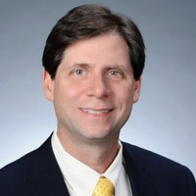
Welcome
ACCA Board Members
& Visitors!
Presiding
William F. Smith
Chair, ACCA Board of Directors
Director of TechOps Training and Development
Delta Air Lines

Slide 3
Public Comment
Thank you for joining us!
Interested in addressing the board today? Please sign up at the entry table and you will have the opportunity to address the board at the end of today’s meeting. Each participant will be given two minutes to address the board during Public Comment.

Slide 4
Virtual Meeting Norms
Mics on Mute
Actively Engage
Cameras On

Slide 5
Agenda

Slide 6
ACCA Board of Directors
Role | Name (or Vacant) | Present or Absent
Parent/Guardian | Lincoln Woods
Business | Charyl Chatman
Business | William Smith
Business | Luke Scanlon
Business | Jon Lewis
Business | Patricia Horton
Metro RESA | Tim Cairl
Secondary | Dwionne Freeman
Secondary | Selena Florence
Post-Secondary Representative | Caroline Angelo
Post-Secondary Representative | Niya Eady
Ex-Officio | Eshe’ Collins
Ex-Officio | Tasharah Wilson
Student | Jordan Best
Student | Joshua Gray

Slide 7
Agenda

Slide 8

Meeting Minutes from 9/08/2022

Slide 9
GO Team Meeting #2
Where we are – Where we’re going

Slide 10


Where We Are
Our strategic plan is the guide for the work we’re doing in the school. By monitoring the plan and ranking priorities, we can all work towards the common goals.

Slide 11
Timeline for GO Teams
You are HERE
Fall 2021
GO Team Developed 2021-2025 Strategic Plan
1
Summer 2022
School Leadership completed Needs Assessment and defined overarching needs for SY22-23
2
August 2022
School Leadership completed 2022-2023 Continuous Improvement Plan
3
Sept. – Dec. 2022
Utilizing current data, the GO Team will review & possibly update the school strategic priorities and plan
4
Before Winter Break
GO Team will take action (vote) on the rank of the strategic plan priorities for SY23-24 in preparation for budget discussions.
5

Slide 12
Discussion Items
Current Strategic Plan
School Strategic Plan
Discussion on Strategic Plan and progress
Updates for Strategic Plan (as necessary)
Data
Data Protocol
Preparing for Budget Development
Ranking Strategic Plan Priorities

Slide 13
Current
Strategic Plan
2021-2025

Slide 15
Data

Slide 16
Economic and Workforce Development Data

Slide 17
Champion | Nicole | Delta Air Lines
Cloud | Rosemary | City of East Point Fire Department
Cannon | Marion | Atlanta Public Schools Office of Safety and Security
Moreno | Keiah | Whitefoord Early Learning Academy
Strommen | Andrea | North Fulton auto center
Barron | Chirre' | Atlanta Public Schools Office of Safety & Security
Strickland | Charles | Renaissance of Garden Walk
Brandon-Wheatle | Shernett | Escovitchez
Downs | Koby | Habitat for Humanity
Stubbs | Jason | iSmooth Media
Williamson | Amber | InspiredEDU
Strommen | Andrea | Enterprise Holdings Inc.

Slide 18
Partnerships
HVAC – AHR Expo
Cybersecurity and Game Design – TEALS
IHG Full Disclosure Experience - Designed to give students a behind the scenes view into professional careers in the hospitality and lodging industry. This event took place on September 22, 2022 at the IHG Hotel & Resorts Corporate Office.
EMR – Atlanta Fire Department
Criminal Investigations – Atlanta Police Department

Slide 19
Number of students in work-based learning programs: | 1
Number of employer sites participating in work-based learning programs: | 1
Number of blocks of work-based learning successfully completed by students: | 1
Number of students in work-based learning that is aligned with their pathway: | 1
What pathways are you interested in adding? | Aviation Maintenance

Slide 20
Teaching and Assessing for Learning

Slide 21
End of Pathway Assessment Results
Notes:
This slide looks at our performance on the End of Pathway Assessments for each pathway.
Overall, 70% of the students participated and 53.7% of the students successfully passed the exams. We will focus this year on aligning class assessments to the EOPA and encouraging all students to take the exams.
One pathway, Programming, was not able to test last school year. We are working now to ensure they are able to test this year.

Slide 22
Pathway | Percent of Students Passing | Additional information
Carpentry | 100%
HVAC & Refrigeration | 93% | 2/27 require remediation Both students failed
Automotive | 97% | 1/31 require remediation Student passed
Hospitality, Recreation & Tourism | 100%
Cybersecurity | 100%
Programming | 100%
Culinary Arts | 98% | 1/41 require remediation Student passed
Patient Care | 100%
Criminal Investigations | 100%
Dental Science | 100%
Graphic Design | 100%
Emergency Medical Responder | 97% | 1/32 require remediation Student passed

Slide 23
Number of students who earn Technical Certificate: | 10
Number of students in Technical Certificate programs who earn more than one Technical Certificate: | 0
Number of Technical Certificates earned: | 10
Percentage of students who are employed in a job directly related to Technical Certificates received, or who are enrolled in additional post-secondary education, or both, within six months of gr... | 10
How many students are enrolled in Dual Enrollment courses at each partnering college/university? (Breakdown by institution) | Atlanta Technical College - 97
How many students enrolled in Dual Enrollment take only core courses? | 54
How many students enrolled in Dual Enrollment take only CTAE courses? | 43
Do you offer Dual Enrollment courses beyond the regular school day? (evening/night or weekend courses) | No
If you answered no to the previous question, would you be interest in offering Dual Enrollment courses beyond the regular school day? | Yes

Slide 24
Strategic Planning and Sustainability

Slide 25
Recruitment Activity Summary—FY21
Recruitment Events
Tour Participants & Applicants by School
ACCA Open House #1 - 10/05/2021, 5-8 pm
﻿ACCA Open House #2 - 10/12/2021, 5-8pm
﻿ACCA Open House #3 - 02/08/2022, 4-6pm
Therrell Recruiting Event – 11/11/2021
Washington Recruiting Event – 11/12/2021
Therrell Signature Program Night – 11/16/2021
Midtown Recruiting Event – 12/1/2021
ATC Application Session #1– 11/12/2021
ATC Application Session #2 – 11/19/2021
ACCA ELL Parent Information Session – 01/19/2022
ACCA Virtual Parent Night #1 - 01/26/2022
ACCA Virtual Parent Night #2 - 02/23/2022
9th Grade Tours @ ACCA - January and February 2022
School | 9th Grade Tour Participants | Applications as of 3/11/22
B.E.S.T | 35 | 47
Carver Early College | 4 | 16
Carver STEAM | 30 | 74
CSKYWLA | 0 | 16
Douglass | 85 | 125
Jackson | 148 | 153
KIPP | 0 | 64
Mays | 158 | 138
Midtown | 32 | 49
North Atlanta | 244 | 219
South Atlanta | 53 | 75
Therrell | 92 | 112
Washington | 62 | 44
Total | 943 | 1132

Slide 26
Applications By Pathway
Applications By School
Applications By Grade
Pathway | # of Students Applied Spring 2022
Patient Care | 146
Cybersecurity | 44
Culinary Arts | 173
Criminal Investigations | 132
Dental Science | 65
Automotive | 87
Infant/Toddler Childcare (college credit) | 60
Carpentry | 83
Early College (college credit) | 54
Graphic Design | 69
HVAC – Refrigeration | 6
Programming | 75
Hospitality, Recreation, Tourism | 40
Emergency Medical Responder | 42
Aviation Maintenance | 15
TOTAL | 1091
Home School | #of Students Applied
KIPP Collegiate | 60
North Atlanta | 205
Maynard Jackson | 140
Mays | 137
Washington | 43
Douglass | 125
South Atlanta | 75
Midtown | 45
Therrell | 111
BEST | 47
CSK | 16
Carver Early | 16
Carver STEAM | 71
Phoenix | 0
Drew | 0
Atlanta Classical | 0
TOTAL | 1091
Grade Level | # of Students Applied
10th Grade | 551
11th Grade | 310
12th Grade | 230
TOTAL | 1091

Slide 27
Enrollment
Enrollment By School
Enrollment By Pathway
Home School | #of Students Enrolled
 | Spring 22 | Fall 22
KIPP Collegiate | 61 | 53
North Atlanta | 50 | 106
Maynard Jackson | 38 | 50
Mays | 36 | 49
Washington | 20 | 23
Douglass | 14 | 72
South Atlanta | 12 | 39
Midtown | 9 | 11
Therrell | 8 | 29
BEST | 6 | 22
CSK | 3 | 13
Carver Early | 0 | 1
Carver STEAM | 0 | 23
Phoenix | 0 | 0
Drew | 0 | 0
Atlanta Classical | 0 | 0
TOTAL | 257 | 491
Enrollment By Grade
Pathway | # of Students Enrolled
 | Spring 22 | Fall 22
Patient Care | 33 | 41
Cybersecurity | 30 | 29
Culinary Arts | 26 | 41
Criminal Investigations | 27 | 45
Dental Science | 26 | 50
Automotive | 19 | 31
Infant/Toddler Childcare (college credit) | 19 | 9
Carpentry | 15 | 33
Early College (college credit) | 14 | 54
Graphic Design | 16 | 47
HVAC – Refrigeration | 11 | 27
Programming | 12 | 35
Hospitality, Recreation, Tourism | 9 | 17
Emergency Medical Responder | N/A | 32
TOTAL | 257 | 491
Grade Level | # of Students Enrolled
 | Spring 22 | Fall 22
10th Grade | 79 | 146
11th Grade | 97 | 192
12th Grade | 81 | 153
TOTAL | 257 | 491

Slide 28
Recruitment Update As of 12/2/2022
ACCA Application Count
 | 11/04/2022 | 11/11/22 | 11/18/22 | 12/02/2022
B.E.S.T | 20 | 27 | 31 | 31
Carver Early College | 6 | 19 | 19 | 19
Carver STEAM | 1 | 4 | 4 | 4
CSKYWLA | 1 | 6 | 6 | 26
Douglass | 1 | 19 | 73 | 73
Jackson | 5 | 22 | 26 | 60
KIPP | 3 | 20 | 20 | 20
Mays | 0 | 25 | 25 | 25
Midtown | 36 | 47 | 47 | 47
NATL | 15 | 36 | 49 | 75
SATL | 0 | 3 | 4 | 5
Therrell | 10 | 23 | 23 | 72
BTW | 29 | 40 | 42 | 42
Total | 127 | 291 | 375 | 499

Slide 29
Recruitment Update As of 12/2/2022
Pathway Application Count
Pathway | 11/04/2022 | 11/11/22 | 11/18/22 | 12/02/22
Carpentry | 4 | 16 | 20 | 23
Criminal Investigations | 15 | 23 | 26 | 37
Culinary Arts | 19 | 40 | 55 | 72
Cybersecurity | 9 | 19 | 21 | 25
Dental Science | 15 | 26 | 30 | 51
Early College Essentials | 5 | 53 | 55 | 60
Emergency Medical Responder | 2 | 3 | 9 | 12
General Automotive | 6 | 12 | 22 | 33
Game Design | 9 | 19 | 27 | 31
Graphic Design | 14 | 19 | 31 | 33
Hospitality | 4 | 4 | 4 | 10
HVAC | 1 | 4 | 4 | 6
Infant Toddler Childcare | 9 | 21 | 27 | 43
Patient Care | 15 | 32 | 44 | 63

Slide 30
Governance and Leadership

Slide 31
Role | Name (or Vacant) | Present or Absent
Parent/Guardian | Lincoln Woods
Business | Charyl Chatman
Business | William Smith
Business | Luke Scanlon
Business | Jon Lewis
Business | Patricia Horton
Metro RESA | Tim Cairl
Secondary | Dwionne Freeman
Secondary | Selena Florence
Post-Secondary Representative | Caroline Angelo
Post-Secondary Representative | Niya Eady
Ex-Officio | Eshe’ Collins
Ex-Officio | Tasharah Wilson
Student | Jordan Best
Student | Joshua Gray

Slide 32

GO Team Discussion:
Data Protocol
What do you notice?
What are your wonderings?
What additional questions do you have?

Slide 33
Activity & Discussion
Review the priorities and goals in your strategic plan and reflect on if the expected progress is being made. These guiding questions will help you determine what, if any, updates are needed for your school’s strategic plan.
Are there any goals which should be added to the Strategic Plan?
What progress has been made towards the priorities identified in our Strategic Plan? What evidence/data do we have?
Based upon available data, are there any other adjustments we need to make to the Strategic Plan?

Slide 34
Updates to the
Strategic Plan
Enter all changes/updates to your plan – be sure to include accountability measures, as appropriate.

Slide 35
Action on the Updated Strategic Plan
The GO Team needs to TAKE ACTION (vote) on its updated Strategic Plan. After the motion and a second, the GO Team may have additional discussion. Once discussion is concluded, the GO Team will vote.

Slide 36
Preparing for
Budget Development

Slide 37
You are HERE
Fall 2021
GO Team Developed 2021-2025 Strategic Plan
1
Summer 2022
School Leadership completed Needs Assessment and defined overarching needs for SY22-23
2
August 2022
School Leadership completed 2022-2023 Continuous Improvement Plan
3
Sept. – Dec. 2022
Utilizing current data, the GO Team will review & update the school strategic priorities and plan, as needed
4
Before Winter Break
GO Team will take action (vote) on the school’s strategic plan and vote on the ranked strategic plan priorities for SY23-24 budget discussions.
5
1
2
3
4
5

Slide 38
Discussion
Strategic Plan Priority Ranking
In preparation for the 2023-2024 Budget Development (January–March 2023), the GO Team needs to rank its Strategic Plan Priorities. Use the next slide to capture the priority ranking.

Slide 39
Strategic Plan
Priority Ranking
Insert the school’s priorities from Higher to Lower
Higher
Lower

Slide 40
Action on the Strategic Plan Priorities
The GO Team needs to TAKE ACTION (vote) on its ranked Strategic Plan Priorities. After the motion and a second, the GO Team may have additional discussion. Once discussion is concluded, the GO Team will vote.

Slide 41
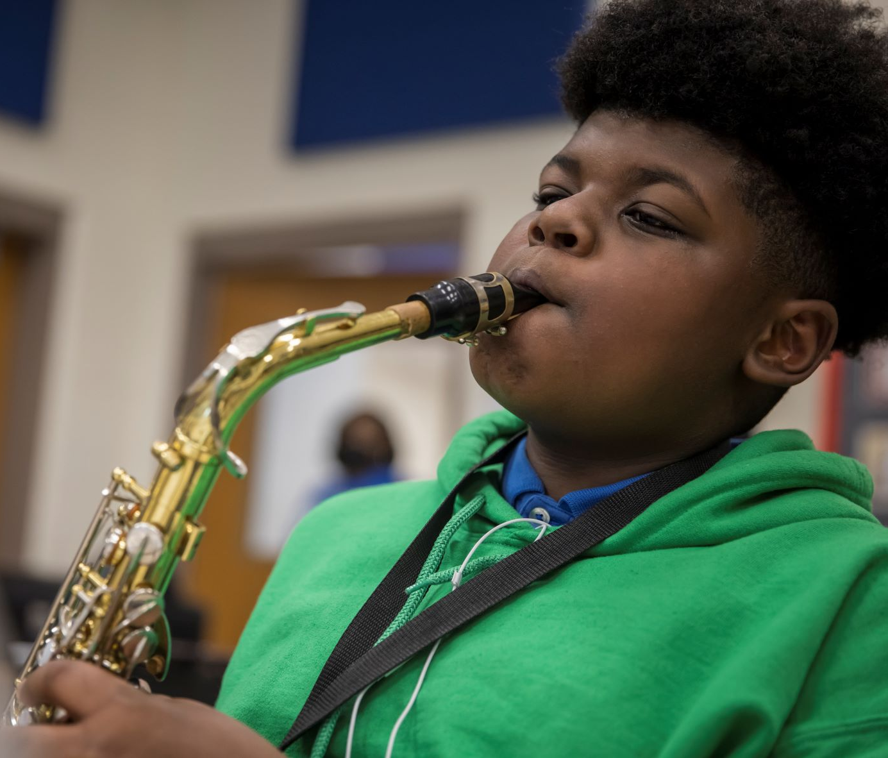

Where we’re going
At our next meeting(s) we will begin the discussion of the 2023-2024 budget.
Let me or the Chair know of any additional information you need for our future discussion.

Slide 42
Thank you

Slide 43
Agenda

Slide 44
Principal’s Report
ACCA Board of Directors Meeting
December 8, 2022
Notes:
Good afternoon,
It is my pleasure to present the Principal’s report on behalf of Dr. Wilson.

Slide 45

Good News!

Slide 46
Topics
Revised Board Training Requirements

Slide 47
Revised Board Training Requirements
The Office of College and Career Academies in partnership with the Charter Systems Foundation is working to ensure that your board members are receiving meaningful training. In that vein, we have put together the calendar/list of available training opportunities below. Unless noted as virtual, all meetings are in-person. Training attendees will be provided with a QR code to document their attendance directly with my office. Please share my e-mail and the calendar/list with your board chairs.
Metro East (Technical College Partners: Atlanta Tech and Georgia Piedmont, Athens Tech and Southern Crescent Welcome)
Host: Newton College and Career Academy - Chad Walker, CEO & Newton County Development Authority
Date: December 13th
Time: 11:30 am - 1:30 pm (lunch provided)
Location: Newton College and Career Academy
RSVP here!
TCSG GCCAN Webinar Series (1 Hour)
Keep an eye out for registration e-mails
· February 7th, 2023 10:00 AM: CCA Marketing
· March 2023 TBD: Innovation and Flexibility
· April 2023 TBD: CCA Funding and Fundraising
Charter System Foundation Regional Flexibility & Governance Workshops (4 Hours):
Register through Charter Systems Foundation
· January 25, 2023 Dublin City Schools (9 to 1pm)
· January 26, 2023 Liberty County Schools (9-1pm)
· March 8, 2023 Decatur City Schools (9-1pm)
· March 29, 2023 Dougherty County Schools (9-1pm)
Charter System Foundation Graduation Dual Enrollment Option B Webex (1 Hour):
Register through Charter Systems Foundation
· November 8, 2022 (8:30 to 9:30)
· January 10, 2023 (8:30 to 9:30)
· March 14, 2023 (8:30 to 9:30)
GEER Healthcare Workshops Zoom (1 Hour):
Keep an eye out for registration e-mail
January 19, 2023 (3:30 to 4:30)
Leadership Industry Council (GACCAN) Zoom (1 Hour):
Keep an eye out for registration e-mails
· January 19, 2023 (8:30 to 9:30)
· February 16, 2023 (8:30 to 9:30)
· March 16, 2023 (8:30 to 9:30)
· April 20, 2023 (8:30 to 9:30)

Slide 48
Meeting Dates
Thursday, 9/08/22 4 p.m.
Thursday, 12/08/22 4 p.m.
Thursday, 1/26/23 4 p.m.
Thursday, 2/09/23 4 p.m.
Thursday, 3/02/23 4 p.m.
Thursday, 5/18/23 4 p.m.
Notes:
As a reminder, we have all approved board meeting dates listed for the school year.

Slide 49

Questions?
Notes:
I will open the floor for questions.
Thank you for your attention.

Slide 50

Announcements

Slide 51
Public Comment
The Public Comment period is designed to gain input from the public and not for immediate responses by the Board to the public comment presented.
Each member of the public will have 2 minutes to speak.
At the end of 20 minutes, we will close public comment and move on to the next agenda item.
If there are questions or information that you have for the Board, you may contact one or more Board members after this meeting. You can find Board member contact information, meeting dates and agendas on ACCA’s website https://www.atlantapublicschools.us/domain/10250

Slide 52

Adjournment

