Slide 1
Board of Directors Meeting
Good evening, everyone!
Thank you for joining us. We will begin shortly.
November 30, 2023
4 P.M.

Slide 2

Welcome Board Members & Visitors!

Slide 3
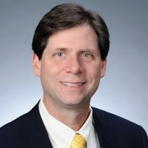
Welcome
ACCA Board Members
& Visitors!
Presiding
William F. Smith
Chair, ACCA Board of Directors
Director of TechOps Training and Development
Delta Air Lines

Slide 4
Public Comment
Thank you for joining us!
Interested in addressing the board today? Please sign up at the entry table and you will have the opportunity to address the board at the end of today’s meeting. Each participant will be given two minutes to address the board during Public Comment.

Slide 5




Virtual Meeting Norms
Mics on Mute
Actively Engage
Cameras On
Non-ACCA Board Members:
Thank you for taking time out of your schedules to support the great work happening at ACCA. We appreciate you!

Slide 6
Atlanta College and Career Academy
Date: November 30, 2023
Time: 4 p.m.
Location: 1090 Windsor Street S.W.
Call to Order
Roll Call; Establish Quorum
Action Items
  Approval of Agenda
  Fill Vacant Seats
  Approval of Previous Minutes
Information Items
  Principal’s Report
  Peach Education Tax Credit
Announcements
Adjournment

Slide 7
Fill Vacant Seats
The Metro Atlanta Chamber of Commerce brings forth the nominations for business seats
    Atlanta Public Schools superintendent nominates representatives for secondary seats
    The Atlanta Board of Education Chair nominates representatives for Board of Education Seats
Upon approval, individuals are immediately full GO Team members and may join the meeting.

Slide 8
Nomination
Seat | Name | Company | Title
Business | Captain Sharyl Chatman | Atlanta Fire Department | Support Services Division | Accreditation Manager
Seat | Name | Company | Title
Business | Dayna Vidal *replacing Dr. Wimberly* | Grady Health System | Vice-President | Nursing Professional Development and Clinical Outcomes
Seat | Name | Company | Title
APS Board of Education | Katie Howard | Atlanta Public Schools | District 1
Seat | Name | Company | Title
Secondary Education | Dr. Dwionne Freeman | Atlanta Public Schools | Director, CTAE
Seat | Name | Company | Title
Secondary Education | Shelly Goodrum | Atlanta Public Schools | Director, CTAE

Slide 9

Meeting Minutes
09/06/2023

Slide 10
Principal’s Report
Presenters:
Dr. T. Wilson, Principal/CEO
Dr. Shaundra Fears, Program Administrator

Slide 11
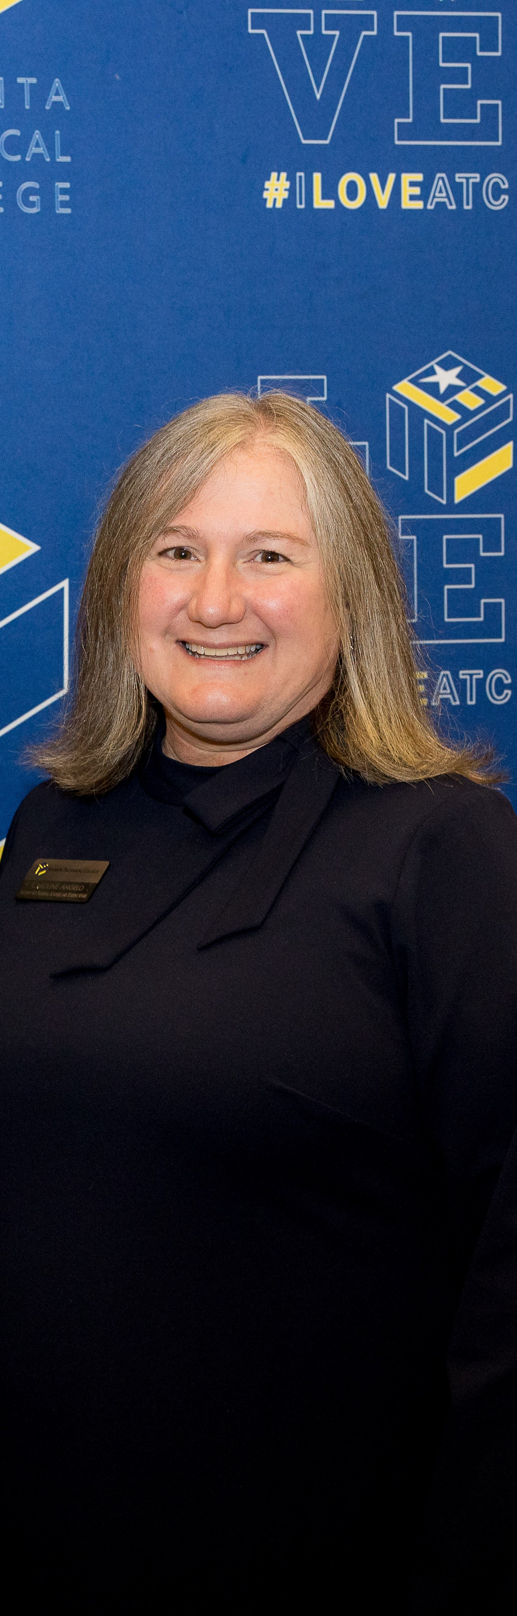
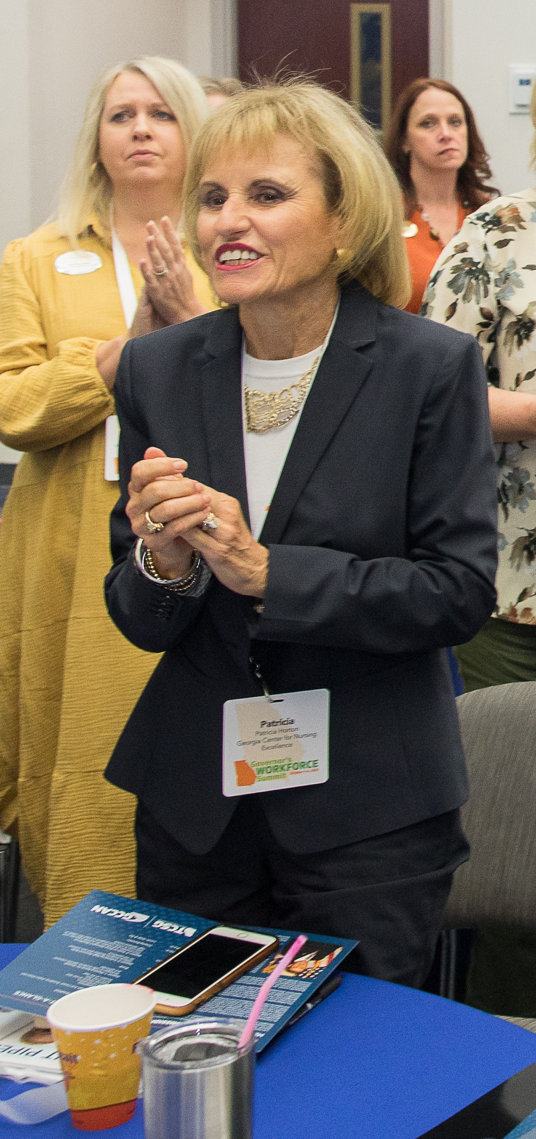
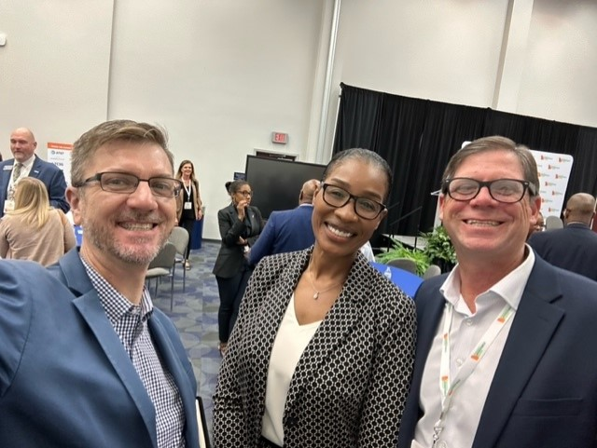
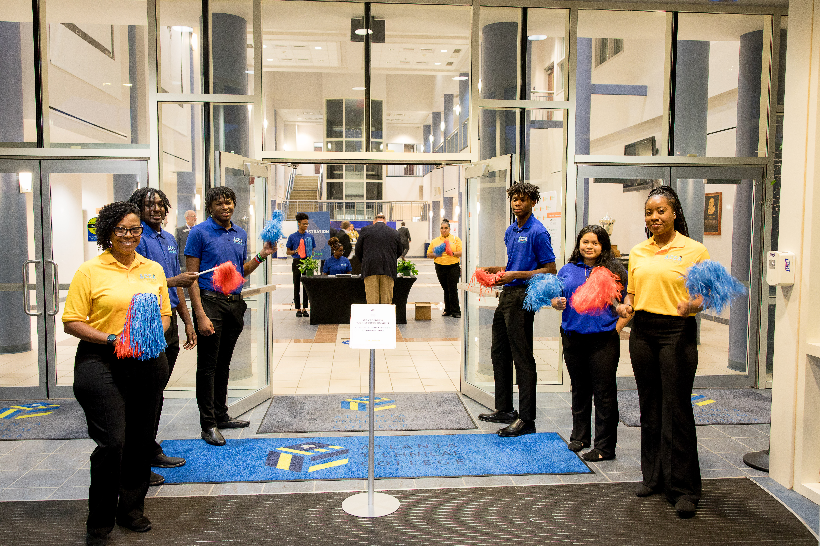
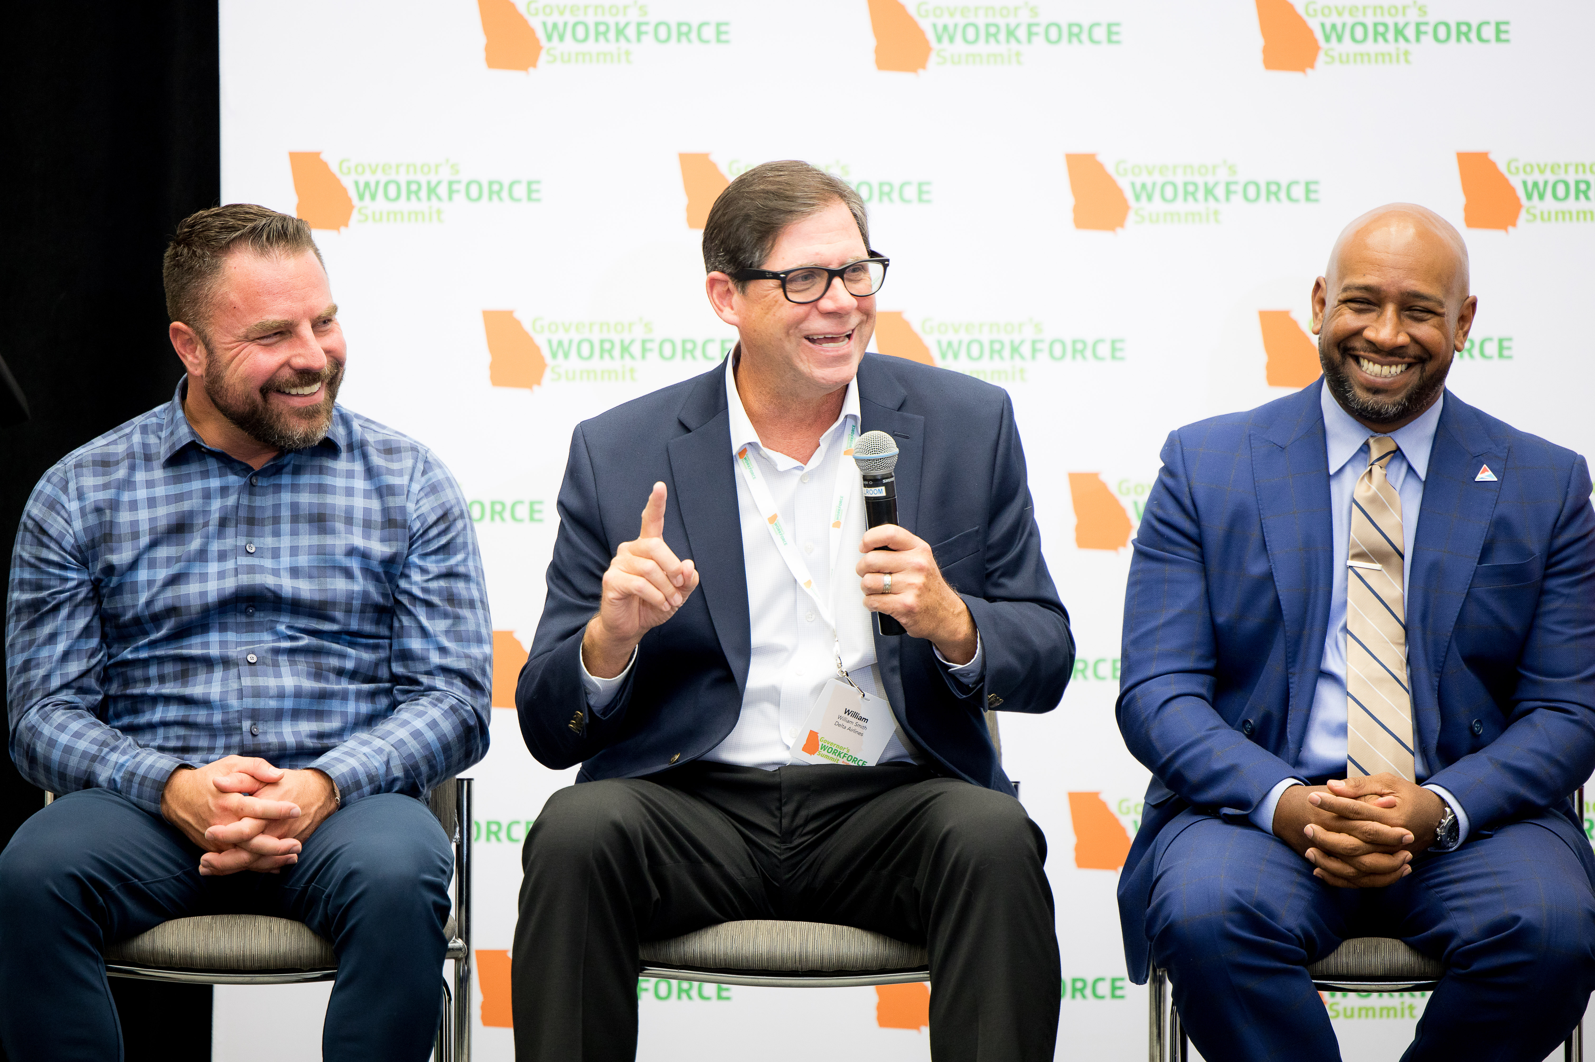
Governor’s Workforce Summit
Friday, October 6, 2023 @ Atlanta Tech
Big shout out to all that were able to attend College and Career Academy Day - Governor's Workforce Summit (Pat Horton, Caroline Angelo, Niya Eady, Tim Cairl, and William Smith).
Congrats to Bill for doing a great job serving on the business panel. Special shout out to our amazing counselors and students that helped and participated as well.

Slide 12


Slide 13

High School Diploma
Accelerated Career
Traditional
24 High School Credits
Plans to attend Post-Secondary immediately following high school graduation
9 High School Credits
2 English
2 Math
2 Sciences
2 Social Studies
1 Health/PE
2 Technical Certificates of Credit
Or
Any TCSG Diploma
Or
Any TCSG Associate’s Degree
Plans to go straight into a career following high school graduation
Notes:
The state of Georgia has now identified two paths to the same high school diploma.
The traditional path and now Accelerated Career.
Let’s begin with the path to graduation that we all are most familiar with – the traditional path.
The traditional path to graduation requires students to receive 24 high school credits to qualify for high school graduation. Students on this pathway to graduation are perhaps enrolled in Advanced Placement Classes or enrolled in IB programs. These are also students that plan to attend a post-secondary institution immediately following high school graduation.
Now let’s explore the new path to that same high school diploma – Accelerated Career.
This pathway to graduation is for students that want to accelerate through high school and move directly into a career following high school graduation.
This pathway to graduation allows scholars to substitute some of the required high school credits for post-secondary credentials aligned to in-demand Metro-Atlanta careers. Specifically, students choosing accelerated career will simultaneously earn a high school diploma and two Technical Certificates of Credit in a specific career pathway.

Slide 14
Recruitment for
FY 2025 has officially started

Slide 15
Pathway changes for 2024-25
Automotive Technology, Carpentry and Cybersecurity will change to dual enrollment pathways.
Aviation Maintenance will be added as a dual enrollment pathway.

Slide 16
Recruitment Strategy
Application Window November 23- March 24
Principal, Counselor and Dual Enrollment Coordinator Informational Sessions
ACCA Fall/Spring Open House Recruitment Sessions
Middle School Tours
In-Person Recruitment Sessions to all APS High Schools
ACCA Tour and Application Sessions for all High Schools
School events as requested for traditional and charter schools
Virtual and Evening Informational Sessions
Spanish Informational Sessions in conjunction with the Multilingual Programs and Services Department
Application support for Dual Enrollment students
As requested, Tours and Informational Sessions for APS departments

Slide 17
B.E.S.T | 3
Carver Early College | 4
Carver STEAM | 1
Douglass | 2
Drew | 0
Jackson | 38
CSKYWLA | 0
KIPP | 4
Mays | 2
Midtown | 0
NATL | 6
SATL | 0
Therrell | 1
BTW | 34
Phoenix | 0
Total | 95

Slide 18


Slide 19


Slide 20



WHO WE ARE
Formed in 2010 by an act of the State Legislature
Funded by the “Educator” and “Support Education” license tags as well donations from corporations, family foundations and individuals
Added the PEACH Education Tax Credit through our merger with the Innovation Fund Foundation, January 1, 2022

Slide 21

What We Do
Our mission is educational excellence for students in Georgia.
We support programs of the Department of Education as well as give grants throughout the state.
We also support our three state schools.

Slide 22

OUR PRIORITY AREAS
Equitable opportunities for children in every community
Students who are prepared for local workforce opportunities
Students who master grade-level literacy and numeracy
Safe and healthy students

Slide 23

WHAT IS THE
PEACH EDUCATION
TAX CREDIT
Georgia individuals and corporations can donate to public education via the PEACH Education Tax Credit and receive a dollar-for-dollar tax credit on their Georgia state income taxes.
The tax credit is capped at $5 million and is approved on a first-come, first-serve basis.
PEACH funds may be awarded to local education agencies, public schools, charter schools, and 501(c)(3) organizations partnering with these entities implementing programs with an innovative focus.
Priority is given to schools identified in the bottom 5% of performance.

Slide 24

MAXIMUM CONTRIBUTIONS
1
Single Individual or
Head of Household:
UP TO $1,000
2
Married couple
filing separate:
UP TO $1,250
Individuals and businesses can donate up to the following amounts to the Georgia Foundation for Public Education in exchange for a PEACH Education tax credit as long as tax credits remain available.
4
S Corporation Shareholder, LLC Member or
Partnership:
UP TO $10,000
5
Corporation or
Fiduciary Taxpayer:
UP TO 75% of annual Georgia income tax liability
3
Married couple
filing jointly:
UP TO $2,500

Slide 25



PROCESS TO OBTAIN A
PEACH TAX CREDIT
Apply for pre-approval for the tax credit at gfpe.org/tax_credit. The Department of Revenue will notify each taxpayer via mail and e-mail of the preapproved contribution amount.
APPLY
DONATE
Once your pre-approved contribution amount is received, submit your donation online or mail your payment to GFPE within 60 days.
CLAIM
Claim the tax credit by completing and submitting Form IT-QED-TP2 with the Georgia tax return. Income taxes must be filed electronically to claim.

Slide 26

Questions?

Slide 27
THANK YOU FOR YOUR TIME
Contact the Georgia Foundation for Public Education
404-656-5594 | ppushkin@doe.k12.ga.us
2062 Twin Towers East, 205 Jesse Hill, Jr. Drive, SE
Atlanta, GA 30334
www.gfpe.org

Slide 28

ACCA
Peach Tax Credit

Slide 29

ACCA Peach Tax Credit Projects
Salary Supplements ($50,000): The first project will focus on supporting the need of staffed positions for the CCA pathways. The CCA caters to the in-demand careers in the metro Atlanta area. The need for industry professional to teach students to skills aligned for the pathways they have chosen is very essential. Unfortunately, professionals are accustomed to making a certain amount of money therefore the CCA seeks support to make the salary competitive. The Peach Tax Credit funds will allow the CCA to add a monetary value to the offering salaries that will be competitive and be appealing to those who qualify. This effort will benefit the entire College and Career Academy as they must be able to employ those that have the knowledge and expertise to teach and employ our students. The salary supplements are not to exceed 20% of the individual’s salary.
Pathway Lab Refresh ($50,000): The pathways include Carpentry, Culinary Arts, Criminal Investigation, Cybersecurity, Dental Science, Game Design, General Automotive Tech, Graphic Design, Hospitality, Recreation & Tourism, HVACR, Infant Toddler Childcare, Patient Care, and Teaching as a Profession. Grant Agreement for Atlanta College & Career Academy GFPE exists for the single purpose of supporting educational excellence for students in Georgia. The second initiative is to provide maintenance for all lab equipment, provide materials, supplies and software. The projected amount for this project is $50,000. The labs that require maintenance and repairs will be maintained as recommended by the CTAE coordinators for those assigned pathways. All other pathways that need up-to-date instructional software, material and supplies will also be funded. This project will impact the entire program to ensure as the need and demand changes in the industries our equipment will be able to sustain the demands.
Student Conferences ($50,000): The final project will be to incentivize the students and staff by allowing students that pass and receive their industrial credentials by sending them on an all-expense paid trip to a conference aligned to their pathway.

Slide 30



Slide 31
Next Steps….
Apply for pre-approval for the tax credit (https://www.gfpe.org/tax_credit/TaxCreditContribute)
  Designate amount pledging to “Atlanta College and Career Academy” on the application.
Designate the amount donating (based on the pre-approved amount) https://www.gfpe.org/tax_credit/PEACHPayment
  Designate amount pledging to “Atlanta College and Career Academy” on the application.
Thanks for all your Support!

Slide 32


Slide 33
Approved Meeting Dates
Wednesday, 9/06/23 4 p.m.
Thursday, 11/30/23 4 p.m.
Thursday, 1/25/24 4 p.m.
Thursday, 2/08/24 4 p.m.
Thursday, 2/29/24 4 p.m.
Monday, 3/04/24 4 p.m.
Thursday, 5/16/23 4 p.m.

Slide 34
Atlanta College and Career Academy
Date: November 30, 2023
Time: 4 p.m.
Location: 1090 Windsor Street S.W.
Call to Order
Roll Call; Establish Quorum
Action Items
  Approval of Agenda
  Fill Vacant Seats
  Approval of Previous Minutes
Information Items
  Principal’s Report
  Peach Education Tax Credit
Announcements
Adjournment

Slide 35

Thank you!

