Slide 1
Board of Directors Meeting
Good evening, everyone!
Thank you for joining us. We will begin shortly.
October 30, 2024
4 P.M.

Slide 2

Welcome Board Members & Visitors!

Slide 3
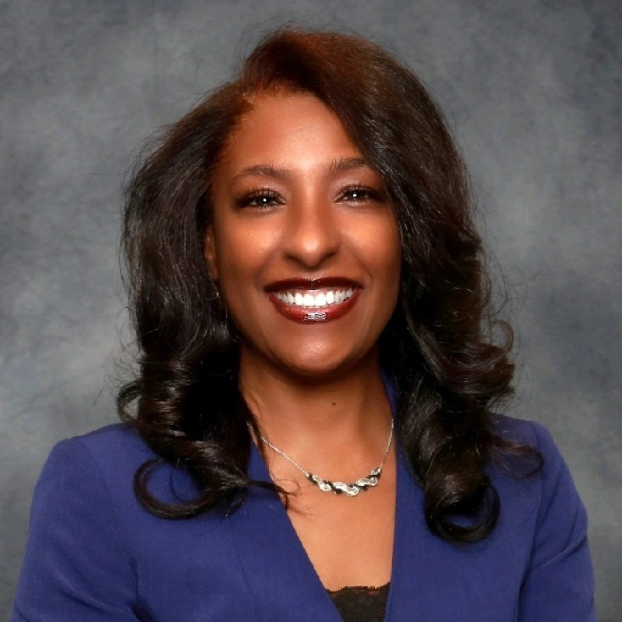

Welcome
ACCA Board Members
& Visitors!
Presiding
ACCA Board of Directors Chair
Dr. Sonya McCoy-Wilson,
Associate Vice President of Learning
Atlanta Technical College

Slide 4
Public Comment
Thank you for joining us!
Interested in addressing the board today? Please sign up at the entry table and you will have the opportunity to address the board at the end of today’s meeting. Each participant will be given two minutes to address the board during Public Comment.

Slide 5




Virtual Meeting Norms
Mics on Mute
Actively Engage
Cameras On
Non-ACCA Board Members:
Thank you for taking time out of your schedules to support the great work happening at ACCA. We appreciate you!

Slide 7
Roll Call
Role | Name (or Vacant) | Present or Absent
Parent/Guardian | Chizelle Archie
Business | Sharyl Chatman
Business | William Smith
Business | Yolanda Wimberly
Business | Jon Lewis
Business | Patricia Horton
Metro RESA | Tim Cairl
Secondary | Dwionne Freeman
Secondary | Shelly Goodrum
Post-Secondary Representative | Sonya McCoy-Wilson
Post-Secondary Representative | Niya Eady
Ex-Officio | Katie Howard
Ex-Officio | Tasharah Wilson
Student | Wesley Gilliard, Jr.
Student | Rajaa Judah

Slide 9
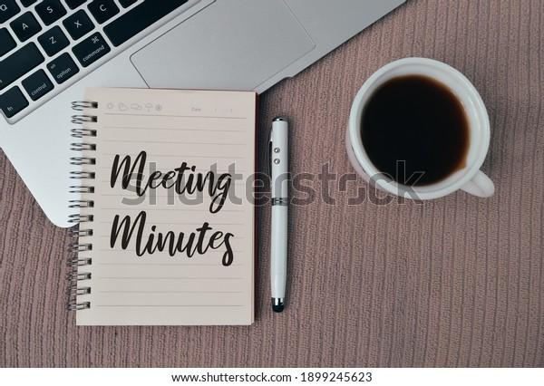
Meeting Minutes
09/26/2024

Slide 10
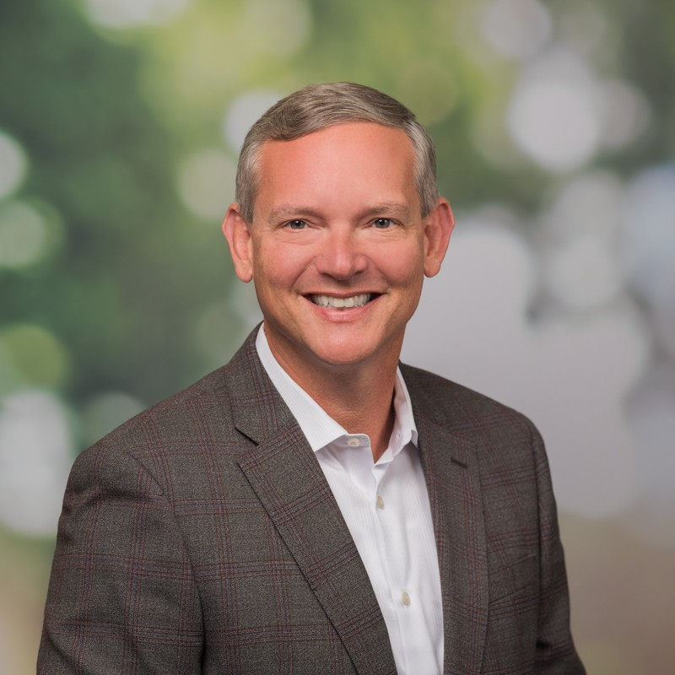
Board Training
Presenter:
Paul Sabin
Program Manager
Technical College System of Georgia

Slide 11

Announcements
Our next meeting will take place on Thursday, January 30.
This meeting is our Internal Review (Certification Renewal).
This meeting is in-person from 10 a.m. – 12 p.m. The ACCA Board of Directors must be present.
Location: ACCA, 1090 Windsor Street SW

Slide 12
Public Comment
The Public Comment period is designed to gain input from the public and not for immediate responses by the Board to the public comment presented.
Each member of the public will have 2 minutes to speak.
At the end of 20 minutes, we will close public comment and move on to the next agenda item.
If there are questions or information that you have for the Board, you may contact one or more Board members after this meeting. You can find Board member contact information, meeting dates and agendas on ACCA’s website https://www.atlantapublicschools.us/domain/10250

Slide 13

Thank you!

