Slide 1
Board of Directors Meeting
Good evening, everyone!
Thank you for joining us. We will begin shortly.
October 3, 2024
4 P.M.

Slide 2

Welcome Board Members & Visitors!

Slide 3



Virtual Meeting Norms
Mics on Mute
Actively Engage
Cameras On

Slide 4

Time for introductions!
Role | Name (or Vacant)
Parent/Guardian | Vacant
Business | Sharyl Chatman
Business | William Smith
Business | Yolanda Wimberly
Business | Jon Lewis
Business | Patricia Horton
Metro Atlanta Chamber | Tim Cairl
Secondary | Dwionne Freeman
Secondary | Shelly Goodrum
Post-Secondary Representative | Sonya McCoy-Wilson
Post-Secondary Representative | Niya Eady
Ex-Officio | Katie Howard
Ex-Officio | Tasharah Wilson
Student | Vacant
Student | Vacant
Please share your
Name
Company/Organization
Role within the company/organization

Slide 5
Atlanta College and Career Academy
Date: October 3, 2024
Time: 4 p.m.
Location: 1090 Windsor Street S.W.
Call to Order
Roll Call; Establish Quorum
Action Items
  Approval of Agenda
  Fill Vacant Seats
  Appoint Student Representatives
  Approval of Previous Minutes
  Election of Officers
    Chair
    Vice-Chair
    Secretary
  Review and Approve Public Comment Format
  Review, Confirm/Update, and Adopt GO Team Meeting Norms
  Approval of Board Meeting Calendar
Information Items
  Principal’s Report
Announcements
  Dr. Johnson’s 100 Day Plan – be sure to take the survey! www.atlantapublicschools.us/100dayplan
  2024 GO Team G3 Summit – Postponed – more info coming soon!
  New GO Team Member Training and Orientation
Adjournment

Slide 6
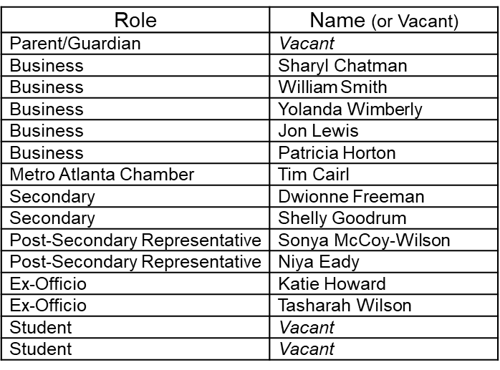
II. Roll Call, Establishment of Quorum

Slide 7
Atlanta College and Career Academy
Date: October 3, 2024
Time: 4 p.m.
Location: 1090 Windsor Street S.W.
Call to Order
Roll Call; Establish Quorum
Action Items
  Approval of Agenda
  Fill Vacant Seats
  Appoint Student Representatives
  Approval of Previous Minutes
  Election of Officers
    Chair
    Vice-Chair
    Secretary
  Review and Approve Public Comment Format
  Review, Confirm/Update, and Adopt GO Team Meeting Norms
  Approval of Board Meeting Calendar
Information Items
  Principal’s Report
Announcements
  Dr. Johnson’s 100 Day Plan – be sure to take the survey! www.atlantapublicschools.us/100dayplan
  2024 GO Team G3 Summit – Postponed – more info coming soon!
  New GO Team Member Training and Orientation
Adjournment

Slide 8
Fill Vacant Seats
The Principal brings forth the nominations for open parent seats
All board members have only one (1) vote per seat.
Individuals filling a vacant seat will serve until the conclusion of that seat’s term.
Upon approval, individuals are immediately full board members and may join the meeting.

Slide 9
Nomination
Seat | Name | Pathway student participates in
Parent | Chizelle Archie | Cybersecurity

Slide 10
Student Representatives
Seat | Name | Pathway | Grade | Home School
Student | Wesley Gilliard | Early College Essentials TCC | 12 | BEST Academy
Student | Rajaa Judah | Patient Care Pathway | 12 | KIPP

Slide 11

Meeting Minutes
05/16/2024

Slide 12
Election of Officers
ACCA HANDBOOK
REMINDERS
Section 4.1. Titles. ACCA Board of Directors will have a Chair, Vice-Chair and Secretary.
    Nominations do not have to be seconded.
    A member may nominate themselves.
    A member may nominate more than one person for any position.
    A member may decline a nomination during the nomination process.
    (high schools) Students may fill any officer position.
    Members may not serve more than two (2) consecutive terms (i.e.- 2 years) in the same officer position at the same school.
    Nominees do not have to leave the room during the nomination period or when a vote is taken.
    If there is more than one nominee per elected office, each nominee will be offered an opportunity to share why they should be elected to the seat.
    The newly elected officers will assume their position starting at the conclusion of this meeting and serve for one (1) year or until a new officer is elected.
    All voting members have only one vote per seat.

Slide 13
Election of Chair

Slide 14
Election of Vice-Chair

Slide 15
Election of Secretary

Slide 16
Public Comment Format
“For those of you wishing to provide comment, there is time allotted on the agenda for the final twenty minutes of the meeting. The sign-up sheet is by the door. Each member of the public will have 2 minutes to speak at which time we will ask you to have a seat to allow others to speak. The Public Comment period is designed to gain input from the public and not for immediate responses by the GO Team to the public comment presented. At the end of the 20 minutes we will close public comment and move on to the next agenda item. If there are questions or information that you have for the GO Team, you may also contact one or more of the GO Team members after this meeting. You can find GO Team member contact information and meeting dates and agendas on the GO Team page of the school’s website.”

Slide 17
Review, Confirm/Update Norms
This is a meeting of the GO Team. Only members of the team may participate in the discussion. Any members of the public present are here to quietly observe.
We will be fully present.
We will follow the agenda as noticed to the public and stay on task.
We will be respectful of each other at all times.
We will be open-minded.
We invite and welcome contributions of every member and listen to each other.
We will respect all ideas and assume good intentions.
We will approach differences of opinion with curiosity.

Slide 18
Recommended Meeting Dates
09/26/2024 4 p.m. Organizational Meeting
10/30/2024 4 p.m. Board Training
01/30/2025 10 a.m.-12 p.m. Internal Review (Certification Renewal) **In-Person**
02/13/2025 4 p.m. Budget Meeting
02/27/2025 4 p.m. Budget Meeting
03/06/2025 4 p.m. Budget Approval Meeting
03/13/2025 Pending External Review (Certification Renewal) **In-Person**

Slide 19

Principal’s Report

Slide 20
Celebrating Student Success

Slide 21
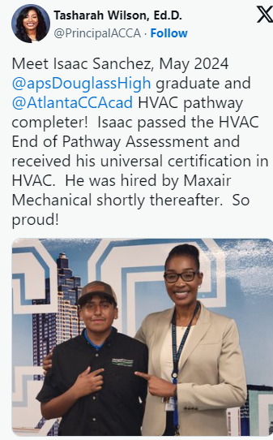
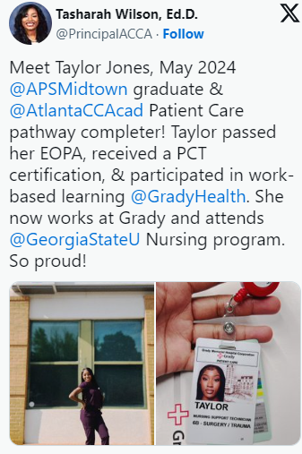

Slide 22
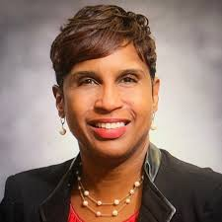
A Special Shout Out to Dr. Wimberly…
For providing Patient Care students with work-based learning opportunities at Grady.
AND
For providing a co-teacher for the Patient Care pathway throughout the year.

Slide 23
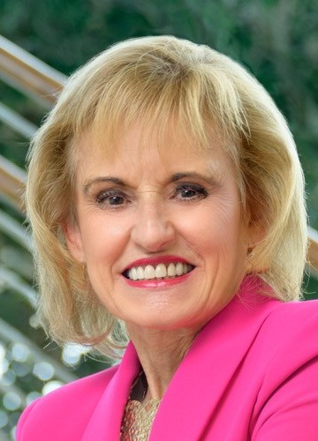
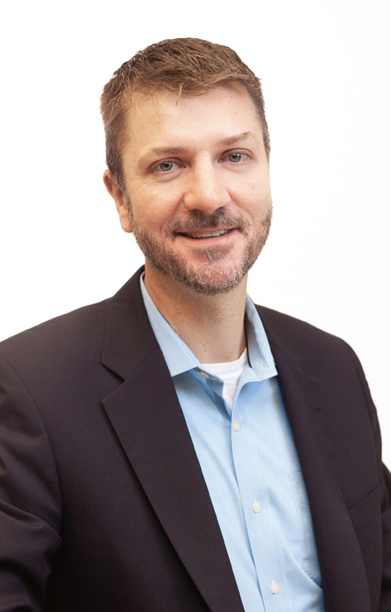
A Special Thank You to Tim Cairl and Patricia Horton for attending the Governor’s Workforce Summit

Slide 24
Annual Partnership Luncheon Highlights – September 24th
50+ participants
Dr. Wilson shared ways to engage with ACCA
We look forward to working with these partners to provide wonderful opportunities for our students

Slide 25
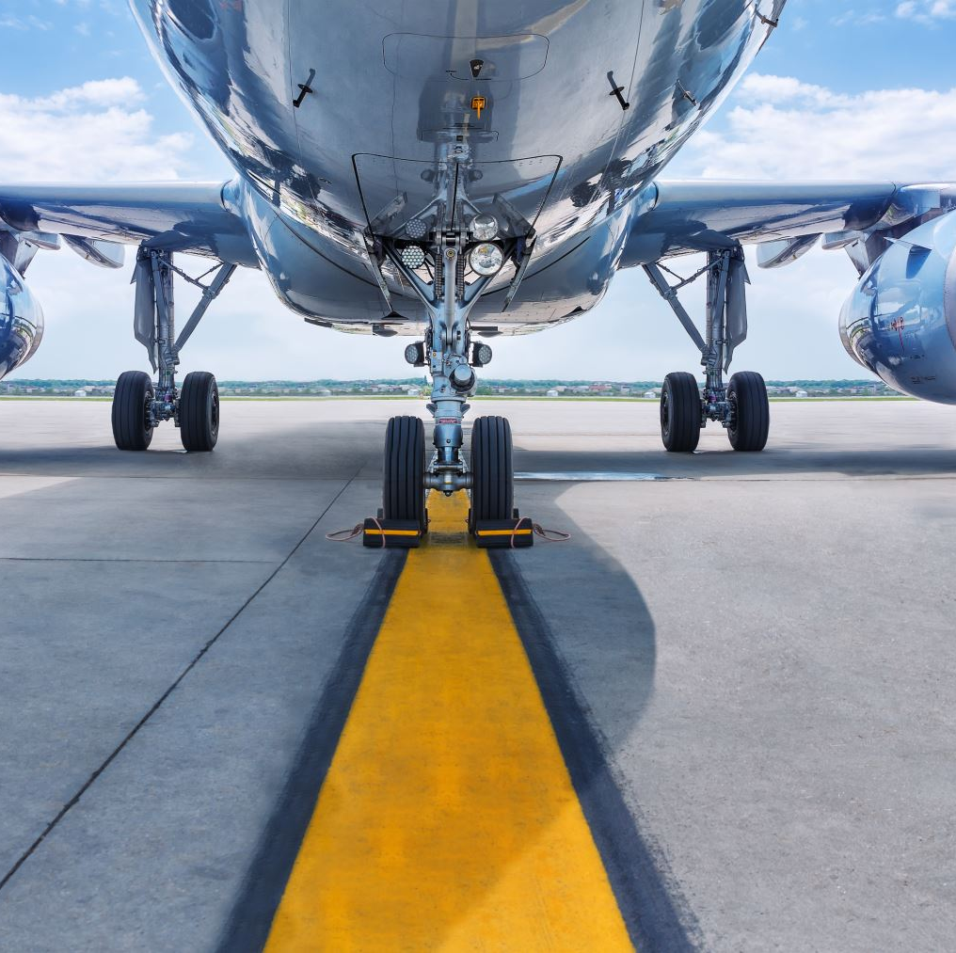
Aviation Maintenance Updates
We have 18 students currently enrolled in the Aviation Dual Enrollment courses on the campus of Atlanta Technical College
Next year – Aviation will move to the campus of Atlanta Technical College as an afternoon pathway option for students

Slide 26
Work-Based Learning at ACCA
We need your help finding WBL placements 4th quarter
March 18, 2025 – May 16, 2025
Pathways needing WBL Opportunities
Criminal Investigations
Culinary Arts
Dental Science
Graphic Design
Hospitality
HVAC-R

Slide 27
ACCA Certification Reminders
Internal Review **in-person** @ ACCA, 1/30, 10 - 12pm
External Review Visit **in-person** @ ACCA, March 13th

Slide 28
Conflict of Interest Policy
You received an email (from Dr. Wilson) to review and sign the Georgia College and Career Academy Conflict of Interest Policy
Please submit this documentation before the end of today’s meeting

Slide 29
ACCA Data Update

Slide 30
Enrollment
FY2024 and FY2025

Slide 31
Pathway Completion
Rates
FY 2024
Pathways | Percentage of Completers
Patient Care | 100% Completers
Cybersecurity | 100% Completers
Culinary Arts | 100% Completers
Criminal Investigations | 100% Completers
Dental Science | 100% Completers
Automotive | 100% Completers
Infant/Toddler Childcare | 100% Completers
Programming | 100% Completers
Graphic Design | 100% Completers
HVAC – Refrigeration | 100% Completers
Teaching as a Profession | 100% Completers
Hospitality, Recreation, Tourism | 100% Completers
*Completion rate reflect only those who attended the full school year.

Slide 32
GA Best Diploma Seals
A total of 143 graduating seniors received a GA Best Diploma seal for the 23-24 school year.
  *Underclassmen will receive their diploma seal upon their graduation year.

Slide 33

Thank you for your attention.

Slide 34
Moving Forward
Dr. Tasharah Wilson

Slide 35
As we prepare for strategic planning, what would you like to see us accomplish in
One Year?
Five Years?
Ten Years?

Slide 36

Announcements
Dr. Bryan Johnson has posted his 100 Day Plan. His plan includes community engagement sessions and a Learn to Listen Survey. All stakeholders are invited to participate in the survey and events. Visit www.atlantapublicschools.us/100dayplan to find out more.
The GO Team Office would like to remind all GO Team members that they must complete their orientation training in order for our school’s board to be in compliance. Please contact them if you have any questions.

Slide 37
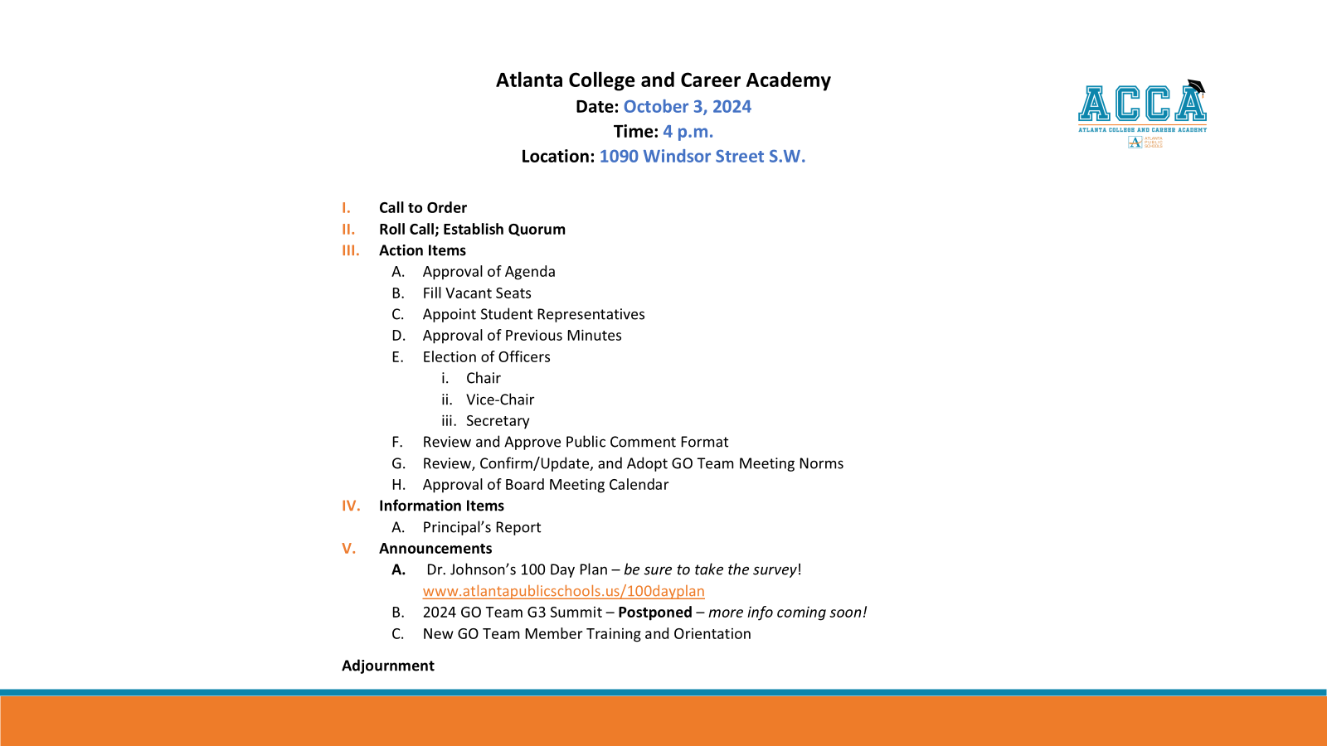

Slide 38

Thank you!

