Slide 1
Board of Directors Meeting
Good evening, everyone!
Thank you for joining us. We will begin shortly.
October 2, 2025
4 P.M.

Slide 2
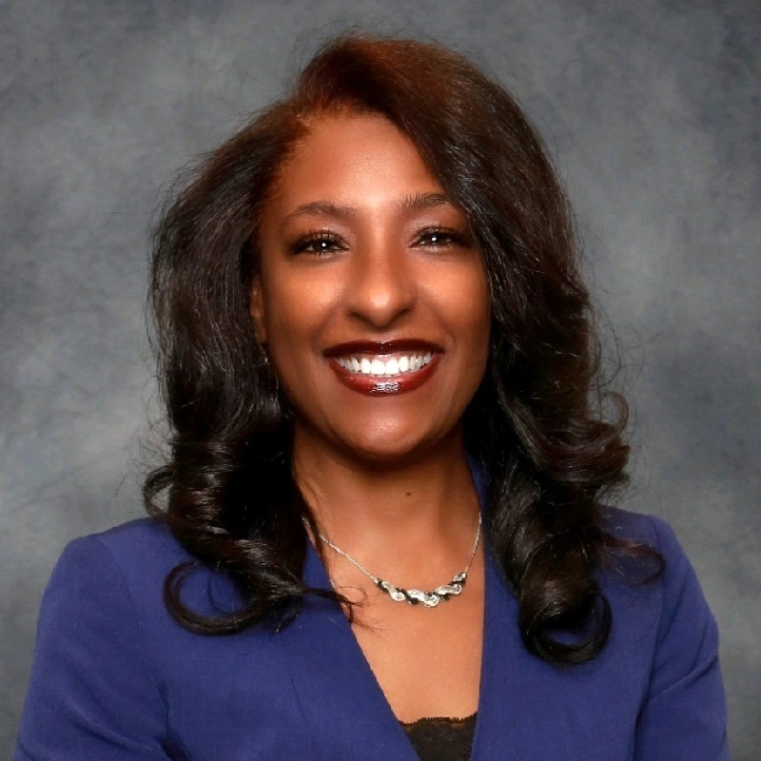

Welcome
ACCA Board Members
& Visitors!
Presiding
ACCA Board of Directors Chair
Dr. Sonya McCoy-Wilson,
Associate Vice President of Learning
Atlanta Technical College

Slide 3



Virtual Meeting Norms
Mics on Mute
Actively Engage
Cameras On

Slide 4
Atlanta College and Career Academy
Date: October 2, 2025
Time: 4:00 p.m. – 5:00 p.m.
Location: 1090 Windsor Street S.W.
Public Viewing Link: http://www.youtube.com/@accainformation830
Call to Order
Roll Call; Establish Quorum
Action Items
  Approval of Agenda
  Approval of Previous Minutes
Discussion Items
  Strategic Plan
Announcements
Public Comment
Adjournment

Slide 5
II. Roll Call, Establishment of Quorum

Slide 6
Atlanta College and Career Academy
Date: October 2, 2025
Time: 4:00 p.m. – 5:00 p.m.
Location: 1090 Windsor Street S.W.
Public Viewing Link: http://www.youtube.com/@accainformation830
Call to Order
Roll Call; Establish Quorum
Action Items
  Approval of Agenda
  Approval of Previous Minutes
Discussion Items
  Strategic Plan
Announcements
Public Comment
Adjournment

Slide 7

Meeting Minutes
09/04/2025

Slide 8



Discussion Items
Notes:
We will now move to the Discussion Items on our agenda.

Slide 9
ACCA
Strategic Planning
FY 2025-2030

Slide 10
It is time to review and revise the strategic plan
Today we will briefly review the APS Strategic Plan and the Georgia College and Career Academy Certification Goals

Slide 11
APS Strategic Plan

Slide 12


We are Atlanta’s Public School System
To educate and empower Atlanta’s students to shape the future

Slide 13


A COMMUNITY OF BELIEVERS GETTING BACK TO BASICS
APS Focus Areas
Our Strength is Our Team
Atlanta’s students will have effective and engaged teachers, leaders, and staff.
Increase concentration of highly-effective teachers and leaders
Prioritize engagement and retention for staff
Grow and promote strong teachers, leaders, and staff
Our Responsibility Is Shared
Atlanta’s students will have supportive families, communities, and partners.
Build meaningful partnerships
Expand Atlanta Partners for Education (APFE) impact
Increase access and engagement for families and communities
Our System Is Efficient & Effective
Atlanta’s students will have the schools and resources they need to succeed.
Maximize facility usage for the student and community good
Leverage data to drive strategic financial investments
Implement sustainability initiatives
We Are Strengthening Our Instructional Core
Atlanta’s students will have high-quality instruction, materials, and targeted support.
Implement high-quality, relevant, and engaging instructional materials and professional learning in all core content areas
Target resources towards subgroups (eg. exceptional education, English learners, economically-disadvantaged)
Accelerate early learning
We Are Caring For Every Child
Atlanta’s students will have trusted, supportive adults meeting their unique needs.
Expand strategies that reduce chronic absenteeism and disproportionate discipline
Implement systematic culture and climate strategies
Increase student access to trusted and reliable adults (eg. mentors, coaches, counselors)
We Are Sparking Student Curiosity
Atlanta’s students will have access to explore and expand their passions and interests.
Promote robust arts, athletics, world language, and enrichment offerings
Expand access to high-interest and workforce-ready offerings (e.g. career programs and pathways, advanced coursework)
Explore specialized and innovative school models (eg. School of the Arts)

Slide 14
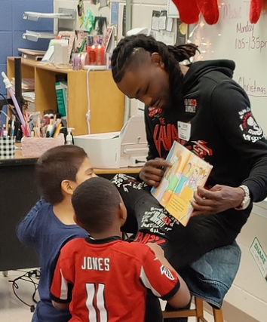
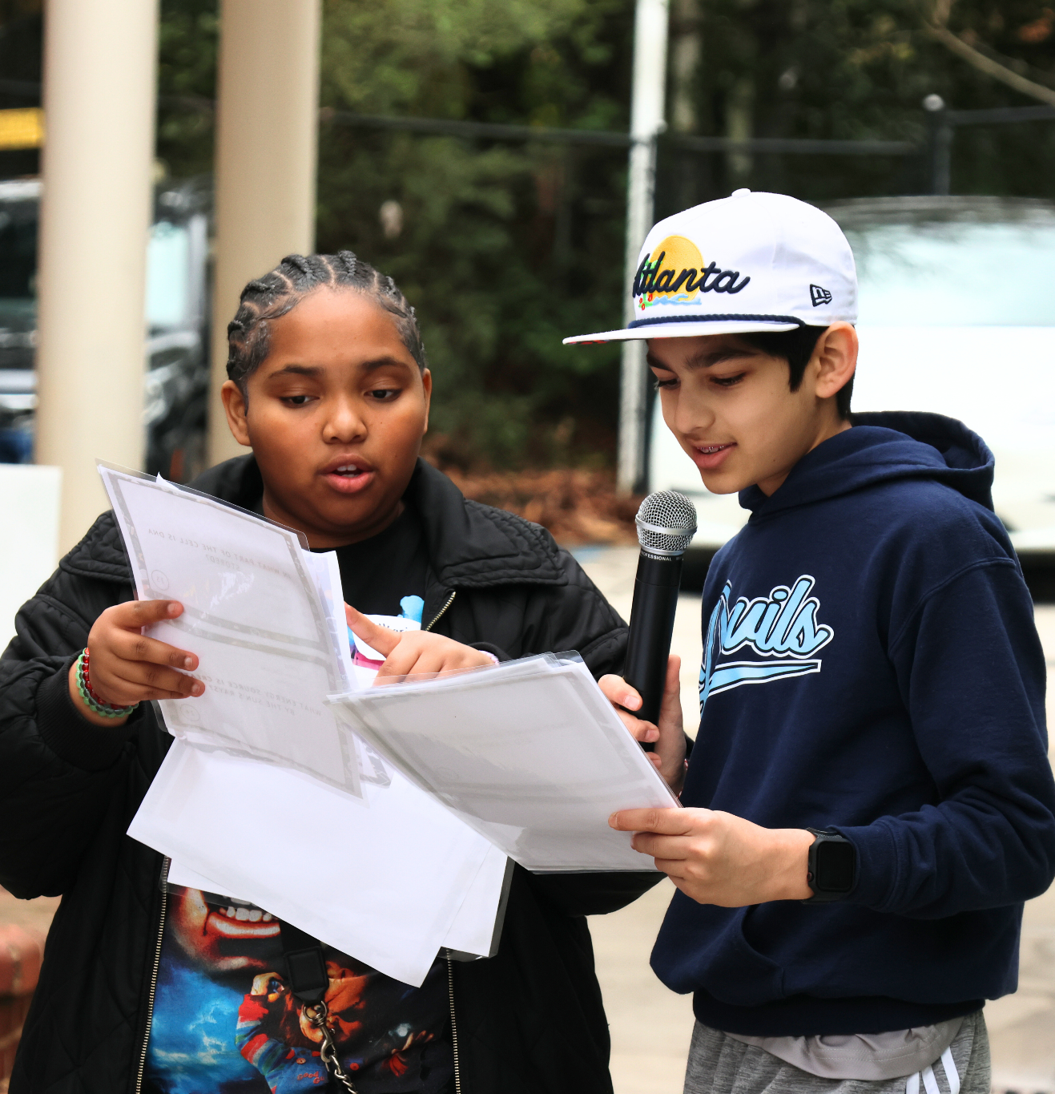

Goals and Key Performance Indicators
Focus Area:
We Are Caring For Every Child
1
By 2030, we will increase the percentage of 3rd grade students scoring proficient or above in ELA (GA Milestones) by 20 percentage points.
Actual (2025)
Light pink: 2024
Target (2030)
68.8% | Absenteeism % of students who are not chronically absent* | 80%
60% | Sense of Belonging % students who feel a sense of belonging* | 75%
89.6% | Discipline: All Students % of all students without suspensions (OSS) * | 95%
83.5% | Discipline: Students with Disabilities % of Students with Disabilities students without suspensions (OSS)* | 95%
86.4% | Discipline: Black Students % of Black students without suspensions (OSS)* | 95%
56% | Student-Staff Relationships % of students feeling comfortable going to most or all of the adults in the school for help* | 75%
0% | Student Success Plans % of students with individual success plans | 90%
19% | School Climate % of schools with 4 or 5 star climate rating* | 50%
2
By 2030, we will increase the percentage of 8th grade students scoring proficient or above in Math (GA Milestones) by 20 percentage points.
3
By 2030, we will increase the percentage of students meeting at least one CCRPI College and Career Readiness Indicator by 20 percentage points.
* Includes Charter and Partner Schools

Slide 15
ACCA Directly Aligns to APS Strategic Goal #3
APS Strategic Goal #3
College and Career Readiness: By 2030, APS will increase the percentage of students meeting at least one CCRPI College and Career Readiness Indicator by 20 percentage points.
Every APS student will graduate enrolled, enlisted, employed, or as an entrepreneur.

Slide 16
Georgia College and Career Academy Network Certification Standards

Slide 17
GCCAN Standards
Standard 1 – Governance and Leadership
Standard 2 – Strategic Planning and Sustainability
Standard 3 – Teaching and Assessing for Learning
Standard 4 – Economic and Workforce Development
Standard 5 – Performance Contract
Based on the feedback from the March 2025 GCCAN certification visit, the ACCA Leadership Team decided to focus on the highlighted standards when developing the draft of our strategic plan.

Slide 18
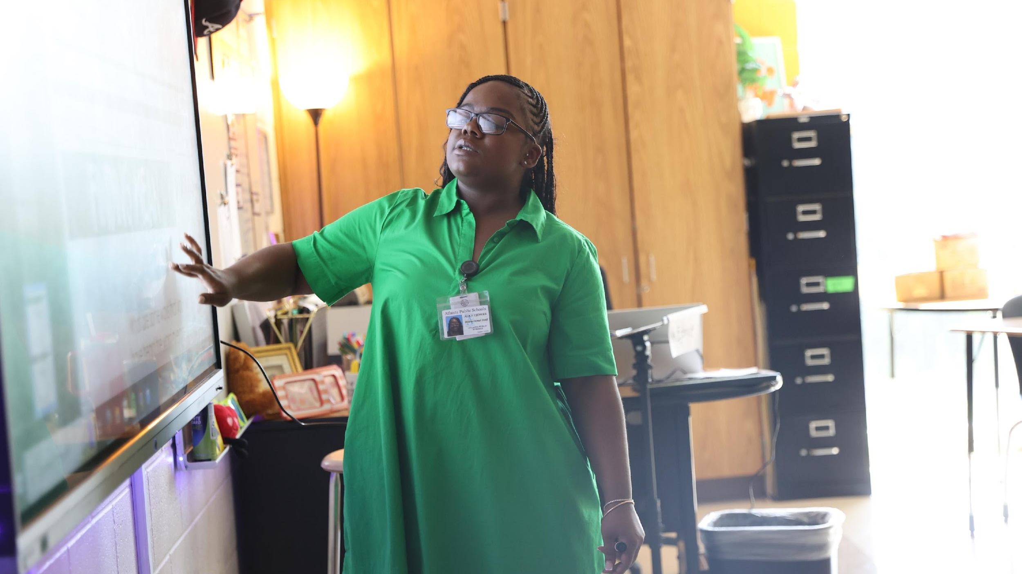

ACCA Strategic Plan Development
One District. One Goal. Every Child.

Slide 19
Mission
What is our purpose?
What do we do?
We are educating and empowering Atlanta’s students to shape the future.
Vision
What is our picture of the future?
Literacy
Numeracy
College & Career Readiness
Strategic Goals
What results do we want to satisfy our stakeholder needs?
Focus Areas
What are the main focus areas (“Pillars of Excellence”) of our work?
We are Caring for Every Child (example)
Objectives
What continuous improvement activities are needed to get results?
Expand strategies that reduce chronic absenteeism (example)
Governance
Key Performance Indicators
How will we evaluate performance to know if we are achieving the results we want?
% of students who are not chronically absent (example)
Strategies
What high-leverage strategies will lead to the desired results?
Implement Multi-Tiered Systems of Support (MTSS) (example)
Actions
Who will do what by when?
Monthly, provide consistent communication with all families on the importance of attendance and supports available (example)
Management

Slide 20
Draft
ACCA Strategic Plan
The ACCA Leadership Team used the GCCAN Certification Feedback, APS Strategic Plan and the Georgia College and Career Academy Standards to create the first draft of the strategic plan.
*** Our SMART Goals are the goals set for all academies by GCCAN

Slide 21
Strategic Planning and Sustainability GCCAN Goal
By August 2030, ACCA will maintain and communicate a purpose and direction that fully utilizes flexibility to support a commitment to high expectations for learning as well as shared values and beliefs about teaching and learning
APS Focus Area – Our System is Efficient and Effective
Strategies | Annual Performance Measures
Adopt and implement a marketing plan that includes collaboration with stakeholders Ensure the ACCA staff including the CEO and Board Members actively participate in the Georgia College and Career Academy Network | The annual review of the marketing plan will include an evaluation of key components such as social media engagement, website content, printed promotional materials, campus tour effectiveness, recruitment event outcomes, and application completion rates Track and monitor annual participation of ACCA staff in activities Ensure all training aligns with the needs of the team

Slide 22
Teaching and Assessing for Learning GCCAN Goal
By August 2030, ACCA will ensure the curriculum, instructional design, and assessment practices fully utilize flexibility to support and ensure teacher effectiveness and student learning.
APS Focus Area – Our Strength is Our Team and We are Strengthening Our Instructional Core
Strategies | Annual Performance Measures
Establish a culture that promotes the success of students in the work force, including soft skills, employability skills, and financial literacy. Use data to identify student learning needs and academic growth Promote student participation in career and technical student organizations (CTSOs) and other organizations Ensure professional growth opportunities are targeted to ACCA’s needs | Track and report the number of students completing GA Best (employability skills) and 21st Century Leaders (financial literacy) Analyze student data during biweekly planning meetings and weekly Whole Child Intervention meetings to provide targeted support for students Establish Skills USA CTSO to enhance student learning through real-world experiences and competitions Conduct a thorough needs assessment using surveys, observations, and data to determine the professional learning needs of the staff

Slide 23
Economic and Workforce Development GCCAN Goal
By August 2030, ACCA will ensure that career pathways, dual enrollment, and postsecondary certifications fully utilize flexibility to support an alignment to the economic and workforce needs of the community.
APS Focus Area – Our Responsibility is Shared, We are Caring for Every Child and We are Sparking Student Curiosity
Strategies | Annual Performance Measures
Collaborate with employers to develop and promote work-based learning opportunities for students, ACCA faculty and staff Ensure staff remains current in its ability to meet workforce development needs through high-quality professional development and externships Utilize data collected from business partners to ensure appropriate program offerings and employability skills are embedded in the curriculum | Annual review of the number and quality of work-based learning opportunities developed through employer collaboration. This includes student internships, faculty externships, job shadowing programs, and employer-led workshops Ensure ACCA staff participate in yearly externship opportunities Collaborate with ACCA Board members and the Metro Chamber to ensure all pathways are in-demand for the metro-Atlanta area.

Slide 24
We need your help…

Slide 25
Next Steps to Finalizing the ACCA Strategic Plan
We request board members review the proposed strategies and performance measures to identify any additional tasks or activities that may enhance the effectiveness of the ACCA Strategic Plan.
Timeline
Submit all feedback to Dr. Wilson by October 17, 2025
ACCA Leadership Team will include submitted feedback in the updated plan
The updated plan will be sent to all board members on October 24th for final review
ACCA Board will vote to approve the strategic plan during the November 6th meeting

Slide 26

Thank you

Slide 27
Update:
Engineering Technology
Presenter: Dr. Kenya Gilliard, ACCA Counselor
Notes:
We will now move to the Discussion Items on our agenda.

Slide 28

Floyd County College and Career Academy
School of Robotics and Engineering
The VEX Robotics' platform is dedicated to providing engaging student experiences that enable individuals to develop the knowledge and skills vital to success in the engineering and manufacturing industries.
The program is designed to prepare students to enter a four-year college, technical college or go directly into the local workforce.
In conjunction with Georgia Northwestern Technical College (GNTC), students in the program will have the opportunity to graduate with two different certificates from GNTC:
  Basic Mechatronics Specialist certificate, and
  Programmable Control Technician certificate.
The classes taught include Pneumatics & Hydraulics, PLC and Automation Programming, 3D Design using Sketchup and OnShape, Programming Industrial Motoman Robots, and Wiring Schematics with Hands-On Applications.

Slide 29
Floyd County College and Career Academy
School of Robotics and Engineering
Admissions Criteria
Grade 11th – 12th
High School GPA of 2.0 or higher (No prerequisite courses)
Students will complete 1 or 2 Technical Certificates of Credit (TCC) in one year and earn four+ high school credits
  MS41 Basic Mechatronics Specialist Certificate
  PC81 Programmable Control Tech I
Students must commit to remaining in the program from August – May
Credits will be awarded in alliance with Dual Enrollment Guidelines and Grading Policies
SST/504/Special Education (IEP) – If yes, team must meet to confirm eligibility to participate, and the student must contact ATC’s Disability Office for support.

Slide 30

QUESTIONS?

Slide 31

Announcements

Slide 32
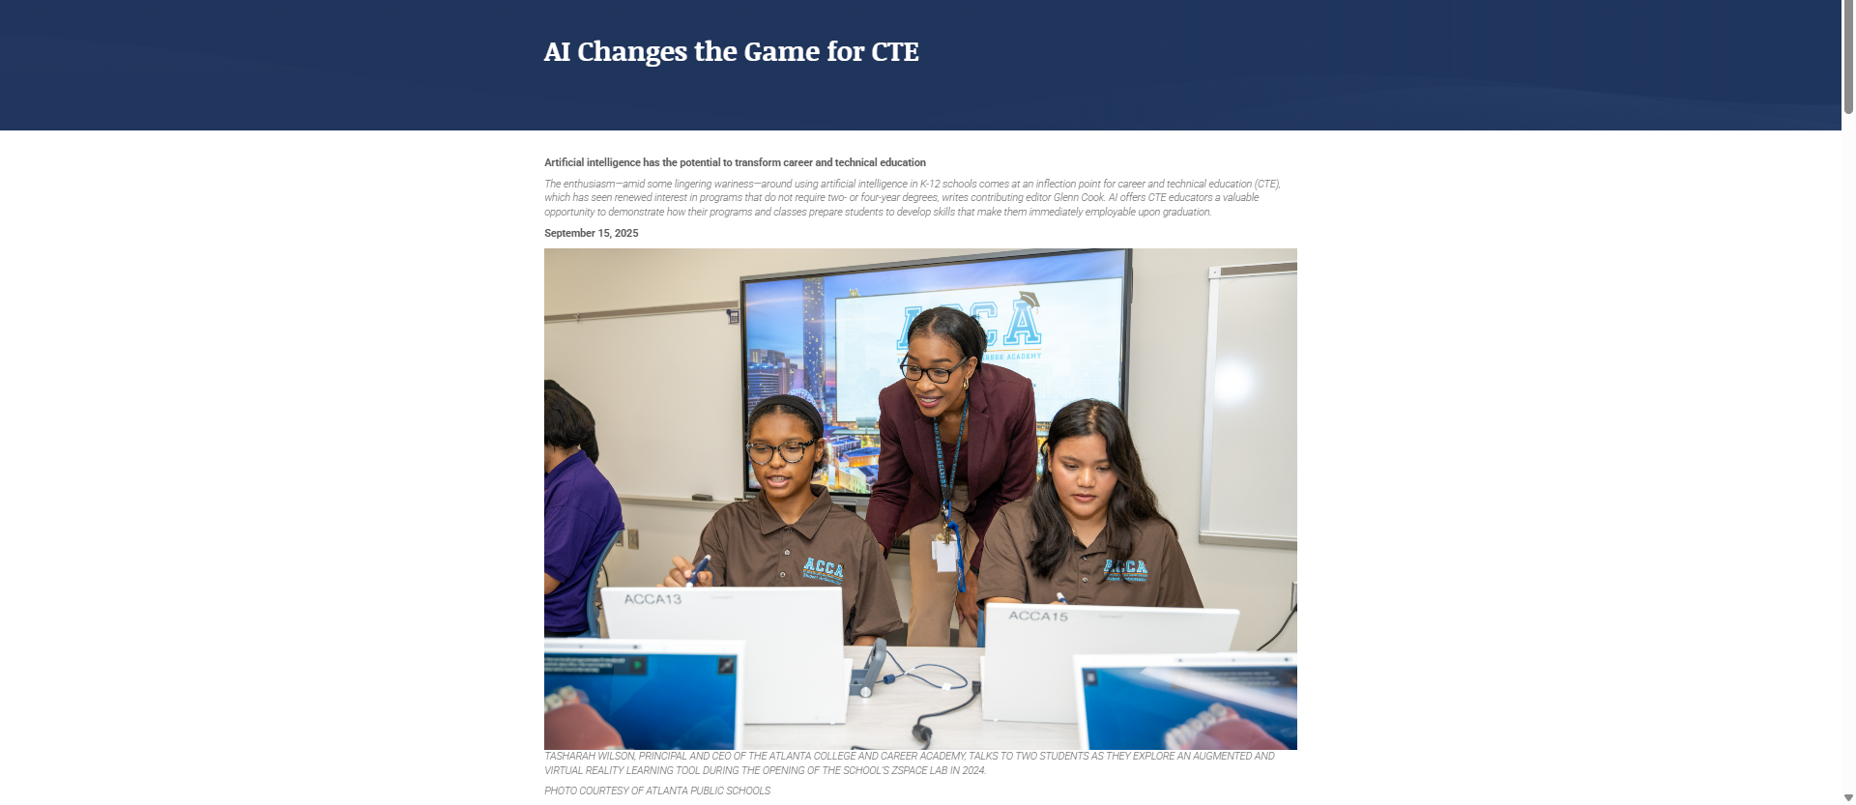
ACCA featured in NSBA article
https://www.nsba.org/resources/asbj/asbj-october-2025/october-2025-ai-changes-the-game-for-cte

Slide 33
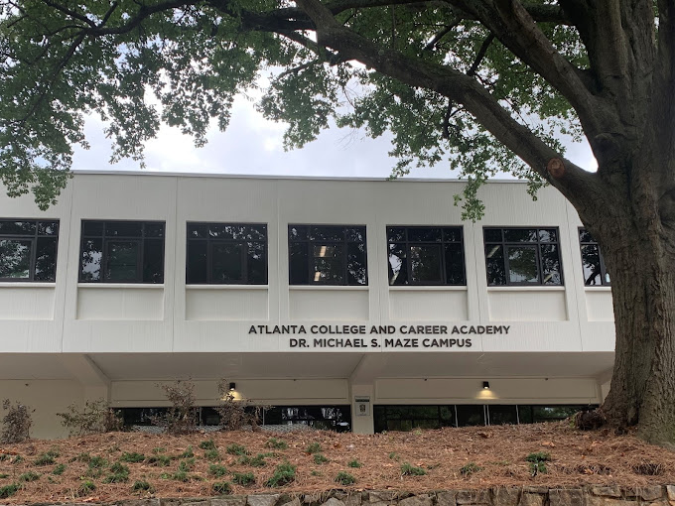

Recruitment Event
Thursday, October 23rd
4 p.m. – 6 p.m.
All students, parents, and community stakeholders are welcome!
Notes:
If you would like to learn more about ACCA, all are welcome to join us for our Fall Recruitment Event scheduled for Thursday, October 23rd. All of our teachers will be here along with industry partners so that you can learn detailed information about specific pathways offered.

Slide 34
Atlanta College and Career Academy
Date: October 2, 2025
Time: 4:00 p.m. – 5:00 p.m.
Location: 1090 Windsor Street S.W.
Public Viewing Link: http://www.youtube.com/@accainformation830
Call to Order
Roll Call; Establish Quorum
Action Items
  Approval of Agenda
  Approval of Previous Minutes
Discussion Items
  Strategic Plan
Announcements
Public Comment
Adjournment

Slide 35

Thank you!

