Slide 1
Board of Directors Meeting
Good evening, everyone!
Thank you for joining us. We will begin shortly.
SEPTEMBER 6, 2023
4 P.M.

Slide 2
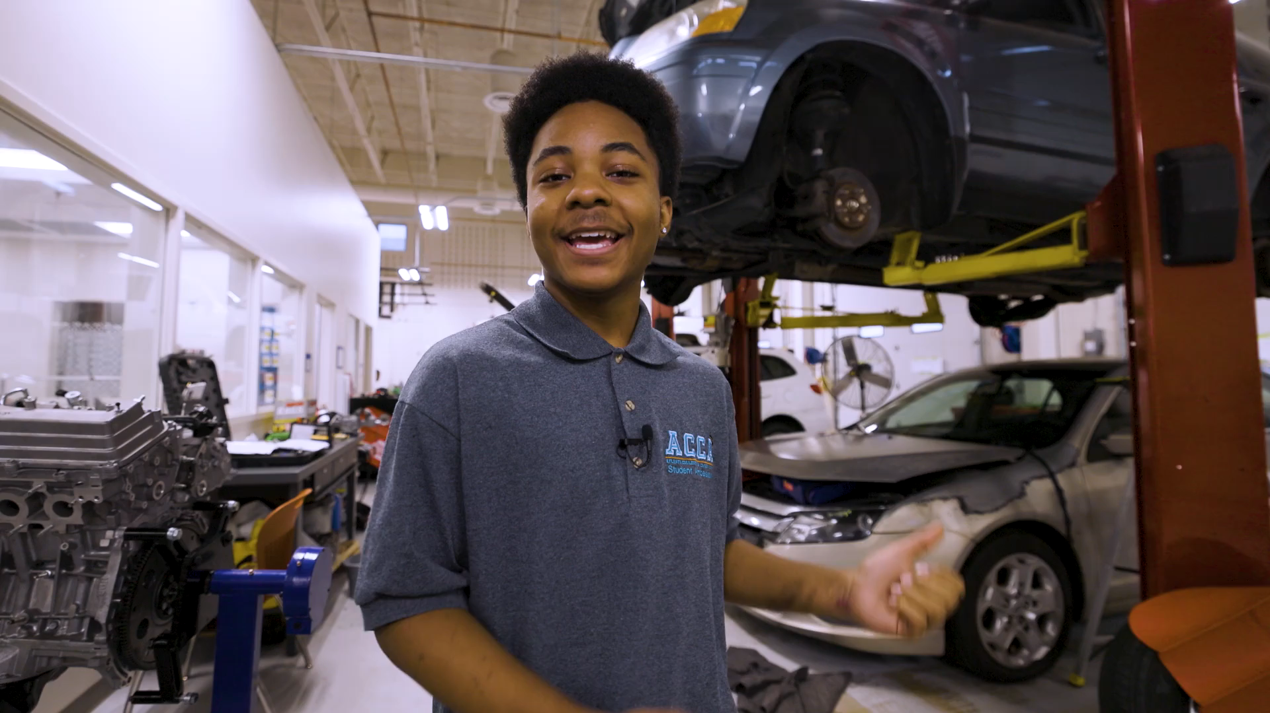

Slide 3

Welcome Board Members & Visitors!

Slide 4




Virtual Meeting Norms
Mics on Mute
Actively Engage
Cameras On
Non-ACCA Board Members:
Thank you for taking time out of your schedules to support the great work happening at ACCA. We appreciate you!

Slide 5

Time for introductions!
Role | Name
Parent/Guardian | Vacant
Business | Vacant
Business | William Smith | Delta Airlines
Business | Vacant
Business | Vacant
Business | Patricia Horton | Georgia Center for Nursing Excellence
Metro RESA | Tim Cairl | Metro Atlanta Chamber of Commerce
Secondary | Dwionne Freeman | APS - CTAE
Secondary | Vacant | APS
Post-Secondary Representative | Vacant | Atlanta Technical College
Post-Secondary Representative | Niya Eady | Atlanta Technical College
Ex-Officio | Eshe’ Collins | APS - Board of Education
Ex-Officio | Tasharah Wilson | APS - ACCA CEO/Principal
Student | Vacant
Student | Vacant

Slide 6
Atlanta College and Career Academy
Date: September 6, 2023
Time: 4 p.m.
Location: 1090 Windsor Street S.W.
Call to Order
Roll Call; Establish Quorum
Action Items
  Approval of Agenda
  Fill Vacant Seats
  Appoint Student Representatives
  Approval of Previous Minutes
  Election of Officers
    Chair
    Vice-Chair
    Secretary
  Review and Approve Public Comment Format
  Review, Confirm/Update, and Adopt GO Team Meeting Norms
Information Items
  Principal’s Report
  Aviation Maintenance Pathway
Announcements
  New GO Team Member Training and Orientation
  5th Annual G3 Summit
  Governor’s Workforce Summit - College and Career Academy Day
Adjournment

Slide 7
Fill Vacant Seats
The Principal brings forth the nominations for open parent seats
All GO Team members have only one (1) vote per seat.
Individuals filling a vacant seat will serve until the conclusion of that seat’s term.
Upon approval, individuals are immediately full GO Team members and may join the meeting.

Slide 8
Nomination
Seat | Name | Pathway son participates in
Parent | Alexandria Robinson | Culinary Arts/Work-Based Learning
Seat | Name | Company | Title
Business | Dr. Patricia Horton | Georgia Center for Nursing Excellence | Chief Executive Officer
Seat | Name | Company | Title
Business | Dr. Yolanda Wimberly | Grady Health System | Senior Vice President and Chief Health Equity Officer
Seat | Name | Company | Title
Post-Secondary Education | Dr. Dr. Sonya McCoy-Wilson | Atlanta Technical College | Associate Vice President of Learning

Slide 9
Student Representatives
Seat | Name | Pathway | Grade | Home School
Student | Wesley Gilliard | Early College Essentials TCC | 11 | BEST Academy
Student | Kyla Moore | Early College Essentials TCC | 12 | Mays High School

Slide 10

Meeting Minutes
05/22/2023

Slide 11
Election of Officers
ACCA HANDBOOK
REMINDERS
Section 4.1. Titles. ACCA Board of Directors will have a Chair, Vice-Chair and Secretary.
Section 4.2. Election and Term of Office. Each officer will be elected from among the voting members at the first meeting of each new fiscal year for APS. Non-voting members (students) may not serve in any officer position. Each officer will serve for a term of one year, and may be eligible for one additional term of one year in the same office. Each officer will serve until a successor is elected and qualified, or until said officer resigns or is removed from office. No officer may hold more than one position at the same time. Only one ACCA Board member may occupy an officer position at any time.
    Nominations do not have to be seconded.
    A member may nominate themselves.
    A member may nominate more than one person for any position.
    A member may decline a nomination during the nomination process.
    (high schools) Students may fill any officer position.
    Members may not serve more than two (2) consecutive terms (i.e.- 2 years) in the same officer position at the same school.
    Nominees do not have to leave the room during the nomination period or when a vote is taken.
    If there is more than one nominee per elected office, each nominee will be offered an opportunity to share why they should be elected to the seat.
    The newly elected officers will assume their position starting at the conclusion of this meeting and serve for one (1) year or until a new officer is elected.
    All voting members have only one vote per seat.

Slide 12
Election of Chair

Slide 13
Election of Vice-Chair

Slide 14
Election of Secretary

Slide 15
Public Comment Format
“For those of you wishing to provide comment, there is time allotted on the agenda for the final twenty minutes of the meeting. The sign-up sheet is by the door. Each member of the public will have 2 minutes to speak at which time we will ask you to have a seat to allow others to speak. The Public Comment period is designed to gain input from the public and not for immediate responses by the GO Team to the public comment presented. At the end of the 20 minutes we will close public comment and move on to the next agenda item. If there are questions or information that you have for the GO Team, you may also contact one or more of the GO Team members after this meeting. You can find GO Team member contact information and meeting dates and agendas on the GO Team page of the school’s website.”

Slide 16
Review, Confirm/Update Norms
This is a meeting of the GO Team. Only members of the team may participate in the discussion. Any members of the public present are here to quietly observe.
We will be fully present.
We will follow the agenda as noticed to the public and stay on task.
We will be respectful of each other at all times.
We will be open-minded.
We invite and welcome contributions of every member and listen to each other.
We will respect all ideas and assume good intentions.
We will approach differences of opinion with curiosity.

Slide 17

Principal’s Report

Slide 18
New for FY 2024
Addition of Teaching as a Profession Pathway – Ms. Dara Tekolu, Instructor
New Assistant Principal – Dr. Robert Wingate

Slide 19

Great News
Total Enrollment 2022-23 430
Total Enrollment 2023-24 532*
* These numbers include the students taking dual enrollment classes on the campus of Atlanta Technical College

Slide 20
Enrollment by School
School | Number of Students
BEST Academy | 20
Carver Early | 10
Carver Steam | 18
CSK | 6
Douglass | 67
Drew | 17
Jackson | 43
KIPP | 27
Mays | 20
Midtown | 18
North Atlanta | 124
South Atlanta | 54
Therrell | 45
Washington | 22

Slide 21
Enrollment by Pathway
Pathway | Number of Students
Automotive Technology | 34
Criminal Investigations | 44
Culinary Arts | 42
Cybersecurity | 32
Dental Science | 41
Early College (TCC) | 59
Graphic Design | 45
Hospitality, Tourism and Recreation | 21
HVAC-Refrigeration | 28
Infant Toddler Childcare (TCC) | 25
Patient Care | 50
Programming (Game Design) | 39
Teaching as a Profession | 31

Slide 22

Additional Enrollment Updates
ACCA supports students on the Atlanta Technical College campus 41 students
  Cosmetology
  EMR
  Small Business Management
  Cybersecurity/CISCO
  Automotive
  Prep Cook
  Nurse Aide
Early College Cohort Year 2 13 students

Slide 23
Thank you for your attention.

Slide 24
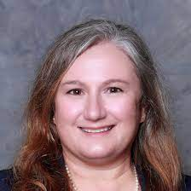

Aviation Maintenance Pathway
Caroline Angelo
Executive Vice President for Academic and Student Affairs
Atlanta Technical College

Slide 25


Slide 26
Approved Meeting Dates
Wednesday, 9/06/23 4 p.m.
Thursday, 11/30/23 4 p.m.
Thursday, 1/25/24 4 p.m.
Thursday, 2/08/24 4 p.m.
Thursday, 2/29/24 4 p.m.
Monday, 3/04/24 4 p.m.
Thursday, 5/16/23 4 p.m.

Slide 27

Online Learning with ELiS
We're excited that all GO Team members have access to our learning and resource platform, ELiS! This is where GO Team members will find required trainings, resources, and other items to help you with your governance work.
Non-APS staff members have been sent an email with their credentials; if you need your login information, please email us. APS staff members will use their APS credentials to access the platform.
To start off, all members will need to ensure they have completed their New Member Orientation. All members will also need to complete an annual Ethics training (APS Staff will complete the District's training and non-staff will complete the GO Team Ethics course). We will enroll non-APS staff members in August.
Be sure to check the site often, as we will continue to add support items and training opportunities!

Slide 28

Announcements
Save the Date
5th Annual G3 Summit
Power of Connections
Saturday, September 23, 2023
8:30 AM - 2:30 PM
Phoenix Academy
Plan for at least three (3) of your GO Team members to attend for this day of learning and leading!

Slide 29
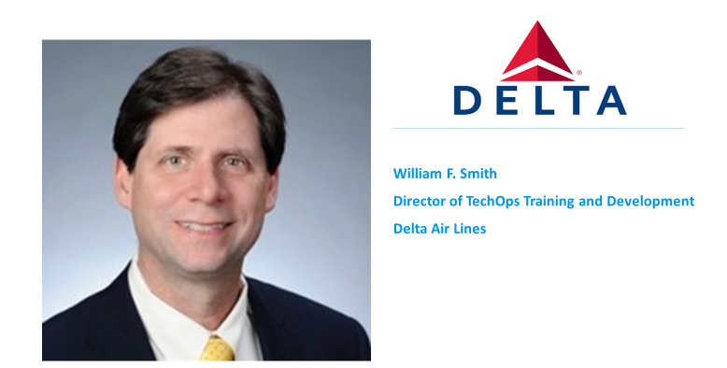
Governor’s Workforce Summit
Registration
Business Panel
Registration for Governor Kemp's Workforce Summit is now open! The Summit will take place at the Georgia Freight Depot in Atlanta on Thursday October 5th followed by our College and Career Academy Day at Atlanta Technical College on Friday October 6th. Both days will provide wonderful opportunities to learn about current workforce initiatives and best practices as well as network.
GCCAN has been given early access to the registration form for one week prior to opening to the general public so please register as soon as possible.
Registration link:
https://subscribe.tcsg.edu/gws
Shout out to William Bill Smith for volunteering to serve on this year’s Business Panel on October 6th.
The topic is business and industry providing expertise and resources to CCAs and students to meet the needs of high-demand careers. The panel is the third session starting at 11 a.m.
Questions the business panel will address:
Who are you/what services do you provide?
What makes an outstanding business partner?
What are your workforce needs today and in the next five years (skills, education/credentials/experience)?
What compensations do you offer at all levels, including entry?
What are your plans for growth/recruitment in Georgia?
How will you involve your company in k-12, and post-secondary education?

Slide 30
Atlanta College and Career Academy
Date: September 6, 2023
Time: 4 p.m.
Location: 1090 Windsor Street S.W.
Call to Order
Roll Call; Establish Quorum
Action Items
  Approval of Agenda
  Fill Vacant Seats
  Appoint Student Representatives
  Approval of Previous Minutes
  Election of Officers
    Chair
    Vice-Chair
    Secretary
  Review and Approve Public Comment Format
  Review, Confirm/Update, and Adopt GO Team Meeting Norms
Information Items
  Principal’s Report
  Aviation Maintenance Pathway
Announcements
  New GO Team Member Training and Orientation
  5th Annual G3 Summit
  Governor’s Workforce Summit - College and Career Academy Day
Adjournment

Slide 31

Thank you!

