Slide 1

Board of Directors Meeting
Good morning, everyone!
Thank you for joining us. We will begin shortly.
March 13, 2025
8 A.M.

Slide 2

Welcome Board Members & Visitors!

Slide 3
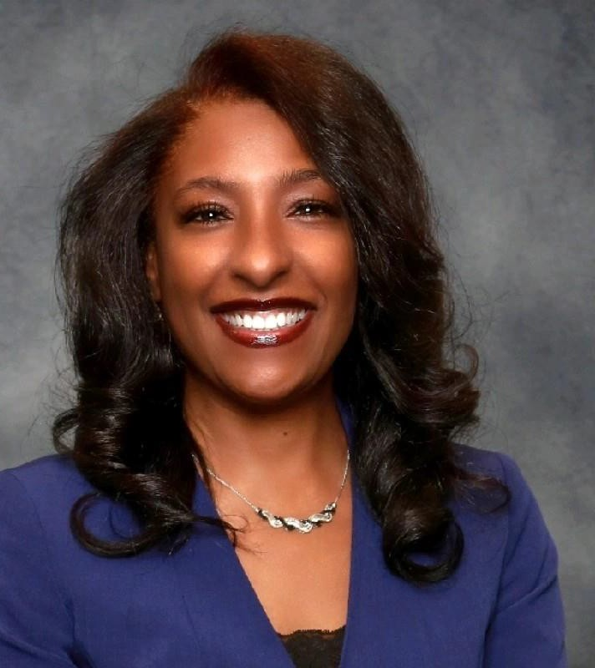


Welcome
ACCA Board Members
& Visitors!
Presiding
ACCA Board of Directors Chair
Dr. Sonya McCoy-Wilson,
Associate Vice President of Learning Atlanta Technical College
3

Slide 4

Public Comment
Thank you for joining us!
Interested in addressing the board today? Please sign up at the entry table and you will
have the opportunity to address the board at the end of today’s meeting. Each participant
will be given two minutes to address the board during Public Comment.
4

Slide 5
Atlanta College and Career Academy Date: March 13, 2025
Time: 8 a.m.
Location: 1090 Windsor Street SW
Call to order
Roll Call; Establish Quorum
Action Items
a.
b.
Approval of Agenda
Approval of Previous Minutes
Information Items
  Principal’s Report
Announcements
Public Comment
Adjournment

Slide 6
Roll Call
Role | Name (or Vacant) | Present or Absent
Parent/Guardian | Chizelle Archie
Business | Sharyl Chatman
Business | William Smith
Business | Sarah Bontrager
Business | Brian Shea
Business | Patricia Horton
Metro Atlanta Chamber | Tim Cairl
Secondary | Dwionne Freeman
Secondary | Shelly Goodrum
Post-Secondary Representative | Sonya McCoy-Wilson
Post-Secondary Representative | Niya Eady
Ex-Officio | Katie Howard
Ex-Officio | Tasharah Wilson
Student | Wesley Gilliard, Jr.
Student | Rajaa Judah

Slide 7
Atlanta College and Career Academy Date: March 13, 2025
Time: 8 a.m.
Location: 1090 Windsor Street SW
Call to order
Roll Call; Establish Quorum
Action Items
a.
b.
Approval of Agenda
Approval of Previous Minutes
Information Items
  Principal’s Report
Announcements
Public Comment
Adjournment

Slide 8

Approval of Previous Minutes
02/27/2025

Slide 9
Principal’s
Report
March 13, 2025

Slide 10
Recruitment FY 2026
Notes:
Good morning everyone, and thank you for joining us today. I’m excited to share with you a recruitment update for the 2025-26 school year.

Slide 11
Application Update – By School
1138
applicants
High School | 10/25/2024 | 11/11/2024 | 11/18/2024 | 12/2/2024 | 12/9/2024 | 1/8/2025 | 2/3/2025 | 2/10/2025 | 2/17/2025 | 2/27/2025 | 3/4/2025 | 3/9/2025
B.E.S.T | 2 | 13 | 13 | 20 | 20 | 21 | 34 | 36 | 36 | 36 | 36 | 38
Carver Early College | 0 | 5 | 5 | 5 | 10 | 11 | 12 | 22 | 22 | 23 | 25 | 33
Carver STEAM | 0 | 0 | 0 | 4 | 4 | 6 | 7 | 37 | 38 | 38 | 39 | 43
Douglass | 38 | 41 | 41 | 58 | 67 | 75 | 100 | 109 | 129 | 129 | 136 | 171
Drew | 0 | 0 | 0 | 8 | 9 | 9 | 9 | 12 | 19 | 20 | 26 | 27
Jackson | 35 | 38 | 37 | 53 | 57 | 64 | 69 | 105 | 109 | 111 | 112 | 122
CSKYWLA | 4 | 4 | 4 | 5 | 7 | 7 | 8 | 9 | 9 | 13 | 14 | 17
KIPP | 1 | 1 | 1 | 4 | 9 | 15 | 60 | 73 | 88 | 92 | 91 | 94
Mays | 3 | 4 | 4 | 29 | 31 | 32 | 33 | 60 | 60 | 60 | 61 | 96
Midtown | 9 | 35 | 34 | 43 | 45 | 48 | 49 | 53 | 67 | 67 | 68 | 68
NATL | 12 | 41 | 44 | 74 | 82 | 92 | 109 | 121 | 144 | 155 | 164 | 176
SATL | 4 | 4 | 22 | 28 | 30 | 31 | 32 | 33 | 54 | 54 | 56 | 70
Therrell | 24 | 24 | 24 | 29 | 29 | 30 | 30 | 33 | 55 | 55 | 55 | 71
BTW | 3 | 17 | 17 | 33 | 36 | 37 | 38 | 88 | 91 | 97 | 107 | 110
Phoenix | 1 | 0 | 1 | 2 | 2 | 2 | 2 | 2 | 2 | 2 | 2 | 2
Weekly Total | 136 | 227 | 247 | 395 | 438 | 480 | 592 | 793 | 923 | 952 | 992 | 1138
Notes:
We are excited to share that we have received over 1,100 applications for enrollment for next year. This slide highlights applications received from each school. The final column shows applications received as of Sunday, March 9th ( the application deadline was Friday, March 7th ).

Slide 12
Application Update – By Pathway
Pathway | 10/25/24 | 11/11/24 | 11/18/24 | 12/2/2024 | 12/9/2024 | 1/8/2025 | 2/3/2025 | 2/10/2025 | 2/17/25 | 2/27/2025 | 3/4/2025 | 3/9/2025
Automotive Technology | 13 | 23 | 26 | 45 | 52 | 57 | 70 | 98 | 104 | 108 | 112 | 125
Carpentry | 6 | 10 | 11 | 26 | 26 | 29 | 31 | 47 | 50 | 50 | 52 | 64
Criminal Investigations | 13 | 27 | 30 | 43 | 48 | 53 | 70 | 95 | 110 | 114 | 115 | 131
Culinary Arts | 16 | 17 | 20 | 39 | 43 | 48 | 64 | 74 | 90 | 93 | 96 | 111
Cybersecurity | 6 | 12 | 10 | 17 | 21 | 22 | 24 | 35 | 39 | 39 | 40 | 46
Dental Science | 14 | 24 | 25 | 32 | 37 | 37 | 45 | 64 | 71 | 71 | 73 | 78
Early College Essentials | 7 | 10 | 12 | 32 | 33 | 37 | 41 | 45 | 50 | 57 | 66 | 102
Graphic Design | 11 | 20 | 20 | 30 | 31 | 34 | 39 | 49 | 69 | 69 | 74 | 77
Hospitality, Recreation, and Tourism | 3 | 4 | 6 | 8 | 10 | 9 | 9 | 17 | 21 | 21 | 21 | 27
HVAC and Refrigeration | 2 | 2 | 2 | 7 | 12 | 15 | 23 | 34 | 43 | 45 | 49 | 64
Infant Toddler Childcare | 18 | 35 | 40 | 52 | 53 | 61 | 76 | 99 | 113 | 114 | 116 | 122
Patient Care | 21 | 35 | 37 | 48 | 51 | 56 | 77 | 104 | 126 | 135 | 141 | 152
Programming | 2 | 4 | 4 | 10 | 10 | 10 | 12 | 20 | 22 | 22 | 24 | 26
Teaching as a Profession | 4 | 4 | 4 | 6 | 11 | 12 | 11 | 12 | 15 | 14 | 13 | 13
Weekly Total | 136 | 227 | 247 | 395 | 438 | 480 | 592 | 793 | 923 | 952 | 992 | 1138
Notes:
Here is a closer look at applications received for individual pathways on ACCA’s campus. As you can see, Patient Care continues to lead the way in student interest, followed by Criminal Investigations, Automotive Technology, Infant Toddler Childcare , and Culinary Arts.

Slide 13

Atlanta Technical College Pathways
Prospective Applicants for Courses on the campus of Atlanta Technical College
Pathway | 10/25/2024 | 11/11/24 | 11/18/2024 | 12/2/2024 | 12/9/2024 | 1/8/2025 | 2/3/2025 | 2/10/2025 | 2/17/25 | 2/27/2025 | 3/4/2025 | 3/9/2025
Aviation Maintenance | 1 | 4 | 4 | 15 | 15 | 15 | 20 | 29 | 32 | 32 | 32
Diesel Electronic Systems | 0 | 2 | 2 | 3 | 3 | 3 | 3 | 4 | 5 | 5 | 5
Emergency Medical Responder | 7 | 13 | 13 | 16 | 16 | 16 | 17 | 22 | 30 | 30 | 30
Natural Gas Technician | 0 | 1 | 1 | 1 | 1 | 1 | 3 | 3 | 5 | 5 | 5
Welding | 3 | 4 | 4 | 6 | 6 | 6 | 11 | 13 | 16 | 16 | 16
Weekly Total | 11 | 24 | 24 | 41 | 41 | 41 | 54 | 71 | 88 | 88 | 88
Notes:
Here are updates regarding students interested in taking classes that are held on Atlanta Tech’s campus. We will share final updates with the board once we receive the data from Atlanta Tech. The deadline for students to apply for programs offered on Atlanta Tech’s campus is tomorrow, Friday, March 14th.
Madam Chair, that concludes the principals report.

Slide 14


Questions/Comments

Slide 15

Announcements
16

Slide 16
Public Comment
The Public Comment period is designed to gain input from the public and not for immediate responses by the Board to the public comment presented.
Each member of the public will have 2 minutes to speak.
At the end of 20 minutes, we will close public comment and move on to the next agenda item.
If there are questions or information that you have for the Board, you may contact one or more Board members after this meeting. You can find Board member contact information, meeting dates and agendas on ACCA’s website https://www.atlantapublicschools.us/domain/10250

Slide 17

Thank you!

