Slide 1
Board of Directors Meeting Good evening, everyone! Thank you for joining us. We will begin shortly.
February 29, 2024
4 P.M.

Slide 2
Welcome Board Members & Visitors!

Slide 3
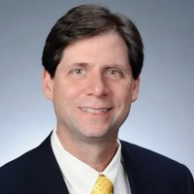
Welcome ACCA Board Members & Visitors!
Presiding
William F. Smith
Chair, ACCA Board of Directors
Director of TechOps Training and Development
Delta Air Lines

Slide 4
Public Comment
Thank you for joining us!
Interested in addressing the board today? Please sign up at the entry table and you will have the opportunity to address the board at the end of today’s meeting. Each participant will be given two minutes to address the board during Public Comment.

Slide 5
Virtual Meeting Norms
Mics on Mute
Actively Engage
Cameras On
Non-ACCA Board Members:
Thank you for taking time out of your schedules to support the great work happening at ACCA. We appreciate you!

Slide 6
Agenda
Call to order
Roll Call; Establish Quorum
Action Items
Approval of Agenda
Approval of Previous Minutes
Budget Approval
Meeting Calendar Adjustment
Discussion Items
Georgia Safety/Security Grant Proposal
Information Items
Principal’s Report
Announcements
Public Comment
Adjournment

Slide 7
Roll Call
Role | Name (or Vacant) | Present or Absent
Parent/Guardian | Alexandria Robinson
Business | Sharyl Chatman
Business | William Smith
Business | Dayna Vidal
Business | Jon Lewis
Business | Patricia Horton
Metro RESA | Tim Cairl
Secondary | Dwionne Freeman
Secondary | Shelly Goodrum
Post-Secondary Representative | Sonya McCoy-Wilson
Post-Secondary Representative | Niya Eady
Ex-Officio | Katie Howard
Ex-Officio | Tasharah Wilson
Student | Wesley Gilliard
Student | Kyla Moore

Slide 8
Agenda
Call to order
Roll Call; Establish Quorum
Action Items
Approval of Agenda
Approval of Previous Minutes
Budget Approval
Meeting Calendar Adjustment
Discussion Items
Georgia Safety/Security Grant Proposal
Information Items
Principal’s Report
Announcements
Public Comment
Adjournment

Slide 9
Meeting Minutes 02/08/2024

Slide 10
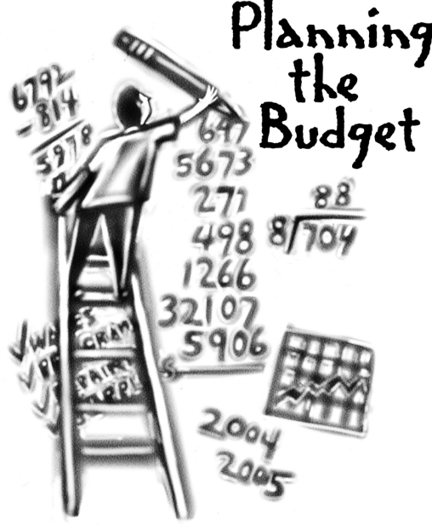
Overview of FY ‘25 GO Team Budget Process
Step 2 Principals: Workshop FY 25 Budget
January 17
Step 4 Principals: Associate Supt. Discussions and Review
February (supports needed, specific challenges, coaching)
Step 1 Review and Update Strategic Plan
Step 6 Principals: HR Staffing Conferences Begin
Late February – Early March
Step 3 GO Team Initial Budget Session
January 17 – early February
Step 7 GO Team Final Budget Approval Meeting
Budgets Approved by March 15
Step 5 GO Team Feedback Session
February – ongoing if necessary
GO Teams are encouraged to have ongoing conversations
Notes:
Here is an overview of the FY 25 budget process. We completed staffing conferences on Tuesday and We are currently at Step 7 – which is the final budget approval meeting.

Slide 11
Budget Approval Meeting
What
During this meeting GO Teams will review the budget, which should be updated based on feedback from the staffing conference, Associate Superintendents, and key leaders. After review, GO Teams will need to take action (i.e., vote) on the FY24 Budget.
Why
Principals will present the final budget recommendations for GO Team approval.
When
All approval meetings must be held after staffing conferences. Budgets must be approved by March 17th.
Notes:
During today’s budget approval meeting, I will share feedback and recommendations received from district leaders at staffing conferences. If all is well, our task today is to approve the budget for the 2024-25 school year.

Slide 12
Budget Review

Slide 13
2024-25 Approved Ranking of Priorities
#1
Teaching and Assessing for Learning
#2
Economic and Workforce Development
#3
Strategic Planning and Sustainability
#4
Governance and Leadership
Notes:
Before we jump into allocations lets first review our school priorities. During our last meeting held January 25th, the board voted to rank our school’s priorities as pictured on the screen. Are there any questions or corrections for our approved ranking of priorities?

Slide 14
FY2025 TOTAL SCHOOL ALLOCATIONS
School | ACCA
Location | 6097
Level | HS
FY2025 Projected Enrollment | 488
Change in Enrollment | 47
Total Earned | $4,296,512
Additional Earnings
Signature |  |  | $0
Turnaround |  |  | $0
Title I |  |  | $0
Title I Holdback |  |  | $0
Title I Family Engagement |  |  | $0
Title I School Improvement |  |  | $0
Field Trip Transportation |  |  | $12,688
Dual Campus Supplement |  |  | $0
District Funded Stipends |  |  | $22,500
Substitute Teachers |  |  | $87,840
Textbooks |  |  | $54,168
Per Pupil |  |  | $66,056
Flex |  |  | $109,171
Additional Flex |  |  | $9,810
Cluster |  |  | $35,000
Marta Cards |  |  | $41,250
Total FTE Allotments | 37.00 |  | $3,858,030
Total Additional Earnings |  |  | $4,296,512
Total Allocation |  |  | $4,296,512
School Allocation
Notes:
Pictured here is a breakdown of allocated funds for ACCA. There are no changes to our allocation.
Are there any questions regarding ACCA’s budget allocation?

Slide 15
Description of Strategic Plan Breakout Categories
Priorities– FY25 funding priorities from the school’s strategic plan, ranked by the order of importance.
APS Five Focus Area- What part of the APS Five is the priority aligned to?
Strategies – Lays out specific objectives for schools improvement.
Request – “The Ask”. What needs to be funded in order to support the strategy?
Amount- What is the cost associated with the Request?
Notes:
We will now pivot to review how resources were allocated to support our strategic priorities.

Slide 16
FY25 Strategic Plan Break-out
Priorities | APS FIVE Focus Area | Strategies | Requests | Amount
Teaching and Assessing for Learning | Curriculum and Instruction | S3-A1 Establish a culture that promotes the success of students in the work force, including soft skills, employability skills, and financial literacy. S3-A5 Establish shared accountability and collaboration between the GCCA and its partners to improve student learning. S3-A6 Ensure access to support to address the physical, social, financial and emotional needs of GCCA students. | Support the growing dual enrollment classes offered on ACCA’s campus (materials/supplies, lab equipment and maintenance costs) Hire a full-time Program Administrator to support dual enrollment Hire a full-time sub to support Aviation Maintenance Provide transportation for summer career exposure camps, field trips, work-based learning opportunities, and students taking classes on Atlanta Tech’s campus (Marta). | $197,829 $178,713 $38,348 $10,000
Notes:
Let’s begin by unpacking Teaching and Assessing for Learning.
During our last meeting we shared that ACCA will shift to offer more dual enrollment on our campus next school year. As we make this shift, we will occur additional costs for materials/supplies, lab equipment and maintenance costs. We are asked the board to dedicate $197,829 towards this effort.
The next ask was based on a recommendation from the Charter System Foundation of Georgia. With the growing number of dual enrollment classes and focus on Accelerated Career, we asked the board to support dual enrollment instruction by approving the hiring of a program administrator that will work directly with home school counselors to ensure that students are taking advantage of these great post secondary training opportunities.
The cost of this position is $178,713 (this includes salary and benefits).
The next ask was for Aviation Maintenance. Aviation Maintenance will be the biggest roll out next school year. As with the other dual enrollment pathways, we need a full-time sub to cover the days college professors are unable to report to ACCA, support daily operational tasks (like attendance), and any other support scholars need to successfully complete the class. The cost of this position is $38, 348 (includes salary/benefits).
We also requested funds to support transportation costs for summer career exposure camps, field trips, work-based learning opportunities, and students taking classes on Atlanta Tech’s campus. This ask is approximately $10,000.

Slide 17
FY25 Strategic Plan Break-out
Priorities | APS FIVE Focus Area | Strategies | Requests | Amount
Economic & Workforce Development | Personalized Learning | S4-A1 Collaborate with employers to develop and promote work-based learning opportunities for students, GCCA faculty, and staff. S4-A6 Provide evidence of innovative practices that ensure students are college and career ready with coursework aligned to the expectations of business and industry. | Hire a full-time Program Administrator to support dual enrollment Provide transportation for summer career exposure camps, field trips, work-based learning opportunities, and students taking classes on Atlanta Tech’s campus (Marta). | $178,713 $10,000
Notes:
Our second ranked priority is Economic & Workforce Development. During our last meeting we discussed increasing the number of students participating in high quality work-based learning continues to be one of our top strategies. We also went on to share that two of the funding requests from the previous slide (hiring a Program Administrator and Transportation costs) will also support this strategic priority.

Slide 18
Priorities | APS Five Focus Area | Strategies | Requests | Amount
Strategic Planning and Sustainability | Personalized Learning | S2-A3 Consolidated Marketing Plan: Adopt and implement a marketing plan that includes collaboration with stakeholders. Suggestions may include, but are not limited to: Communication: •social media •website •brochures •flyers •campus tours •career fairs Promotion: •special populations •academic advisement •articulation •fund raising •CTSOs and other student organizations •career development •dual enrollment (academic, CTAE, and Accelerated Career) | Create additional marketing materials that promote individual pathways and training opportunities | $45,000
Notes:
The final ask was for the board to continue to fund our marketing efforts to ensure the word gets out about this amazing program. The ask here was for $45,000.

Slide 19
Staffing Conference Changes
There were changes made to the draft budget we discussed at our last meeting.
HR recommended ACCA hire an “Assistant Principal” instead of a “Program Administrator.” This position costs less money and resulted in a + $15,295 balance. We moved these funds to instructional materials and supplies to support daily instruction.
Notes:
Since our last meeting, all principals have completed staffing conferences. There are some updates that I need to share as a result of staffing conferences. Human resources recommended ACCA hires an “Assistant Principal” and not a “Program Administrator.” This change saved us $15, 295. In an effort to support Strategic Priority #1 (Teaching and Assessing for Learning) these extra funds were transferred to instructional materials and supplies. While the name of the position changed, the work this person will do to support students participating in dual enrollment will not change.

Slide 20
Summary of Changes
Change at Staffing Conference | Impact to Proposed Budget
Hire an “Assistant Principal” (not a Program Admin) | We saved + S15, 295.00. This money was moved to instructional materials/supplies which aligns to Priority #1 Teaching & Assessing for Learning.
Notes:
So here is a summary of all changes that were made since our previous meeting.

Slide 21
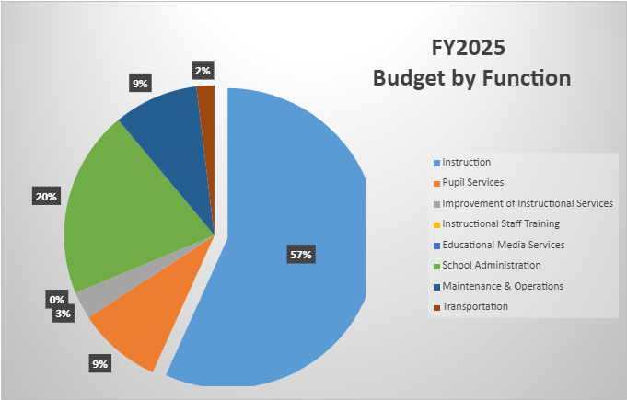
Notes:
This slide highlights how funds were distributed overall. As you can see, our top ranked priority, Teaching and assessing for learning, received the most funding.

Slide 22
Questions for the GO Team to Consider
Are our school’s priorities (from your strategic plan) reflected in this budget?
Are new positions and/or resources included in the budget to address our major priorities?
Do we know (as a team) the plan to support implementation of these priorities beyond the budget (ex. What strategies will be implemented)?
What tradeoffs are being made in order to support these priorities?
How are district priorities reflected in our budget?
Are there positions our school will share with another school, i.e. nurse, counselor?
Notes:
Alright everyone. That concludes budget updates. The floor is now open for questions. Pictured here are questions for you to consider or feel free to ask any additional questions you may have.
If there are no more questions, I will turn it over to Bill for board approval.

Slide 23
The GO Team needs to TAKE ACTION (vote) on the presented budget. After the motion and a second, the GO Team may have additional discussion. Once discussion is concluded, the GO Team will vote.
Action on the Budget
Notes:
If there are no questions, I will turn it back over to Bill so that the Board can vote on the presented budget.

Slide 24
Agenda
Call to order
Roll Call; Establish Quorum
Action Items
Approval of Agenda
Approval of Previous Minutes
Budget Approval
Meeting Calendar Adjustment
Discussion Items
Georgia Safety/Security Grant Proposal
Information Items
Principal’s Report
Announcements
Public Comment
Adjournment

Slide 25
Meeting Calendar Adjustment
We included one additional meeting date (March 4th) just in case we needed it during FY 2025 budget season.
Monday, March 4, 2024 – Cancel or continue?

Slide 26
Georgia Safety/Security Grant Proposal
We need your input!
Presenter:
Dr. Robert Wingate,
Assistant Principal
Notes:
Good evening everyone! My name is Robert Wingate, Proud Assistant Principal of the Atlanta College and Career Academy. I wanted to bring to your attention an upcoming potential opportunity that could significantly impact the security measures within our school. It has come to our attention that the Governor will be proposing a grant aimed at enhancing security in schools statewide. If approved by the Georgia General Assembly, this grant would allocate forty-five thousand dollars ($45K) annually to each school. In light of this potential opportunity, the Operations Division is eager to collect your input to formulate a plan on how best to utilize these resources to bolster security within our buildings. I’m inserting a link in the chat box to collect your thoughts and feedback regarding how these resources should be allocated in a manner that maximizes their impact on the safety and well-being of our students and staff. If possible, we ask that each GO Team member complete the survey on or before March 29, 2024 so that your input is considered in the planning process. The floor is now open for discussion on this very important topic.

Slide 27
Principal’s Report
Presenter:
Dr. Shaundra Fears, Program Administrator

Slide 28
Application Update
953 applicants
`
High School | 11/17/23 | 12/8/2023 | 1/5/24 | 1/12/2024 | 1/19/24 | 2/2/24 | 2/9/24 | 2/19/24
B.E.S.T | 3 | 14 | 16 | 16 | 24 | 25 | 25 | 29
Carver Early College | 4 | 4 | 4 | 4 | 17 | 18 | 17 | 18
Carver STEAM | 1 | 25 | 25 | 42 | 44 | 48 | 48 | 46
Douglass | 2 | 82 | 97 | 101 | 118 | 153 | 183 | 185
Drew | 0 | 1 | 2 | 2 | 3 | 15 | 15 | 15
Jackson | 38 | 41 | 47 | 47 | 49 | 63 | 63 | 65
CSKYWLA | 0 | 10 | 12 | 12 | 12 | 18 | 19 | 21
KIPP | 4 | 12 | 17 | 19 | 22 | 63 | 65 | 65
Mays | 2 | 37 | 43 | 43 | 45 | 65 | 65 | 87
Midtown | 0 | 7 | 13 | 13 | 13 | 28 | 28 | 39
NATL | 6 | 19 | 30 | 97 | 100 | 126 | 146 | 158
SATL | 0 | 40 | 47 | 65 | 67 | 67 | 66 | 73
Therrell | 3 | 38 | 42 | 44 | 45 | 48 | 62 | 63
BTW | 38 | 56 | 62 | 62 | 63 | 82 | 82 | 89
Phoenix | 0 | 0 | 0 | 0 | 0 | 0 | 0 | 0
Weekly Total | 101 | 386 | 457 | 567 | 622 | 819 | 884 | 953

Slide 29
Application Update - continued
Pathway | 11/17/23 | 12/8/23 | 1/5/24 | 1/12/2024 | 1/19/2024 | 2/2/24 | 2/9/4 | 2/19/24
AP Computer Science AP Computer Science Principles | 0 | 2 | 3 | 3 | 3 | 3 | 4 | 4
Automotive Technology | 8 | 35 | 39 | 55 | 60 | 89 | 90 | 94
Aviation Maintenance | 0 | 4 | 4 | 4 | 4 | 5 | 8 | 16
Carpentry | 5 | 13 | 16 | 18 | 23 | 26 | 36 | 39
Criminal Investigations | 7 | 35 | 44 | 53 | 60 | 72 | 71 | 81
Culinary Arts | 13 | 72 | 84 | 98 | 107 | 124 | 130 | 137
Cybersecurity | 3 | 13 | 16 | 20 | 26 | 35 | 35 | 41
Dental Science | 6 | 22 | 28 | 36 | 39 | 59 | 56 | 62
Early College Essentials | 10 | 28 | 32 | 43 | 43 | 53 | 75 | 78
Graphic Design | 6 | 37 | 41 | 45 | 50 | 64 | 68 | 74
Hospitality, Recreation, and Tourism | 5 | 10 | 11 | 16 | 18 | 21 | 21 | 22
HVAC and Refrigeration | 2 | 8 | 11 | 12 | 16 | 25 | 29 | 32
Infant Toddler Childcare | 11 | 33 | 37 | 47 | 50 | 75 | 79 | 85
Patient Care | 16 | 56 | 69 | 89 | 91 | 127 | 136 | 141
Programming | 8 | 17 | 21 | 23 | 26 | 34 | 35 | 39
Teaching as a Profession | 1 | 1 | 1 | 5 | 6 | 7 | 7 | 8
Weekly Total | 101 | 386 | 457 | 567 | 622 | 819 | 884 | 953

Slide 30
Application is open until March 8, 2024

Slide 31
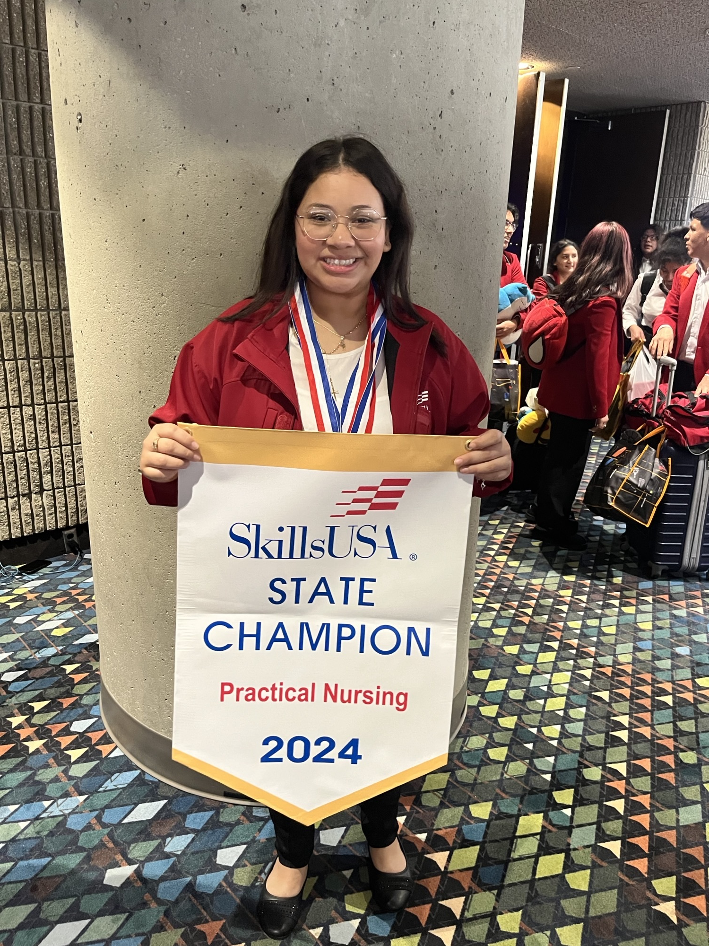
Patient Care Superstar
Patient Care student Ashley Molina-Garcia competed in the Skills USA competition in healthcare.
She won Silver in medical assisting and Gold in practical nursing.

Slide 32
Graphic Arts – Amazing Scholars
Several students competed in the APS 11th Annual Tech and Innovation Competition
Student – Jose Escandon-Hernandez won first place in the 9-10 grade band
He is invited to participate in the state competition in Carterville, GA.

Slide 33
Questions/Comments

Slide 34
Announcements

Slide 35
Approved Meeting Dates
Wednesday, 9/06/23 4 p.m.
Thursday, 11/30/23 4 p.m.
Thursday, 1/25/24 4 p.m.
Thursday, 2/08/24 4 p.m. Initial Budget Allocation & Feedback Meeting
Thursday, 2/29/24 4 p.m. Budget Approval Meeting
Monday, 3/04/24 4 p.m. - Canceled
Thursday, 5/16/23 4 p.m.
Notes:
Please mark your calendars! Our next meeting is Thursday, May 16th at 4 p.m. This will be our final meeting for the 2024-25 school year.

Slide 36
Complete your GO Team Training
Remember to complete your required GO Team trainings so your team will remain in compliance (see below for current status). At this time, all members will need to ensure they have completed their New Member Orientation (both parts: online and live) and the annual Ethics trainings (APS Staff will complete the District's training and non-staff will complete the GO Team Ethics course).
We're excited that all GO Team members have access to our learning and resource platform, ELiS! This is where GO Team members will find required trainings, resources, and other items to help you with your governance work. ELiS automatically sends reminders until the trainings are completed. Non APS staff members have been sent an email with their credentials; if you need your login information, please email us. APS staff members will use their APS credentials to access the platform.
Be sure to check the site often, as we will continue to add support items and training opportunities!
Notes:
Also want to remind everyone of required training for all GO Teams.

Slide 37
Public Comment
The Public Comment period is designed to gain input from the public and not for immediate responses by the Board to the public comment presented.
Each member of the public will have 2 minutes to speak.
At the end of 20 minutes, we will close public comment and move on to the next agenda item.
If there are questions or information that you have for the Board, you may contact one or more Board members after this meeting. You can find Board member contact information, meeting dates and agendas on ACCA’s website https://www.atlantapublicschools.us/domain/10250

Slide 38
Thank you!

