Slide 1
Board of Directors Meeting
Good evening, everyone!
Thank you for joining us. We will begin shortly.
February 27, 2025
4 P.M.

Slide 2

Welcome Board Members & Visitors!

Slide 3
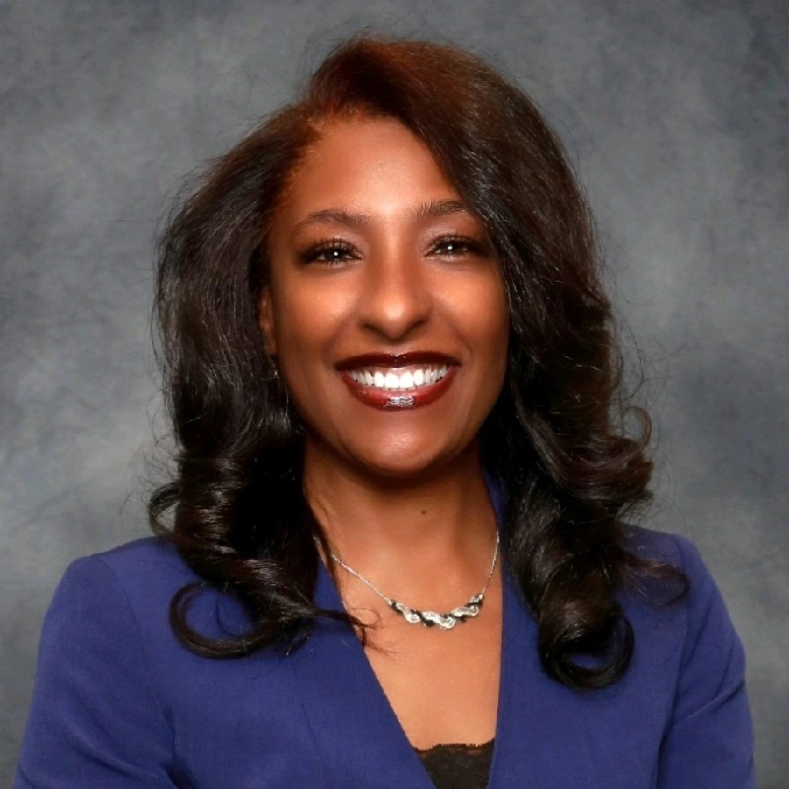

Welcome
ACCA Board Members
& Visitors!
Presiding
ACCA Board of Directors Chair
Dr. Sonya McCoy-Wilson,
Associate Vice President of Learning
Atlanta Technical College

Slide 4
Public Comment
Thank you for joining us!
Interested in addressing the board today? Please sign up at the entry table and you will have the opportunity to address the board at the end of today’s meeting. Each participant will be given two minutes to address the board during Public Comment.

Slide 5




Virtual Meeting Norms
Mics on Mute
Actively Engage
Cameras On
Non-ACCA Board Members:
Thank you for taking time out of your schedules to support the great work happening at ACCA. We appreciate you!

Slide 6
Atlanta College and Career Academy
Date: February 27, 2025
Time: 4 p.m.
Location: 1090 Windsor Street SW
Call to order
Roll Call; Establish Quorum
Action Items
  Approval of Agenda
  Approval of Previous Minutes
  Budget Approval
Information Items
  Principal’s Report
Announcements
Public Comment
Adjournment

Slide 7
Roll Call
Role | Name (or Vacant) | Present or Absent
Parent/Guardian | Chizelle Archie
Business | Sharyl Chatman
Business | William Smith
Business | Sarah Bontrager
Business | Brian Shea
Business | Patricia Horton
Metro Atlanta Chamber | Tim Cairl
Secondary | Dwionne Freeman
Secondary | Shelly Goodrum
Post-Secondary Representative | Sonya McCoy-Wilson
Post-Secondary Representative | Niya Eady
Ex-Officio | Katie Howard
Ex-Officio | Tasharah Wilson
Student | Wesley Gilliard, Jr.
Student | Rajaa Judah

Slide 8
Atlanta College and Career Academy
Date: February 27, 2025
Time: 4 p.m.
Location: 1090 Windsor Street SW
Call to order
Roll Call; Establish Quorum
Action Items
  Approval of Agenda
  Approval of Previous Minutes
  Budget Approval
Information Items
  Principal’s Report
Announcements
Public Comment
Adjournment

Slide 9

Approval of Previous Minutes
02/13/2025

Slide 10


Overview of FY26 GO Team
Budget Process
Step 8* GO Team Final Budget Approval Meeting
Feb. 27th
Step 7 Principals HR Staffing Conferences Begin
Feb. 26th
Step 6 Cluster Supt. Review February 17th-21st
Step 5* GO Team Feedback Mtg. February 13th
Step 4 Principals Cluster Supt. Discussions
Step 3 GO Team Initial Budget Session
February 13th
Step 2 Principals Workshop FY 26 Budget
January 15th
Step 1 Update Strategic Plan & Rank Priorities
GO Teams are encouraged to have ongoing conversations
* GO Teams will need to take ACTION on the budget at these meetings.
Notes:
Good evening everyone and thank you for your active involvement and feedback throughout the the FY 26 budget process. We completed staffing conferences yesterday which places us at Step 8 – the final budget approval meeting.

Slide 11
Budget Approval Meeting
What
During this meeting GO Teams will review all components of the budget, which should be updated based on feedback from the Cluster Superintendent and key leaders. After review, GO Teams will take Action on the FY26 Budget.
Why
Principals will present their final budget recommendations for GO Team approval.
When
All approval meetings must be held after staffing conferences. Budgets must be approved by March 14th.
Notes:
During today’s budget approval meeting, I will share feedback and recommendations received from district leaders at staffing conferences. If all is well, our task today is to approve the budget for the 2025-26 school year.

Slide 12
Budget Review

Slide 13
2025-26
Approved
Ranking of Priorities
#1
Teaching and Assessing for Learning
#2
Economic and Workforce Development
#3
Strategic Planning and Sustainability
#4
Governance and Leadership
Notes:
Before we jump into allocations lets first review our school priorities. During our last meeting held February 13th, the board voted to rank our school’s priorities as pictured on the screen. Are there any questions or corrections for our approved ranking of priorities?

Slide 14
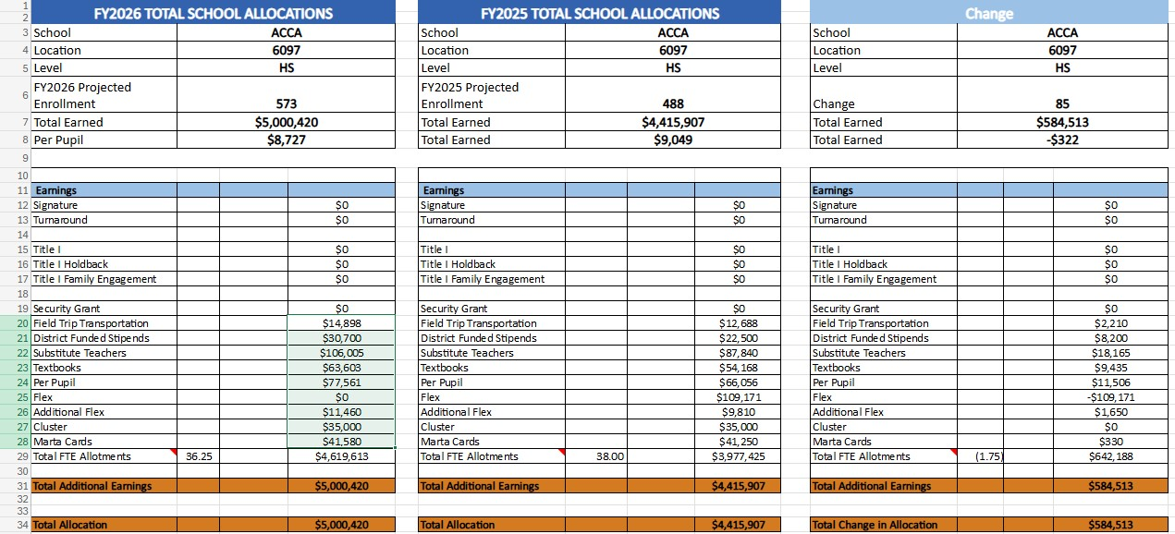
School Allocation
Notes:
Pictured here is a breakdown of allocated funds. There are no changes to our allocation. The first column shows the FY 26 allocation, the second column reflects last year’s allocation, and the third column shows the difference between the two. The proposed budget for the general operations of the school are reflected at $5,000,420.
Are there any questions regarding ACCA’s budget allocation?

Slide 15

Description of Strategic Plan Breakout Categories
Option A
Option B
Priorities– FY26 funding priorities from the school’s strategic plan, ranked by the order of importance.
Strategies – Lays out specific objectives for schools improvement.
Request – “The Ask”. What needs to be funded in order to support the strategy?
Amount- What is the cost associated with the Request?
Priorities– FY26 funding priorities from the school’s strategic plan, ranked by the order of importance.
Strategies – Lays out specific objectives for schools improvement.
Request – “The Ask”. What needs to be funded in order to support the strategy?
Amount- What is the cost associated with the Request?
Notes:
We will now pivot to review how resources were allocated to support our strategic priorities. During our last meeting I presented two options.

Slide 16

Option A
Notes:
Lets begin by reviewing how we allocated funds to support strategic priorities for Option A

Slide 17
FY26 Strategic Plan Break-out
Priorities | Strategies | Requests | Amount
Teaching and Assessing for Learning | S3-A1 Establish a culture that promotes the success of students in the work force, including soft skills, employability skills, and financial literacy. S3-A5 Establish shared accountability and collaboration between the GCCA and its partners to improve student learning. S3-A6 Ensure access to support to address the physical, social, financial and emotional needs of GCCA students. | Support the growing dual enrollment classes offered on ACCA’s campus (materials/supplies, lab equipment and maintenance costs) Hire two full-time subs to support dual enrollment | $123,120 $85,819
Notes:
Pictured is funding for Teaching and Assessing for Learning.

Slide 18
FY25 Strategic Plan Break-out
Priorities | APS FIVE Focus Area | Strategies | Requests | Amount
Economic & Workforce Development | Personalized Learning | S4-A1 Collaborate with employers to develop and promote work-based learning opportunities for students, GCCA faculty, and staff. S4-A6 Provide evidence of innovative practices that ensure students are college and career ready with coursework aligned to the expectations of business and industry. | Support the growing dual enrollment classes offered on ACCA’s campus (materials/supplies, lab equipment and maintenance costs) Fund transportation for the summer career exposure camp, field trips, work-based learning opportunities, and students taking classes on Atlanta Tech’s campus (Marta). | $123,120 $55,000
Notes:
Economic and Workforce Development.

Slide 19

Priorities | APS Five Focus Area | Strategies | Requests | Amount
Strategic Planning and Sustainability | Personalized Learning | S2-A3 Consolidated Marketing Plan: Adopt and implement a marketing plan that includes collaboration with stakeholders. Suggestions may include, but are not limited to: Communication: •social media •website •brochures •flyers •campus tours •career fairs Promotion: •special populations •academic advisement •articulation •fund raising •CTSOs and other student organizations •career development •dual enrollment (academic, CTAE, and Accelerated Career) | Create additional marketing materials that promote individual pathways and training opportunities | $20,000
Notes:
And Strategic Planning and Sustainability

Slide 20
Option A
Summary
  Prioritizes dual enrollment, work-based learning, and summer exposure camp
  Abolishment of one teacher position
Notes:
To summarize, Option A will support our ongoing efforts to prioritize dual enrollment, work-based learning, our annual summer exposure camp and support marketing efforts. If we choose this option it will result in the abolishment of one teacher position.

Slide 21
Option B
Notes:
So now we will review how funds were allocated to support strategic priorities for Option B

Slide 22
FY26 Strategic Plan Break-out
Priorities | Strategies | Requests | Amount
Teaching and Assessing for Learning | S3-A1 Establish a culture that promotes the success of students in the work force, including soft skills, employability skills, and financial literacy. S3-A5 Establish shared accountability and collaboration between the GCCA and its partners to improve student learning. S3-A6 Ensure access to support to address the physical, social, financial and emotional needs of GCCA students. | Purchase one School-Funded Teacher Hire two full-time subs to support dual enrollment | $131,970 $85,819
Notes:
So here is how we allocated the budget to support Teaching and Learning for Option B.

Slide 23
FY25 Strategic Plan Break-out
Priorities | APS FIVE Focus Area | Strategies | Requests | Amount
Economic & Workforce Development | Personalized Learning | S4-A1 Collaborate with employers to develop and promote work-based learning opportunities for students, GCCA faculty, and staff. S4-A6 Provide evidence of innovative practices that ensure students are college and career ready with coursework aligned to the expectations of business and industry. | Fund transportation for the summer career exposure camp, field trips, work-based learning opportunities, and students taking classes on Atlanta Tech’s campus (Marta). | $55,000
Notes:
Economic and Workforce Development

Slide 24
Priorities | APS Five Focus Area | Strategies | Requests | Amount
Strategic Planning and Sustainability | Personalized Learning | S2-A3 Consolidated Marketing Plan: Adopt and implement a marketing plan that includes collaboration with stakeholders. Suggestions may include, but are not limited to: Communication: •social media •website •brochures •flyers •campus tours •career fairs Promotion: •special populations •academic advisement •articulation •fund raising •CTSOs and other student organizations •career development •dual enrollment (academic, CTAE, and Accelerated Career) | Create additional marketing materials that promote individual pathways and training opportunities | $20,000
Notes:
And finally, Strategic Planning and Sustainability

Slide 25
Option B
Summary
  Prioritizes work-based learning, field trips to industry sites, and summer exposure camp
  Purchases one teacher position
  Sacrifice funding to support dual enrollment (materials/supplies/equipment)
Notes:
To summarize, Option B supports our ongoing efforts to prioritize work-based learning, field trips to industry sites and our annual summer exposure camp activities. This option also purchases one school funded teacher position to offset the lost FTE. The trade off is that ACCA will not have funding to support ongoing dual enrollment costs like instructional materials, supplies and equipment replacement or repair.

Slide 26

ACCA Board Recommendation = Option A
Option A
Option B
  Prioritizes dual enrollment, work-based learning, and summer exposure camp
  Abolishment of one teacher position
  Prioritizes work-based learning, field trips to industry sites, and summer exposure camp
  Purchases one teacher position
  Sacrifice funding to support dual enrollment (materials/supplies/equipment)
Notes:
During our last meeting we asked the board to share your recommendation - Option A or Option B.
Option A = supports growing dual enrollment costs and abolishes one teacher position
And
Option B = Purchases one teacher position and sacrifices funding to support dual enrollment
Your vote was unanimous with all Board members voting in favor of Option A. Please note: Your recommendation was reviewed by our Cluster Superintendent and discussed during staffing conferences. District leaders appreciate your feedback and support your recommendation to move forward with Option A, which prioritizes funding for dual enrollment and abolishes one teacher position.
Are there any questions or comments?
Madam Chair, I will now turn it back over to you for final board vote and approval.

Slide 27
Principal’s Report
February 27, 2025
Notes:
Thank you Madam Chair.

Slide 28
Recruitment
FY 2026
Notes:
I’ll begin the principals report by sharing a quick update regarding recruitment and end with next steps for our certification visit.

Slide 29
Application Update – By School
923 applicants
Notes:
We are excited to share that we continue to receive many applications for enrollment for next school year. We are now up to 923 applications for the 2025-26 school year. This slide highlights applications received from each school. The final column shows applications received as of February 17th. As you can see, we have received the most applications from scholars at Douglass, Jackson, and North Atlanta High School.

Slide 30
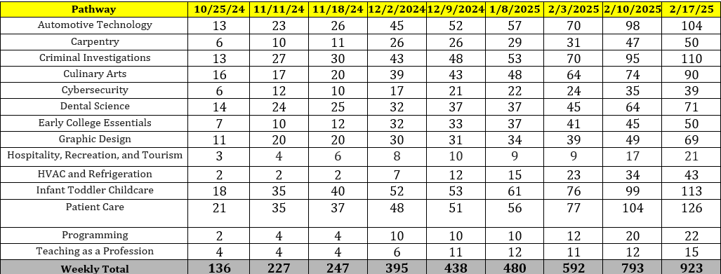
Application Update – By Pathway
Notes:
Here is a closer look at applications we received for pathways on ACCA’s campus. As you can see, Patient Care continues to lead the way in student interest.

Slide 31
Application is open until March 7, 2025
Notes:
Students can continue to apply until March 7th

Slide 32
Atlanta Technical College pathways
Prospective Applicants for Courses on the campus of Atlanta Technical College
Pathway | 10/25/2024 | 11/11/24 | 11/18/2024 | 12/2/2024 | 12/9/2024 | 1/8/2025 | 2/3/2025 | 2/10/2025 | 2/17/25
Aviation Maintenance | 1 | 4 | 4 | 15 | 15 | 15 | 20 | 29 | 32
Diesel Electronic Systems | 0 | 2 | 2 | 3 | 3 | 3 | 3 | 4 | 5
Emergency Medical Responder | 7 | 13 | 13 | 16 | 16 | 16 | 17 | 22 | 30
Natural Gas Technician | 0 | 1 | 1 | 1 | 1 | 1 | 3 | 3 | 5
Welding | 3 | 4 | 4 | 6 | 6 | 6 | 11 | 13 | 16
Weekly Total | 11 | 24 | 24 | 41 | 41 | 41 | 54 | 71 | 88
Notes:
Here are updates regarding students interested in taking classes that are held on Atlanta Tech’s campus. As you can see, Aviation Maintenance is leading the way with 32 students interested in signing up to participate during the 2025-26 school year, followed by 30 students interested in Emergency Medical Responder. We’re hoping that Bill and Captain Chatman are pleased. We want to give a shout out to the Atlanta Tech team for their help with recruitment efforts. We will continue to recruit students for all pathways until the application deadline closes.

Slide 33
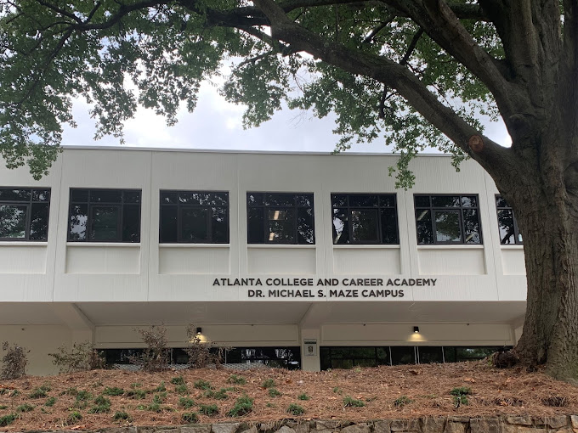

GCCAN Certification Visit
Date: March 13, 2025
Time: 8 a.m.
Location: 1090 Windsor Street Sw
Notes:
We will now shift to discuss our upcoming certification visit. The External Certification Team will visit ACCA on Thursday, March 13th. This is the final step in our certification renewal process. As previously shared, your participation and involvement is key. The certification team does require in-person interviews for board members.

Slide 34
Notes:
Here is a snapshot of March 13th ’s agenda. We acknowledge that time is money, so we intentionally scheduled your interviews for early morning so that you can participate and then go about your regular day.

Slide 35

In-Person Interviews
March 13 @ 8 a.m.
Please arrive by 7:45 a.m. at the latest and gather in the Multi-Purpose Room
Park in the staff parking lot located behind the building
The meeting will commence promptly at 8:00 a.m., as we need to record and live stream the start.
Interviews will begin at 8:15 a.m. (Note: These will not be recorded)
You are free to leave after the interviews conclude
You are welcome to return at 2:00 p.m. for the final report (attendance is not mandatory)
Board members will receive a complete report following the visit.
Notes:
We are asking all board members to arrive by 7:45 a.m. on March 13th. Please park in the staff parking lot which is located behind the building. We will begin at 8 a.m. with standard meeting protocols (including roll call, approval of the agenda and meeting minutes). This portion of the meeting will be livestreamed and recorded as required. Board member interviews will begin promptly at 8:15 a.m. Please note: this portion of the meeting will not be livestreamed or recorded. Interviews conclude at 8:45 a.m. and you are free to leave after that. The certification team will share their final report at 2 p.m.; however, you do not have to be present during the final report (you are invited to come back, but are not required to do so). We will share the detailed final report with the entire board once it is finalized. Are there any questions about March 13th?

Slide 36
Interview Questions
How are you involved in the development of the GCCA?
Do you feel the GCCA serves a role in economic development?
Describe how your business/industry, organization has a presence in the GCCA.
Are the students you hire prepared for the work force? Do they have needed soft skills/work ethics?
Describe The collaboration between the GCCA and business and industry to develop work-based learning opportunities for students, faculty and staff.
What are your local workforce development needs? And, how does the GCCA contribute to meeting those needs
Notes:
So you may be wandering….what are they going to ask us. Here are some example questions that you can expect during the interview; however, they may ask different questions and request additional information.

Slide 37



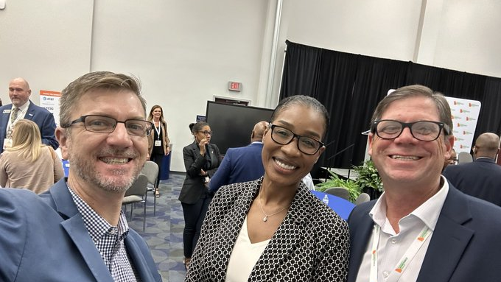
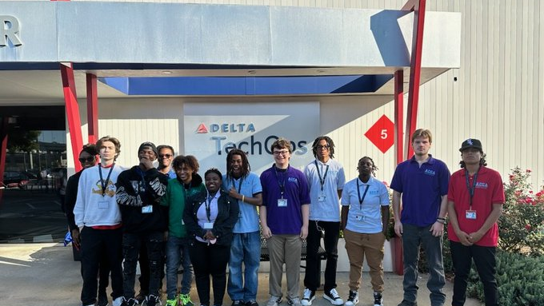
Thank you, ACCA Board of Directors!
Notes:
So to help better prepare you for what you can expect during interviews on March 13th, I want to call out the amazing work that all of you are doing to support ACCA. These are things that the certification team will be listening for and I encourage you to brag on yourselves and how you are supporting ACCA during your interviews. I want to begin by shouting out Tim and the Metro Atlanta Chamber. From the very beginning the metro atlanta chamber helped identify pathways that ACCA should offer that meet workforce needs in the metro area, the second year we opened the chamber helped coordinate teacher externships. The chamber also plays a critical role ensuring we stay aligned to workforce needs by presenting data to the entire board, shout out to Tim & his team for last May’s presentation, hosting meetings at ACCA, like last summer, bringing partners to the table for potential partnerships; publishing the Talent Supply Report which helps guide the work at ACCA; and inviting me to participate on industry tours, like our recent visit to Delta Air Lines. Speaking of Delta Air Lines, I want to give a shout out to Bill and the entire Delta Air Lines team for all that they are doing to support ACCA. I’ll begin with Bill serving as our board chair for three years leading up to the launch of our Aviation Maintenance Pathway. For two years we established an Aviation Maintenance planning committee that met monthly to ensure we had a successful launch – Delta Air Lines went as far as funding a consultant to support the launch and provided resources and staff to help recruit for the new pathway. Delta also continues to support ACCA by allowing our first cohort to visit the Tech Ops headquarters (pictured is our first cohort visiting last semester), helping to recruit next year’s cohort of scholars, and we’re now working with Bill’s team to participate in this year’s summer exposure camp to expose APS middle school students to careers in Aviation Maintenance.

Slide 38

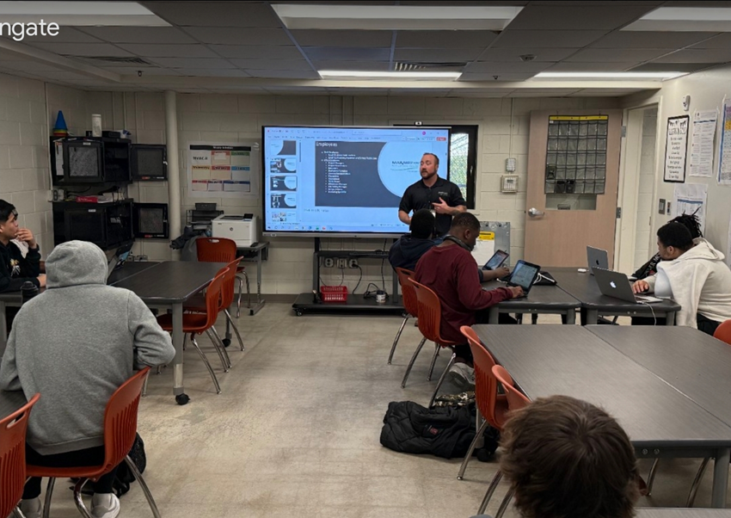
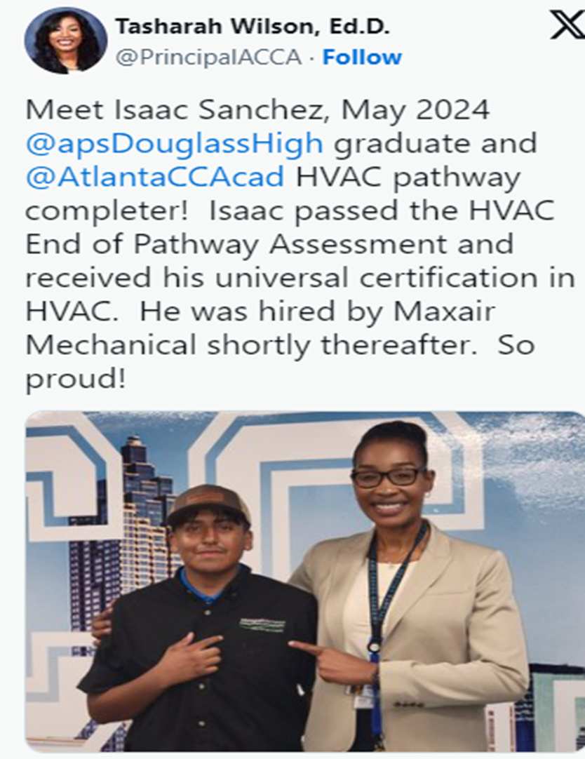
Industry Mentor Day
Hiring Students
Notes:
Next, I want to shout out Brian and the entire Max Air Mechanical Team for their ongoing support of ACCA. Our partnership began last year when Max Air took the lead completing our school’s HVAC renovation. Throughout the renovation, several of the HVAC professionals would stop by the lab and mentor our HVAC students in the technical skills and employability skills that it takes to be successful in the HVAC industry. Today they continue to support us by participating in our Industry Mentor Days, providing students work based learning opportunities, and hiring students to come and work for their company upon graduation. Pictured here is Brian mentoring our HVAC scholars and also a tweet highlighting one of our recent graduates and HVAC pathway completer, Isaac Sanchez. Isaac passed his End of Pathway Assessment, received his universal certification and was hired by MaxAir shortly thereafter. A few months after graduating he showed in the front office to sign in as an official employee of MaxAir and we stopped our entire day to celebrate him (and that’s what you see in that picture). So thank you Brian for your company’s continued support of ACCA. The certification team wants to know that our industry partners are engaging with students, our industry partners are providing work based learning opportunities for students, our industry partners are hiring our students to fill workforce needs within their organization.

Slide 39
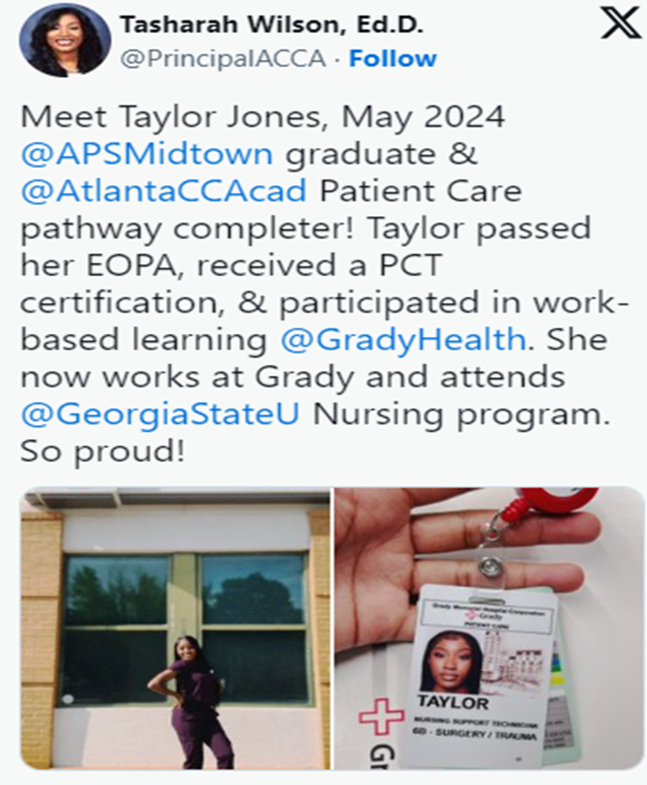

Work-Based Learning
Notes:
Speaking of work based learning, must give a shout out to Sarah and Grady Health for not only providing work based learning opportunities, but also hiring students upon graduation (like Taylor in this tweet), and helping her pay for nursing grad school. We are also excited to share that Grady sends one of their Clinical Nurse Educators to coteach with our patient care teacher twice a week. So Sarah, please, don’t be shy sharing all of the amazing support Grady is providing to our patient care program. We appreciate you all so much

Slide 40

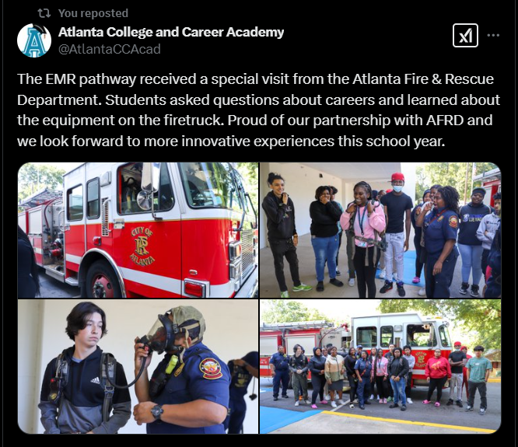
Recruitment Event
Notes:
Also a special thank you to Captain Chatman and the entire Atlanta Fire Department for attending all of our recruitment events to help recruit scholars for careers in public safety! And also, Captain Chatman, I want to encourage you to brag on the career event we held a few years ago when you brought an entire team of professionals from Atlanta Fire to share the various career opportunities that you all offer to graduating seniors.

Slide 41




Notes:
Also big shout out to Dr. McCoy-Wilson, Ms. Eady and the entire Atlanta Tech team for serving as our primary post-secondary partners. We are very thankful for all of your help recruiting students, providing instructors for our Early College Essentials Pathway, certifying our teachers so that we can award students college credit for participation in classes held on our campus, and opening your campus for students to come and learn. We appreciate you!

Slide 42
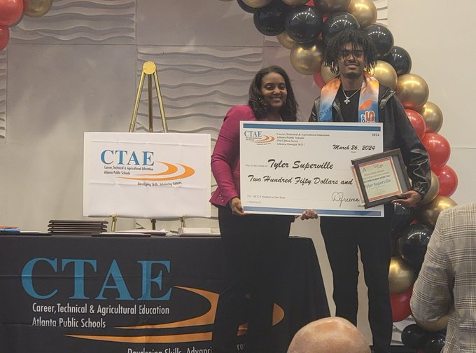

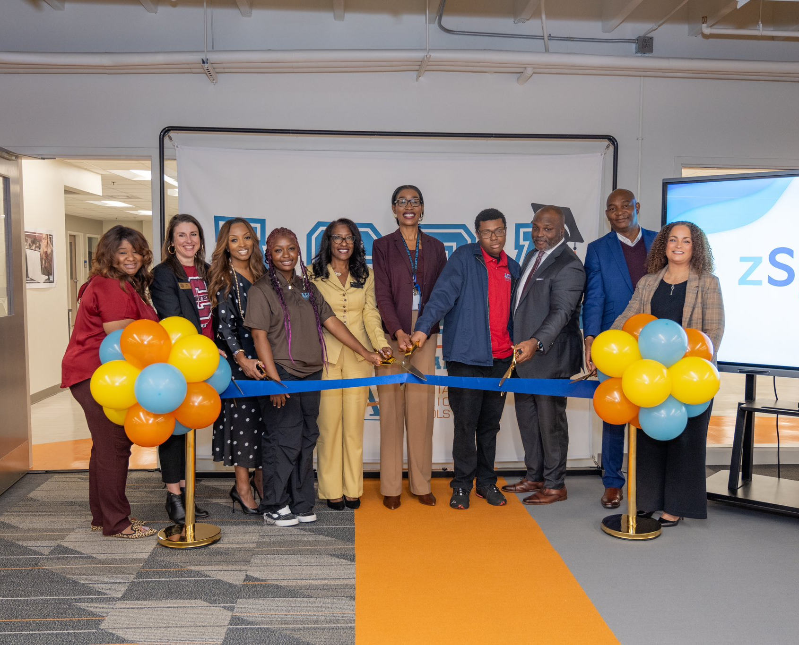
We appreciate you!
Notes:
Last but not least, I have to give a shout out to Ms. Katie Howard, Ms. Goodrum, Dr. Freeman and the entire Atlanta Public Schools team for their amazing support of ACCA! During our pre-certification visit five years ago, the certification team shared a concern that there seems to be a disconnect between the ACCA Board of Directors and the Atlanta Public Schools governing board. So we are so excited that we now have Katie Howard, who serves on the Atlanta Board of Education representing District 1, that serves on our Board of Directors. And Katie is always advocating on our behalf – thank you so much Katie for all of your support. We are also blessed to have the cluster superintendent over non-traditional schools, Ms. Shelly Goodrum, on our board. Ms. Goodrum ensures we have everything we need and serves as our representative on the Atlanta Worksource Board of Directors. We also are very thankful to have the CTAE Director of Atlanta Public Schools, Dr. Dwionne Freeman, on our board. Dr. Freeman supports our work in many ways from securing funding to support our high school pathways, providing professional learning and teacher externships for ACCA teachers, and coordinating all of our work based learning placements.. So to the entire board I say thank you, thank you, thank you! And please, brag on your support of ACCA during your interview, don’t be shy, the certification team wants to hear how you’re engaged and how you’re supporting the work.

Slide 43
Questions/Comments
Notes:
Questions/Comments? If none, we will turn it back over to the chair for the next item on the agenda

Slide 44

Announcements

Slide 45

Complete your GO Team Training
Remember to complete your required GO Team trainings so your team will remain in compliance (see below for current status). At this time, all members will need to ensure they have completed their New Member Orientation (both parts: online and live) and the annual Ethics trainings (APS Staff will complete the District's training and non-staff will complete the GO Team Ethics course).
We're excited that all GO Team members have access to our learning and resource platform, ELiS! This is where GO Team members will find required trainings, resources, and other items to help you with your governance work. ELiS automatically sends reminders until the trainings are completed. Non APS staff members have been sent an email with their credentials; if you need your login information, please email us. APS staff members will use their APS credentials to access the platform.
Be sure to check the site often, as we will continue to add support items and training opportunities!
Notes:
We do have one reminder from the GOTeam office: please complete all required GO Team trainings so our board can remain in compliance.

Slide 46
Public Comment
The Public Comment period is designed to gain input from the public and not for immediate responses by the Board to the public comment presented.
Each member of the public will have 2 minutes to speak.
At the end of 20 minutes, we will close public comment and move on to the next agenda item.
If there are questions or information that you have for the Board, you may contact one or more Board members after this meeting. You can find Board member contact information, meeting dates and agendas on ACCA’s website https://www.atlantapublicschools.us/domain/10250

Slide 47

Thank you!

