Slide 1
Board of Directors Meeting
Good evening, everyone!
Thank you for joining us. We will begin shortly.
February 13, 2025
4 P.M.

Slide 2

Welcome Board Members & Visitors!

Slide 3
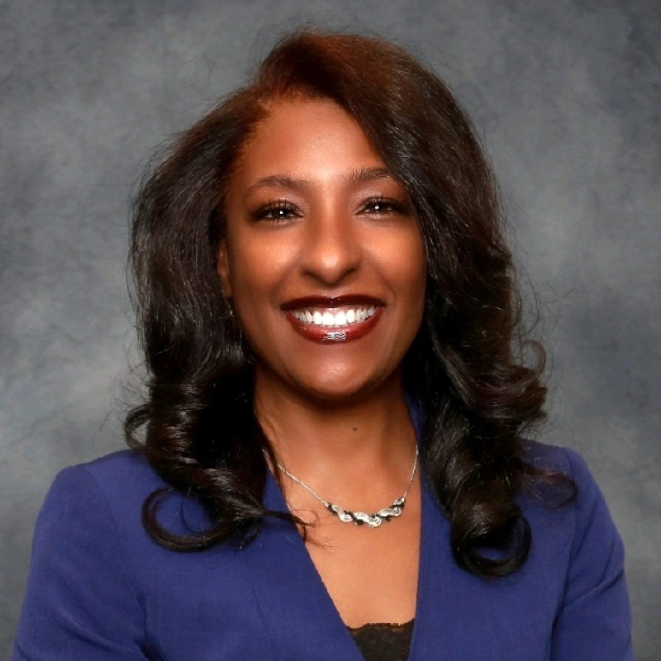

Welcome
ACCA Board Members
& Visitors!
Presiding
ACCA Board of Directors Chair
Dr. Sonya McCoy-Wilson,
Associate Vice President of Learning
Atlanta Technical College

Slide 4
Public Comment
Thank you for joining us!
Interested in addressing the board today? Please sign up at the entry table and you will have the opportunity to address the board at the end of today’s meeting. Each participant will be given two minutes to address the board during Public Comment.

Slide 5




Virtual Meeting Norms
Mics on Mute
Actively Engage
Cameras On
Non-ACCA Board Members:
Thank you for taking time out of your schedules to support the great work happening at ACCA. We appreciate you!

Slide 7
Roll Call
Role | Name (or Vacant) | Present or Absent
Parent/Guardian | Chizelle Archie
Business | Sharyl Chatman
Business | William Smith
Business | Sarah Bontrager
Business | VACANT
Business | Patricia Horton
Metro RESA | Tim Cairl
Secondary | Dwionne Freeman
Secondary | Shelly Goodrum
Post-Secondary Representative | Sonya McCoy-Wilson
Post-Secondary Representative | Niya Eady
Ex-Officio | Katie Howard
Ex-Officio | Tasharah Wilson
Student | Wesley Gilliard, Jr.
Student | Rajaa Judah

Slide 9
Fill Vacant Seats
The Metro Atlanta Chamber brings forth the nominations for business seats.
All board members have only one vote per seat.
Individuals filling a vacant seat will serve until the conclusion of that seat’s term.
Upon approval, individuals are immediately full board members and may join the meeting.

Slide 10

Nominee: Brian Shea
Project Coordinator
bshea@maxairmech.com
404-476-1001
Maxairmech.com

Slide 11

Approval of Previous Minutes
01/30/2025

Slide 12
Meeting Dates
09/26/2024 4 p.m. Organizational Meeting
10/30/2024 4 p.m. Board Training
01/30/2025 2 p.m. - 3:30 p.m. Internal Review (Certification Renewal)
02/13/2025 4 p.m. Budget Meeting
02/27/2025 4 p.m. Budget Approval Meeting
03/06/2025 4 p.m. Budget Meeting
03/13/2025 External Review (Certification Renewal) **In-Person**
Notes:
Good evening everyone! We are asking the board to approve canceling the March 6th board of directors meeting. In light of the upcoming certification visit on March 13th, we are doing some heavy lifting today around the budget so that we don’t have back to back meetings in March.

Slide 13

Notes:
Good evening, everyone and thank you for joining us. Pictured here is a copy of our strategic plan that we created five years ago. Throughout this year we have reviewed various data points to assess our current progress as an Academy. I am excited to share that thanks to your help and support, ACCA has successfully achieved all the goals we established in our strategic plan and we continue to make great strides in accomplishing our mission to graduate all scholars ready for college, career, and life. Please note that after this budget season, we will begin a deep dive into creating our strategic plan that will guide our work for the next five years.

Slide 14
2024-25
Approved
Ranking of Priorities
#1
Teaching and Assessing for Learning
#2
Economic and Workforce Development
#3
Strategic Planning and Sustainability
#4
Governance and Leadership
Notes:
As everyone knows, it is officially budgeting season. But before we discuss budget for the 2025-26 School Year, best practice is to first rank the priorities from our current strategic plan. Pictured here are last year’s priorities and the ranking you approved during last year’s budget season

Slide 15
School Priorities | Example Strategies
Economic and Workforce Development | Increase student participation in work-based learning opportunities
Teaching and Assessing for Learning | Fund costs associated with increasing dual enrollment participation
Strategic Planning and Sustainability | Fund costs associated with our marketing plan
Governance and Leadership | ACCA Board Training
Notes:
As we consider the ranking of priorities for next year, I wanted to share some example strategies for each priority. These are only examples, I encourage all to please review the current College and Career Academy certification manual for a list of all expectations related to each priority.

Slide 16
1. Which priority should be ranked #1? Why?
2. Which priority should be ranked #2? Why?
3. Which priority should be ranked #3? Why?
4. Which priority should be ranked #4? Why?
After discussion, please share your final recommendation in the Chat Box
Economic and Workforce Development
Teaching and Assessing for Learning
Strategic Planning and Sustainability
Governance and Leadership
Notes:
We will now open the floor for discussion regarding how we should rank priorities for the 2025-26 school year. At the conclusion of today’s discussion, we are going to ask each board member to share your recommendations in the chat box. Our goal is to ensure that we capture each board members feedback and input before we take a final vote. At this time, the floor is open for discussion. We are going to ask each board member to share which priority should be ranked #1? Why?
**Now that everyone has shared, we need each board member to go to the chat box and rank each priority. For example you can say #1: Strategic Planning, #2: Teaching and Assessing for Learning, etc….We will collate the data and share after we receive everyone’s feedback. So at this time, please go to the chatbox and rank.
**After collating your feedback, the recommended ranking is:
Priority #1:
Priority #2:
Priority #3:
Priority#4:
**I will now turn it back over to Dr. McCoy-Wilson so that you can vote to accept Strategic Plan updates and the ranking of priorities.

Slide 17

GO Team Budget Process FY26
Notes:
Now that we have ranked our priorities, we are going to dive right into the budgeting process.

Slide 18

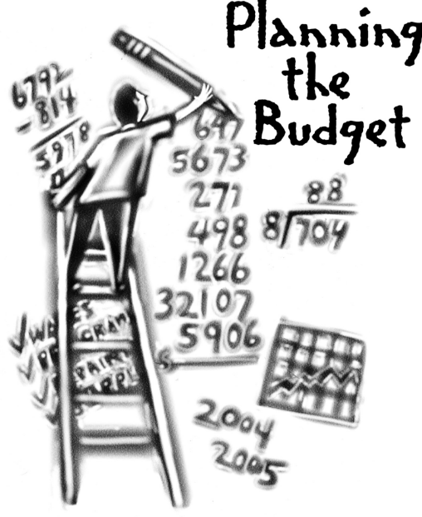
Overview of FY26 GO Team Budget Process
Step 8* GO Team Final Budget Approval Meeting
Feb. 27th
Step 7 Principals HR Staffing Conferences Begin
Feb. 26th
Step 6 Cluster Supt. Review February 17th-21st
Step 5* GO Team Feedback Mtg. February 13th
Step 4 Principals Cluster Supt. Discussions
Step 3 GO Team Initial Budget Session
February 13th
Step 2 Principals Workshop FY 26 Budget
January 15th
Step 1 Update Strategic Plan & Rank Priorities
GO Teams are encouraged to have ongoing conversations
* GO Teams will need to take ACTION on the budget at these meetings.
Notes:
Here is an overview of the FY 26 budget process. We are currently at Step 3. We will also complete Step 5 during today’s meeting .

Slide 19
Budget Allocation Meeting
What
During the first GO Team meeting the principal will provide an overview of the budget and position allocations.
Why
This meeting provides an opportunity for the principal and GO Team to ensure alignment on the school’s key strategic priorities, gain a deeper understanding of the budget and position allocations and provide input to drive the development of the draft budget.
When
January 15th- Early February
Notes:
Step 3 is the budget allocation meeting. During this portion of the meeting I will share an overview of ACCA’s budget allocation for the 2025-26 school year

Slide 20
Budget Feedback Meeting
What
During the GO Team Feedback meeting the principal will share the 25-26 Strategic Plan Breakout, provide an overview of the school’s draft budget, share updated tabs from the Excel template, and review/collaborate with the GO Team on the comments/notes to explain the use of school-level flexibility in budget allocations.
Why
This meeting provides an opportunity for GO Teams to discuss the principal’s proposed budget and how it supports the school's programmatic needs and key strategic priorities for the 25-26 school year. It also provides the GO Team the opportunity to review and provide feedback on proposed use of school-level flexibility.
When
Early February- February 14th, before Cluster Superintendent review.
Notes:
Step 5 is the Budget Feedback Meeting. During this portion of the meeting I will ask for your feedback on budget allocations, we will ensure alignment on the school’s key strategic priorities, and discuss any additional budget items we need to consider for the 2025-26 school year.

Slide 21
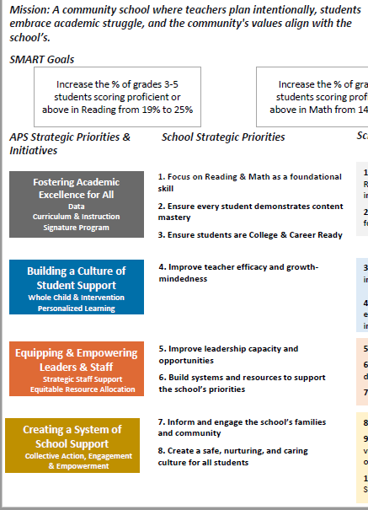
FY26 Budget Development Process
Principal’s Role
Design the budget and propose operational changes that can raise student achievement
Flesh out strategies, implement and manage them at the school level
Focus on the day-to-day operations
Serve as the expert on the school
Hire quality instructional and support personnel
The GO Team’s Role
Focus on the big picture
Ensure that the budget is aligned to the school’s mission and vision and that resources are allocated to support key strategic priorities
Notes:
The role of the principal during the budget development process is to flesh out strategies and focus on the day-to-day operations of the school.
The role of the board is to focus on the big picture and ensure the budget is aligned to the school’s mission and vision; and resources are allocated to support key strategic priorities.

Slide 22
2025-26
Approved
Ranking of Priorities
Teaching and Assessing for Learning
Economic and Workforce Development
Strategic Planning and Sustainability
Governance and Leadership
Notes:
Before we jump into allocations lets first review our school priorities. Just a few minutes ago the board voted to rank our school’s priorities. The ranking was as follows: >>>>
Are there any questions or corrections for our approved ranking of priorities?

Slide 23
FY2026 Budget Allocation
Notes:
We will now review ACCA’s budget allocation for the 2025-2026 school year.

Slide 24
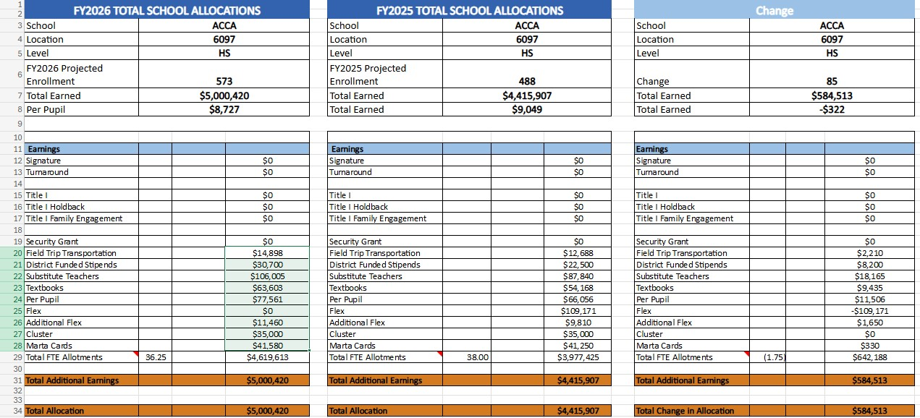
School Allocation
Notes:
Pictured here is a breakdown of allocated funds. The first column shows the FY 26 allocation, the second column reflects last year’s allocation, and the third column shows the difference between the two. The proposed budget for the general operations of the school are reflected at $5,000,420. Are there any questions regarding ACCA’s budget allocation?

Slide 25
Summary Tab
Teacher CTE 9-12 | 100240560973011 | 1000 | 1100 | 12.00 | $131,970 | 12.00 | $1,583,640 | $(1,583,640)
Teacher CTE 9-12 School Funded | 100240560971041 | 1000 | 1100 |  | $131,970 | 1.00 |  | $(131,970)
Notes:
Pictured here is a snapshot of the budget “Summary Tab” that highlights the number of teacher FTE positions that we earned and currently using. For those that have been keeping up with budget commission meetings, APS has a $100 million dollar budget deficit, and all schools and departments are asked to tighten our belts to ensure a balanced budget. Pictured here you’ll see that ACCA received an allotment of 12 teachers for the 2025-26 school year; however, we currently have 13 teachers on our roster. So today, we need your help, input and feedback to determine our strategy forward.

Slide 26
Description of Strategic Plan Breakout Categories
Option A
Option B
Priorities– FY26 funding priorities from the school’s strategic plan, ranked by the order of importance.
Strategies – Lays out specific objectives for schools improvement.
Request – “The Ask”. What needs to be funded in order to support the strategy?
Amount- What is the cost associated with the Request?
Priorities– FY26 funding priorities from the school’s strategic plan, ranked by the order of importance.
Strategies – Lays out specific objectives for schools improvement.
Request – “The Ask”. What needs to be funded in order to support the strategy?
Amount- What is the cost associated with the Request?
Notes:
We will now pivot to review how resources were allocated to support our strategic priorities. I will present you with two options. Each option is broken down into the following strategic plan categories: Priorities, Strategies, Request and Amount needed for the request.

Slide 27

Option A
Notes:
We will begin with Option A

Slide 28
FY26 Strategic Plan Break-out
Priorities | Strategies | Requests | Amount
Teaching and Assessing for Learning | S3-A1 Establish a culture that promotes the success of students in the work force, including soft skills, employability skills, and financial literacy. S3-A5 Establish shared accountability and collaboration between the GCCA and its partners to improve student learning. S3-A6 Ensure access to support to address the physical, social, financial and emotional needs of GCCA students. | Support the growing dual enrollment classes offered on ACCA’s campus (materials/supplies, lab equipment and maintenance costs) Hire two full-time subs to support dual enrollment | $123,120 $85,819
Notes:
During our pre-certification visit five years ago the certification team shared concerns about ACCA offering only high school level classes. Since that visit, we continue to shift to offer more dual enrollment pathways on our campus. We currently offer the following dual enrollment pathways on our campus: Infant/Toddler Childcare, Early College Essentials, Carpentry, Cybersecurity, and Automotive. We are excited to share that next year we are adding an additional dual enrollment pathway, Programming, as a post-secondary opportunity on ACCA’s campus. As we make this shift, we will occur additional costs for materials/supplies, lab equipment and maintenance costs. We are asking the board to dedicate $123,120 to support growing dual enrollment needs.
The next ask is to fund two full time subs. We currently employ two full time district funded subs; however, beginning next school year, individual schools are responsible for incurring this cost. Currently, our full time subs fill in on days that dual enrollment instructors are not present and provide support to specific dual enrollment pathways (Ex. Aviation Maintenance). So for Option A, specifically around our Teaching and Learning priority, we are requesting funding to support growing dual enrollment pathways and two full time subs.

Slide 29
FY25 Strategic Plan Break-out
Priorities | APS FIVE Focus Area | Strategies | Requests | Amount
Economic & Workforce Development | Personalized Learning | S4-A1 Collaborate with employers to develop and promote work-based learning opportunities for students, GCCA faculty, and staff. S4-A6 Provide evidence of innovative practices that ensure students are college and career ready with coursework aligned to the expectations of business and industry. | Support the growing dual enrollment classes offered on ACCA’s campus (materials/supplies, lab equipment and maintenance costs) Fund transportation for the summer career exposure camp, field trips, work-based learning opportunities, and students taking classes on Atlanta Tech’s campus (Marta). | $123,120 $55,000
Notes:
This next slide unpacks Economic and Workforce Development. Increasing the number of students participating in high quality work-based learning continues to be one of our top strategies for this priority. We are asking the board to approve $55,000 to help pay for students to participate in work-based learning, field trips to industry sites, and our annual summer exposure camp. Supporting growing dual enrollment cost, as mentioned on the previous slide, also supports Economic & Workforce Development.

Slide 30

Priorities | APS Five Focus Area | Strategies | Requests | Amount
Strategic Planning and Sustainability | Personalized Learning | S2-A3 Consolidated Marketing Plan: Adopt and implement a marketing plan that includes collaboration with stakeholders. Suggestions may include, but are not limited to: Communication: •social media •website •brochures •flyers •campus tours •career fairs Promotion: •special populations •academic advisement •articulation •fund raising •CTSOs and other student organizations •career development •dual enrollment (academic, CTAE, and Accelerated Career) | Create additional marketing materials that promote individual pathways and training opportunities | $20,000
Notes:
The final ask for Option A is for the board to continue to fund our marketing efforts to ensure the word gets out about this amazing program. We are asking the board to approve $20,000 to fund this request.

Slide 31
Option A
Summary
  Prioritizes dual enrollment, work-based learning, and summer exposure camp
  Abolishment of one teacher position
Notes:
To summarize, Option A will support our ongoing efforts to prioritize dual enrollment, work-based learning, our annual summer exposure camp and support marketing efforts. If we choose this option it will result in the abolishment of one teacher position.

Slide 32
Option B
Notes:
So now we will move on to Option B

Slide 33
FY26 Strategic Plan Break-out
Priorities | Strategies | Requests | Amount
Teaching and Assessing for Learning | S3-A1 Establish a culture that promotes the success of students in the work force, including soft skills, employability skills, and financial literacy. S3-A5 Establish shared accountability and collaboration between the GCCA and its partners to improve student learning. S3-A6 Ensure access to support to address the physical, social, financial and emotional needs of GCCA students. | Purchase one School-Funded Teacher Hire two full-time subs to support dual enrollment | $131,970 $85,819
Notes:
So here is how we have allocated the budget to support Option B. If the board chooses this option, we are opting to purchase one school funded teacher position to offset the lost FTE. This option also allows for the purchase of two full time subs.

Slide 34
FY25 Strategic Plan Break-out
Priorities | APS FIVE Focus Area | Strategies | Requests | Amount
Economic & Workforce Development | Personalized Learning | S4-A1 Collaborate with employers to develop and promote work-based learning opportunities for students, GCCA faculty, and staff. S4-A6 Provide evidence of innovative practices that ensure students are college and career ready with coursework aligned to the expectations of business and industry. | Fund transportation for the summer career exposure camp, field trips, work-based learning opportunities, and students taking classes on Atlanta Tech’s campus (Marta). | $55,000
Notes:
Option B also funds transportation needed for work-based learning, field trips to industry sites, and the summer exposure camp.

Slide 35
Priorities | APS Five Focus Area | Strategies | Requests | Amount
Strategic Planning and Sustainability | Personalized Learning | S2-A3 Consolidated Marketing Plan: Adopt and implement a marketing plan that includes collaboration with stakeholders. Suggestions may include, but are not limited to: Communication: •social media •website •brochures •flyers •campus tours •career fairs Promotion: •special populations •academic advisement •articulation •fund raising •CTSOs and other student organizations •career development •dual enrollment (academic, CTAE, and Accelerated Career) | Create additional marketing materials that promote individual pathways and training opportunities | $20,000
Notes:
Option B also funds our marketing efforts.

Slide 36
Option B
Summary
  Prioritizes work-based learning, field trips to industry sites, and summer exposure camp
  Purchases one teacher position
  Sacrifice funding to support dual enrollment (materials/supplies/equipment)
Notes:
To summarize, Option B will support our ongoing efforts to prioritize work-based learning, field trips to industry sites and our annual summer exposure camp activities. This option also purchases one school funded teacher position to offset the lost FTE. The trade off is that ACCA will not have funding to support ongoing dual enrollment costs like instructional materials, supplies and equipment replacement or repair.

Slide 37

Notes:
The floor is now open for discussion. Which do you prefer and why?
Before you make a decision, I want to share some quick data with you to provide more context…..

Slide 38
Pathways on ACCA’s campus
Automotive
Andrea Strommen
Carpentry
Harry Morgan
Criminal Investigation
Chirre Barron
Culinary Arts
Shernett Wheatle
Cybersecurity
Amber Williamson
Dental Science
Shante' Mosley
Infant/Toddler Childcare
Keiah Moreno
Graphic Design
Jason Stubbs
HVACR
Charles Strickland
Hospitality, Recreational & Tourism
Nicole Champion
Patient Care
Tamika Latham
Programming
Mishun Miller
Teaching as a Profession
Dara Tekolu
Early College Essentials
Atlanta Technical College
Notes:
Here is a closer look at all of the pathways offered on ACCA’s campus. Pathways highlighted in orange are dual enrollment pathways. Pathways in blue are GaDOE pathways.

Slide 39
Pathway | 10/25/24 | 11/11/24 | 11/18/24 | 12/2/2024 | 12/9/2024 | 1/8/2025 | 2/3/2025
Automotive Technology | 13 | 23 | 26 | 45 | 52 | 57 | 70
Carpentry | 6 | 10 | 11 | 26 | 26 | 29 | 31
Criminal Investigations | 13 | 27 | 30 | 43 | 48 | 53 | 70
Culinary Arts | 16 | 17 | 20 | 39 | 43 | 48 | 64
Cybersecurity | 6 | 12 | 10 | 17 | 21 | 22 | 24
Dental Science | 14 | 24 | 25 | 32 | 37 | 37 | 45
Early College Essentials | 7 | 10 | 12 | 32 | 33 | 37 | 41
Graphic Design | 11 | 20 | 20 | 30 | 31 | 34 | 39
Hospitality, Recreation, and Tourism | 3 | 4 | 6 | 8 | 10 | 9 | 9
HVAC and Refrigeration | 2 | 2 | 2 | 7 | 12 | 15 | 23
Infant Toddler Childcare | 18 | 35 | 40 | 52 | 53 | 61 | 76
Patient Care | 21 | 35 | 37 | 48 | 51 | 56 | 77
Programming | 2 | 4 | 4 | 10 | 10 | 10 | 12
Teaching as a Profession | 4 | 4 | 4 | 6 | 11 | 12 | 11
Weekly Total | 136 | 227 | 247 | 395 | 438 | 480 | 592
Notes:
Pictured here are the current applications we have received by pathway for the 2025-26 school year. As you can see, there are a few pathways that have little student interest. There is one pathway, in particular, that receives little to no student interest every year. I shared this data so that as you make your decision around Option A or B, you can make an informed decision seeing that one of the pathways receives little to no student interest each year.

Slide 40

Please type your recommendation in the Chat Box
Option A
Option B
  Prioritizes dual enrollment, work-based learning, and summer exposure camp
  Abolishment of one teacher position
  Prioritizes work-based learning, field trips to industry sites, and summer exposure camp
  Purchases one teacher position
  Sacrifice funding to support dual enrollment (materials/supplies/equipment)
Notes:
The floor is now open for discussion. Which do you prefer and why?
Option A = support growing dual enrollment costs and abolish one teacher position
Or
Option B = Purchase one teacher position and sacrifice funding to support dual enrollment
And if you don’t mind, we’re going to ask each board member to please type Option A or Option B in the chat box. This will help us record your feedback and share with district officials during the upcoming staffing conferences.

Slide 41
Overview of FY26 GO Team Budget Process
Step 8* GO Team Final Budget Approval Meeting
February 27th @ 4 p.m.
Step 7 Principals HR Staffing Conferences Begin
Feb. 26th
Step 6 Cluster Supt. Review February 17th-21st
Step 5* GO Team Feedback Mtg. Feb 13th
Step 4 Principals Cluster Supt. Discussions
Step 3 GO Team Initial Budget Session
February 13th
Step 2 Principals Workshop FY 26 Budget
January 15th
Step 1 Update Strategic Plan & Rank Priorities
GO Teams are encouraged to have ongoing conversations
* GO Teams will need to take ACTION on the budget at these meetings.
Notes:
Thank you so much for your sharing feedback regarding this year’s budget. The next step will be sending our plan to our cluster superintendent for review and staffing conferences. After staffing conferences, we will reconvene for the final budget approval meeting on February 27 @ 4 p.m.
I’ll now turn it back over to the chair for the next item on the agenda.

Slide 42
Principal’s Report
February 13, 2025

Slide 43
Recruitment
FY 2026

Slide 44

Recruitment Strategies
Hosted school tours for all APS high schools - Fall 2024
Facilitating recruitment sessions for both CTAE and Dual Enrollment pathways at all APS High School – Spring 2025
Participating in Department of Exceptional Education Cluster Nights to recruit students FY26 – Spring 2025
Presenting program information to various stakeholders including but not limited to:
  Family Engagement Meetings – Parent Liaisons
  ESOL and World Language Parent Meetings
  Various High School Parent Meetings as requested

Slide 45
Application Update – By School
592 applicants
High School | 10/25/2024 | 11/11/2024 | 11/18/2024 | 12/2/2024 | 12/9/2024 | 1/8/2025 | 2/3/2025
B.E.S.T | 2 | 13 | 13 | 20 | 20 | 21 | 34
Carver Early College | 0 | 5 | 5 | 5 | 10 | 11 | 12
Carver STEAM | 0 | 0 | 0 | 4 | 4 | 6 | 7
Douglass | 38 | 41 | 41 | 58 | 67 | 75 | 100
Drew | 0 | 0 | 0 | 8 | 9 | 9 | 9
Jackson | 35 | 38 | 37 | 53 | 57 | 64 | 69
CSKYWLA | 4 | 4 | 4 | 5 | 7 | 7 | 8
KIPP | 1 | 1 | 1 | 4 | 9 | 15 | 60
Mays | 3 | 4 | 4 | 29 | 31 | 32 | 33
Midtown | 9 | 35 | 34 | 43 | 45 | 48 | 49
NATL | 12 | 41 | 44 | 74 | 82 | 92 | 109
SATL | 4 | 4 | 22 | 28 | 30 | 31 | 32
Therrell | 24 | 24 | 24 | 29 | 29 | 30 | 30
BTW | 3 | 17 | 17 | 33 | 36 | 37 | 38
Phoenix | 1 | 0 | 1 | 2 | 2 | 2 | 2
Weekly Total | 136 | 227 | 247 | 395 | 438 | 480 | 592

Slide 46
Application Update – By Pathway
Pathway | 10/25/24 | 11/11/24 | 11/18/24 | 12/2/2024 | 12/9/2024 | 1/8/2025 | 2/3/2025
Automotive Technology | 13 | 23 | 26 | 45 | 52 | 57 | 70
Carpentry | 6 | 10 | 11 | 26 | 26 | 29 | 31
Criminal Investigations | 13 | 27 | 30 | 43 | 48 | 53 | 70
Culinary Arts | 16 | 17 | 20 | 39 | 43 | 48 | 64
Cybersecurity | 6 | 12 | 10 | 17 | 21 | 22 | 24
Dental Science | 14 | 24 | 25 | 32 | 37 | 37 | 45
Early College Essentials | 7 | 10 | 12 | 32 | 33 | 37 | 41
Graphic Design | 11 | 20 | 20 | 30 | 31 | 34 | 39
Hospitality, Recreation, and Tourism | 3 | 4 | 6 | 8 | 10 | 9 | 9
HVAC and Refrigeration | 2 | 2 | 2 | 7 | 12 | 15 | 23
Infant Toddler Childcare | 18 | 35 | 40 | 52 | 53 | 61 | 76
Patient Care | 21 | 35 | 37 | 48 | 51 | 56 | 77
Programming | 2 | 4 | 4 | 10 | 10 | 10 | 12
Teaching as a Profession | 4 | 4 | 4 | 6 | 11 | 12 | 11
Weekly Total | 136 | 227 | 247 | 395 | 438 | 480 | 592

Slide 47
Application is open until March 7, 2025

Slide 48
Questions/Comments

Slide 49

Announcements
Upcoming Meetings
Thursday, February 27 @ 4 p.m.
  Budget Approval Meeting
Thursday, March 13 (External Review)
  This is an in-person meeting.
  The ACCA Board of Directors will be interviewed.
  Location: ACCA, 1090 Windsor Street SW
Notes:
We have two upcoming meetings. Our budget approval meeting on Feb. 27th @ 4 p.m. and the final step in our certification process (the external review) on March 13th. This is an in-person meeting. All board members will be interviewed. We will email you the schedule soon.

Slide 50

Complete your GO Team Training
Remember to complete your required GO Team trainings so your team will remain in compliance (see below for current status). At this time, all members will need to ensure they have completed their New Member Orientation (both parts: online and live) and the annual Ethics trainings (APS Staff will complete the District's training and non-staff will complete the GO Team Ethics course).
We're excited that all GO Team members have access to our learning and resource platform, ELiS! This is where GO Team members will find required trainings, resources, and other items to help you with your governance work. ELiS automatically sends reminders until the trainings are completed. Non APS staff members have been sent an email with their credentials; if you need your login information, please email us. APS staff members will use their APS credentials to access the platform.
Be sure to check the site often, as we will continue to add support items and training opportunities!
Notes:
Also a reminder from the GOTeam office: please complete all required GO Team trainings so our board can remain in compliance.

Slide 51
Public Comment
The Public Comment period is designed to gain input from the public and not for immediate responses by the Board to the public comment presented.
Each member of the public will have 2 minutes to speak.
At the end of 20 minutes, we will close public comment and move on to the next agenda item.
If there are questions or information that you have for the Board, you may contact one or more Board members after this meeting. You can find Board member contact information, meeting dates and agendas on ACCA’s website https://www.atlantapublicschools.us/domain/10250

Slide 52

Thank you!

