Slide 1
Board of Directors Meeting
Good evening, everyone!
Thank you for joining us. We will begin shortly.
February 8, 2024
4 P.M.

Slide 2

Welcome Board Members & Visitors!

Slide 3
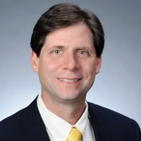
Welcome
ACCA Board Members
& Visitors!
Presiding
William F. Smith
Chair, ACCA Board of Directors
Director of TechOps Training and Development
Delta Air Lines

Slide 4
Public Comment
Thank you for joining us!
Interested in addressing the board today? Please sign up at the entry table and you will have the opportunity to address the board at the end of today’s meeting. Each participant will be given two minutes to address the board during Public Comment.

Slide 5




Virtual Meeting Norms
Mics on Mute
Actively Engage
Cameras On
Non-ACCA Board Members:
Thank you for taking time out of your schedules to support the great work happening at ACCA. We appreciate you!

Slide 6
Atlanta College and Career Academy
Date: February 8, 2024
Time: 4 p.m.
Location: 1090 Windsor Street SW
Call to order
Roll Call; Establish Quorum
Action Items
  Approval of Agenda
  Approval of Previous Minutes
Discussion Items
  Budget Allocation and Feedback Presentation
Announcements
Public Comment
Adjournment

Slide 7
Roll Call
Role | Name (or Vacant) | Present or Absent
Parent/Guardian | Alexandria Robinson
Business | Sharyl Chatman
Business | William Smith
Business | Dayna Vidal
Business | Jon Lewis
Business | Patricia Horton
Metro RESA | Tim Cairl
Secondary | Dwionne Freeman
Secondary | Shelly Goodrum
Post-Secondary Representative | Sonya McCoy-Wilson
Post-Secondary Representative | Niya Eady
Ex-Officio | Katie Howard
Ex-Officio | Tasharah Wilson
Student | Wesley Gilliard
Student | Kyla Moore

Slide 8
Atlanta College and Career Academy
Date: February 8, 2024
Time: 4 p.m.
Location: 1090 Windsor Street SW
Call to order
Roll Call; Establish Quorum
Action Items
  Approval of Agenda
  Approval of Previous Minutes
Discussion Items
  Budget Allocation and Feedback Presentation
Announcements
Public Comment
Adjournment

Slide 9

Meeting Minutes
01/25/2024

Slide 10

Notes:
We will now provide an overview of the draft budget and receive your feedback and/or questions.

Slide 11

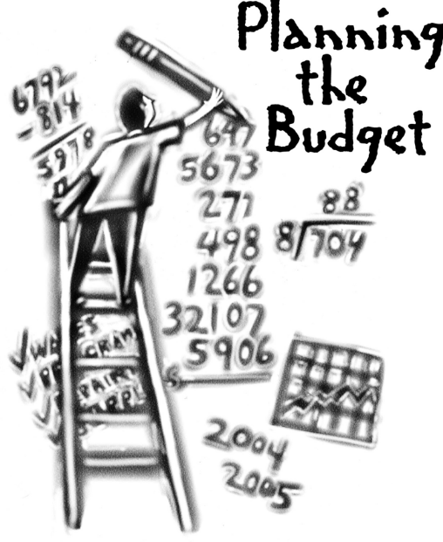
Overview of FY ‘25 GO Team Budget Process
Step 2 Principals: Workshop FY 25 Budget
January 17
Step 4 Principals: Associate Supt. Discussions and Review
February (supports needed, specific challenges, coaching)
Step 1 Review and Update Strategic Plan
Step 6 Principals: HR Staffing Conferences Begin
Late February – Early March
Step 3 GO Team Initial Budget Session
January 17 – early February
Step 7 GO Team Final Budget Approval Meeting
Budgets Approved by March 15
Step 5 GO Team Feedback Session
February – ongoing if necessary
GO Teams are encouraged to have ongoing conversations
Notes:
Here is an overview of the FY 25 budget process. We are currently at Step 3. We will also complete Step 5 during today’s meeting .

Slide 12
Budget Allocation Meeting
What
The first GO Team meeting should be scheduled for the principal to provide an overview of the budget allocation for GO Team members and the general public.
Why
This meeting provides an opportunity for the principal and GO Team to ensure alignment on the school’s key strategic priorities, gain a deeper understanding of the budget allocation and provide input to drive the direction of the draft budget.
When
End of January- Early February
Notes:
Step 3 is the budget allocation meeting. During this portion of the meeting I will share an overview of ACCA’s budget allocation for the 2024-25 school year.

Slide 13
Budget Feedback Meeting
What
The GO Team feedback session should be scheduled for the principal to provide an overview of the school’s draft budget for the GO Team members and the general public.
Why
This meeting provides an opportunity for GO Teams to discuss how the school’s budget has been allocated to support the programmatic needs and key strategic priorities.
When
Meetings should be held in February before staffing conferences. Can be combined with the initial meeting, as needed.
Notes:
Step 5 is the Budget Feedback Meeting. During this portion of the meeting I will ask for your feedback on budget allocations, we will ensure alignment on the school’s key strategic priorities, and discuss any additional budget items we need to consider for the 2024-25 school year.

Slide 14
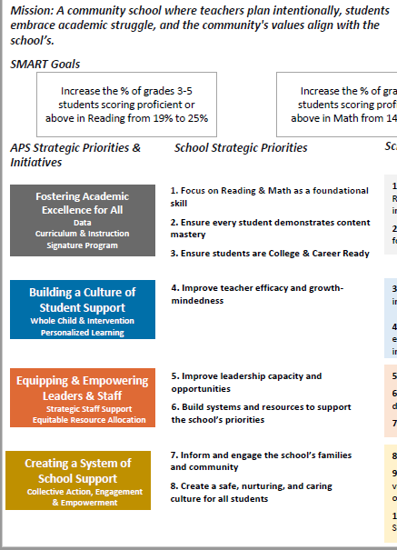
FY25 Budget Development Process
Principal’s Role
Design the budget and propose operational changes that can raise student achievement
Flesh out strategies, implement and manage them at the school level
Focus on the day-to-day operations
Serve as the expert on the school
Hire quality instructional and support personnel
The GO Team’s Role
Focus on the big picture (positions and resources, not people)
Ensure that the budget is aligned to the school’s mission and vision and that resources are allocated to support key strategic priorities
Notes:
The role of the principal during the budget development process is to flesh out strategies and focus on the day-to-day operations of the school.
The role of the board is to focus on the big picture and ensure the budget is aligned to the school’s mission and vision; and resources are allocated to support key strategic priorities.

Slide 15
2024-25
Approved
Ranking of Priorities
#1
Teaching and Assessing for Learning
#2
Economic and Workforce Development
#3
Strategic Planning and Sustainability
#4
Governance and Leadership
Notes:
Before we jump into allocations lets first review our school priorities. During our last meeting held January 25th, the board voted to rank our school’s priorities as pictured on the screen. Are there any questions or corrections for our approved ranking of priorities?

Slide 16

Discussion of Budget Summary
(Step 4: Budget Choices)

Slide 17
Executive Summary
This budget represents an investment plan for our school’s students, employees and the community as a whole.
The budget recommendations are tied directly to the school’s strategic vision and direction.
The proposed budget for the general operations of the school are reflected at $4,296,512
Notes:
Here’s a few highlights for our budget this year – read executive summary
This budget represents an investment plan for our school’s students, employees and the community as a whole.
The budget recommendations are tied directly to the school’s strategic vision and direction.
The proposed budget for the general operations of the school are reflected at $4,296,512

Slide 18
FY2025 TOTAL SCHOOL ALLOCATIONS
School | ACCA
Location | 6097
Level | HS
FY2025 Projected Enrollment | 488
Change in Enrollment | 47
Total Earned | $4,296,512
Additional Earnings
Signature |  |  | $0
Turnaround |  |  | $0
Title I |  |  | $0
Title I Holdback |  |  | $0
Title I Family Engagement |  |  | $0
Title I School Improvement |  |  | $0
Field Trip Transportation |  |  | $12,688
Dual Campus Supplement |  |  | $0
District Funded Stipends |  |  | $22,500
Substitute Teachers |  |  | $87,840
Textbooks |  |  | $54,168
Per Pupil |  |  | $66,056
Flex |  |  | $109,171
Additional Flex |  |  | $9,810
Cluster |  |  | $35,000
Marta Cards |  |  | $41,250
Total FTE Allotments | 37.00 |  | $3,858,030
Total Additional Earnings |  |  | $4,296,512
Total Allocation |  |  | $4,296,512
School Allocation
Notes:
For FY25, APS is continuing to increase equity within the District and the flexibility principals have in regards to our schools budgeted funds. Pictured here is a breakdown of allocated funds for ACCA.
Are there any questions regarding ACCA’s budget allocation?

Slide 19
School Priorities | Example Strategies
Teaching and Assessing for Learning | Ensure close coordination with students’ home high schools and post-secondary partners to address other student needs such as counseling, assessment, referral, and education planning Ex. Guidance plans, career guidance lessons, four-year planning documents, YouScience reports
Economic and Workforce Development | Increase student participation in work-based learning opportunities Increase student participation in Accelerated Career
Strategic Planning and Sustainability | Provide pathway options that meet employment needs of the region and state and take into account students’ interests
Governance and Leadership | Funding a marketing plan
Notes:
Here are our ranked priorities and example strategies shared during our last meeting.

Slide 20
Description of Strategic Plan Breakout Categories
Priorities– FY25 funding priorities from the school’s strategic plan, ranked by the order of importance.
APS Five Focus Area- What part of the APS Five is the priority aligned to?
Strategies – Lays out specific objectives for schools improvement.
Request – “The Ask”. What needs to be funded in order to support the strategy?
Amount- What is the cost associated with the Request?
Notes:
We will now pivot to review how resources were allocated to support our strategic priorities. Here is a description of the strategic plan breakout categories. I’ll pause and give you a moment to review.

Slide 21
FY25 Strategic Plan Break-out
Priorities | APS FIVE Focus Area | Strategies | Requests | Amount
Teaching and Assessing for Learning | Curriculum and Instruction | S3-A1 Establish a culture that promotes the success of students in the work force, including soft skills, employability skills, and financial literacy. S3-A5 Establish shared accountability and collaboration between the GCCA and its partners to improve student learning. S3-A6 Ensure access to support to address the physical, social, financial and emotional needs of GCCA students. | Support the growing dual enrollment classes offered on ACCA’s campus (materials/supplies, lab equipment and maintenance costs) Hire a full-time Program Administrator to support dual enrollment Hire a full-time sub to support Aviation Maintenance Provide transportation for summer career exposure camps, field trips, work-based learning opportunities, and students taking classes on Atlanta Tech’s campus (Marta). | $197,829 $178,713 $38,348 $10,000
Notes:
So here is how we have allocated the budget to support our strategic priorities. The allocations were made
based on the funds we received, which focus area it addresses, the strategies that will be implemented, the purchase request, and the amount.
Let’s begin by unpacking Teaching and Assessing for Learning.
ACCA will shift to offer more dual enrollment on our campus next school year. We currently offer Infant/Toddler Childcare and Early College Essentials as post secondary credit. Next year we are adding several additional post-secondary opportunities: Aviation Maintenance, Cybersecurity, Automotive Technology and Carpentry. Cybersecurity, Automotive and Carpentry all qualify for Accelerated Career. As we make this shift, we will occur additional costs for materials/supplies, lab equipment and maintenance costs. We are asking the board to dedicate $197,829 towards this effort.
With the growing number of dual enrollment classes and focus on Accelerated Career, the Charter System Foundation of Georgia recommends academies dedicate one person to manage the enrollment and matriculation of students through the program. We are asking the board to support dual enrollment instruction by approving the hiring of a program administrator that will work directly with home school counselors to ensure that students are taking advantage of these great post secondary training opportunities.
Specifically, we need someone with an extensive counseling background and experience training other counselors regarding college and career readiness. The cost of this position is $178,713 (this includes salary and benefits).
The next ask is for Aviation Maintenance. Aviation Maintenance will be the biggest roll out next school year. As with the other dual enrollment pathways, we need a full-time sub to cover the days college professors are unable to report to ACCA, support daily operational tasks (like attendance), and any other support scholars need to successfully complete the class. The cost of this position is $38, 348 (includes salary/benefits).
We also request funds to support transportation costs for summer career exposure camps, field trips, work-based learning opportunities, and students taking classes on Atlanta Tech’s campus. This ask is approximately $10,000.

Slide 22
FY25 Strategic Plan Break-out
Priorities | APS FIVE Focus Area | Strategies | Requests | Amount
Economic & Workforce Development | Personalized Learning | S4-A1 Collaborate with employers to develop and promote work-based learning opportunities for students, GCCA faculty, and staff. S4-A6 Provide evidence of innovative practices that ensure students are college and career ready with coursework aligned to the expectations of business and industry. | Hire a full-time Program Administrator to support dual enrollment Provide transportation for summer career exposure camps, field trips, work-based learning opportunities, and students taking classes on Atlanta Tech’s campus (Marta). | $178,713 $10,000
Notes:
Our second ranked priority is Economic & Workforce Development. Increasing the number of students participating in high quality work-based learning continues to be one of our top strategies for this priority.
Two of the funding requests mentioned on the previous slide also support Economic & Workforce Development.
Earlier I mentioned hiring a Program Administrator to support dual enrollment, particularly students participating in Accelerated Career. Another primary responsibility of the Program Administrator will be to partner with Metro Atlanta businesses that are willing to provide students high quality work-based learning opportunities aligned to their career choice and training. The second funding request that supports Economic and Workforce Development is the $10,000 for transportation. A large portion of these funds will support providing transportation for students to participate in work-based learning during the 4th quarter (after they have successfully completed their respective pathways)

Slide 23

Priorities | APS Five Focus Area | Strategies | Requests | Amount
Strategic Planning and Sustainability | Personalized Learning | S2-A3 Consolidated Marketing Plan: Adopt and implement a marketing plan that includes collaboration with stakeholders. Suggestions may include, but are not limited to: Communication: •social media •website •brochures •flyers •campus tours •career fairs Promotion: •special populations •academic advisement •articulation •fund raising •CTSOs and other student organizations •career development •dual enrollment (academic, CTAE, and Accelerated Career) | Create additional marketing materials that promote individual pathways and training opportunities | $45,000
Notes:
The final ask is for the board to continue to fund our marketing efforts to ensure the word gets out about this amazing program. Our next marketing project includes creating marketing materials for each individual pathway featuring students, industry partners, and pathway teachers. This marketing strategy will help students and parents establish a deeper understanding about the individual training opportunities available so that they can make an informed decision.
I will now turn it back over to Bill to receive your feedback regarding budget allocations.

Slide 24
Questions for the GO Team to Consider
Are our school’s priorities (from your strategic plan) reflected in this budget?
Are new positions and/or resources included in the budget to address our major priorities?
Do we know (as a team) the plan to support implementation of these priorities beyond the budget (ex. What strategies will be implemented)?
What tradeoffs are being made in order to support these priorities?
How are district priorities reflected in our budget?
Are there positions our school will share with another school, i.e. nurse, counselor?

Slide 25

Announcements

Slide 26
Approved Meeting Dates
Wednesday, 9/06/23 4 p.m.
Thursday, 11/30/23 4 p.m.
Thursday, 1/25/24 4 p.m.
Thursday, 2/08/24 4 p.m. Initial Budget Allocation & Feedback Meeting
Thursday, 2/29/24 4 p.m. Budget Approval Meeting
Monday, 3/04/24 4 p.m.
Thursday, 5/16/23 4 p.m. Strategic Planning Meeting
Notes:
Please mark your calendars! Our next meeting is February 29th at 4 p.m. This will be our budget approval meeting.

Slide 27

Complete your GO Team Training
Remember to complete your required GO Team trainings so your team will remain in compliance (see below for current status). At this time, all members will need to ensure they have completed their New Member Orientation (both parts: online and live) and the annual Ethics trainings (APS Staff will complete the District's training and non-staff will complete the GO Team Ethics course).
We're excited that all GO Team members have access to our learning and resource platform, ELiS! This is where GO Team members will find required trainings, resources, and other items to help you with your governance work. ELiS automatically sends reminders until the trainings are completed. Non APS staff members have been sent an email with their credentials; if you need your login information, please email us. APS staff members will use their APS credentials to access the platform.
Be sure to check the site often, as we will continue to add support items and training opportunities!
Notes:
Also want to remind everyone of required training for all GO Teams.

Slide 28
Public Comment
The Public Comment period is designed to gain input from the public and not for immediate responses by the Board to the public comment presented.
Each member of the public will have 2 minutes to speak.
At the end of 20 minutes, we will close public comment and move on to the next agenda item.
If there are questions or information that you have for the Board, you may contact one or more Board members after this meeting. You can find Board member contact information, meeting dates and agendas on ACCA’s website https://www.atlantapublicschools.us/domain/10250

Slide 29

Thank you!

