Slide 1
Board of Directors Meeting
Good afternoon, everyone!
Thank you for joining us. We will begin shortly.
January 30, 2025
2 P.M.

Slide 2

Welcome Board Members & Visitors!

Slide 3
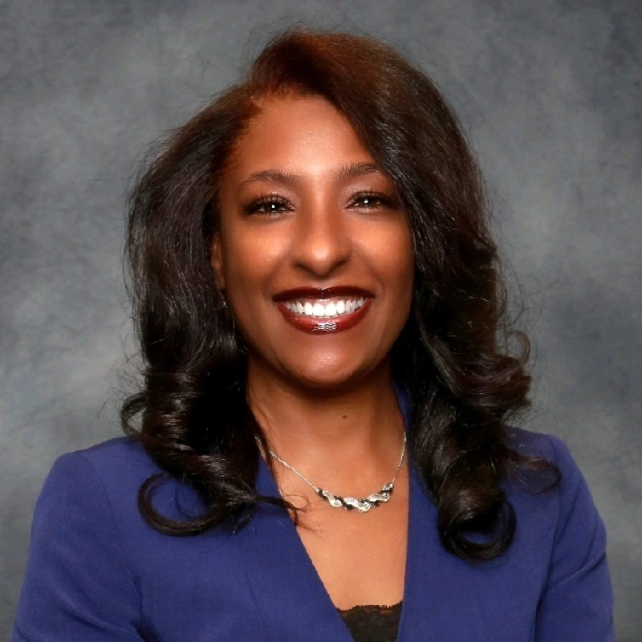

Welcome
ACCA Board Members
& Visitors!
Presiding
ACCA Board of Directors Chair
Dr. Sonya McCoy-Wilson,
Associate Vice President of Learning
Atlanta Technical College

Slide 4
Public Comment
Thank you for joining us!
Interested in addressing the board today? Please sign up at the entry table and you will have the opportunity to address the board at the end of today’s meeting. Each participant will be given two minutes to address the board during Public Comment.

Slide 5




Virtual Meeting Norms
Mics on Mute
Actively Engage
Cameras On
Non-ACCA Board Members:
Thank you for taking time out of your schedules to support the great work happening at ACCA. We appreciate you!

Slide 7
Roll Call
Role | Name (or Vacant) | Present or Absent
Parent/Guardian | Chizelle Archie
Business | Sharyl Chatman
Business | William Smith
Business | VACANT
Business | Jon Lewis
Business | Patricia Horton
Metro RESA | Tim Cairl
Secondary | Dwionne Freeman
Secondary | Shelly Goodrum
Post-Secondary Representative | Sonya McCoy-Wilson
Post-Secondary Representative | Niya Eady
Ex-Officio | Katie Howard
Ex-Officio | Tasharah Wilson
Student | Wesley Gilliard, Jr.
Student | Rajaa Judah

Slide 9
Fill Vacant Seats
The Metro Atlanta Chamber brings forth the nominations for business seats.
All board members have only one vote per seat.
Individuals filling a vacant seat will serve until the conclusion of that seat’s term.
Upon approval, individuals are immediately full board members and may join the meeting.

Slide 10

Nominee: Sarah Bontrager
Director of Nursing Academics, Nurse Residency, and Onboarding
Nursing Professional Development, Grady Hospital
smbontrager@gmh.edu
Office: 404-616-5869
Cell: 404-368-5419

Slide 11

Approval of Previous Minutes
10/30/2024

Slide 12
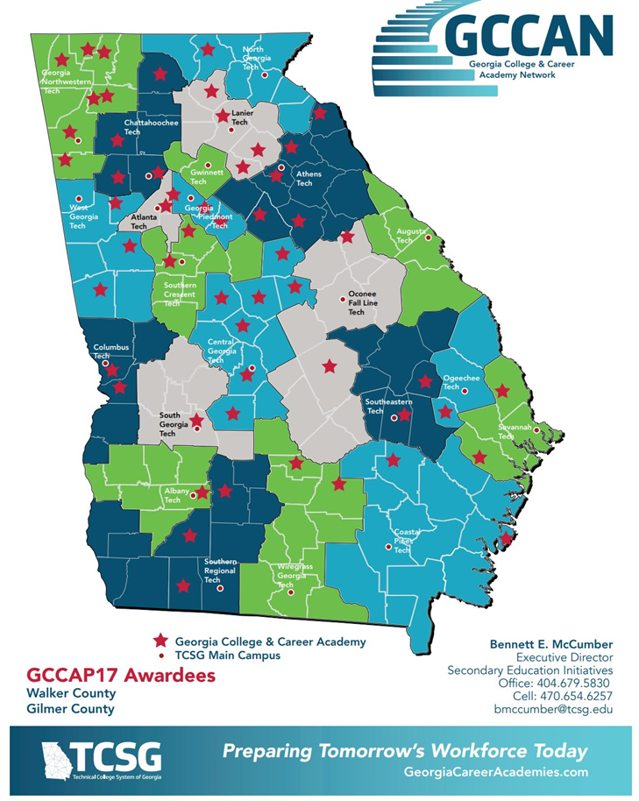
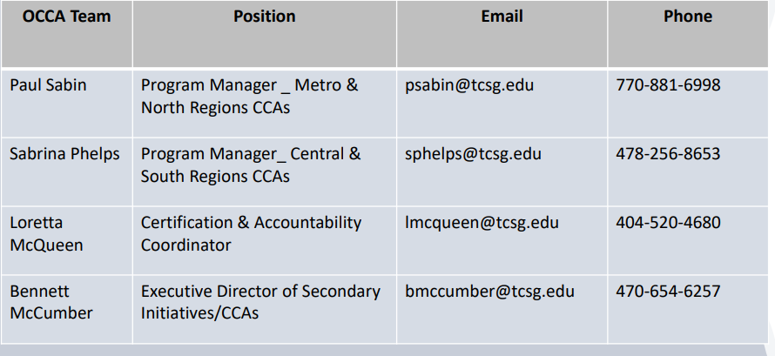
Internal Review

Slide 13

Announcements
Upcoming Meetings
Thursday, February 13 @ 4 p.m. (Budget)
Thursday, February 27 @ 4 p.m. (Budget)
Thursday, March 13 (External Review)
  This is an in-person meeting. The ACCA Board of Directors will be interviewed.
  Location: ACCA, 1090 Windsor Street SW

Slide 14
Public Comment
The Public Comment period is designed to gain input from the public and not for immediate responses by the Board to the public comment presented.
Each member of the public will have 2 minutes to speak.
At the end of 20 minutes, we will close public comment and move on to the next agenda item.
If there are questions or information that you have for the Board, you may contact one or more Board members after this meeting. You can find Board member contact information, meeting dates and agendas on ACCA’s website https://www.atlantapublicschools.us/domain/10250

Slide 15

Thank you!

